Slide 1

Wellbore Expandable Tubular - Progress, Issues and Challenges
Prof. Tasneem Pervez
Assistant Dean for Postgraduate Studies and Research
Project Leader, Applied Mechanics and Advanced Materials Research Group
Sultan Qaboos University, Oman

Slide 2

Materials & Design
Natural-desire or Demand-driven Improvements
Materials
& Design
Stone – Metals –
Polymers – Composites –
Tailored materials
New/update Design
or Processes
Subsequent Developments
Expose Limitations
Emerging Materials
or Improvements
in Existing Materials
New Opportunities
New Challenges

Slide 3
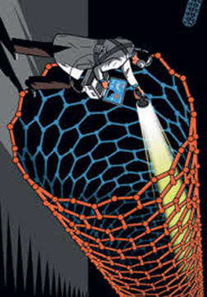
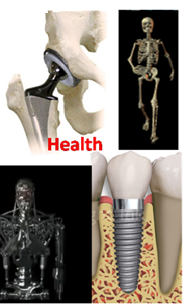
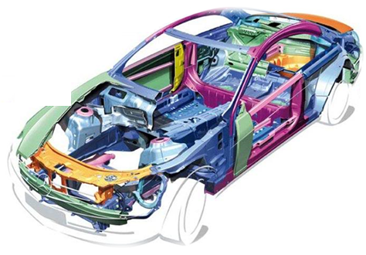
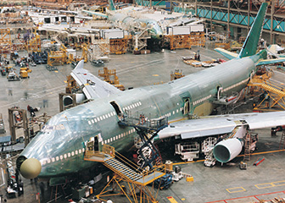
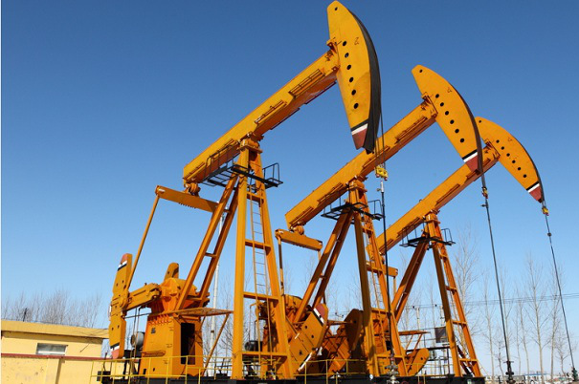
Tailored Materials
Macro-to-Micro
Scale

Slide 4
Why Tailored Materials?
The engineers and scientists develop tailored materials:
To have better safety
To do things which were not doable before
To have improved properties
To fulfill demands of design/tools/processes
To save/preserve/store energy
To have better health/environment
To have better affordability

Slide 5
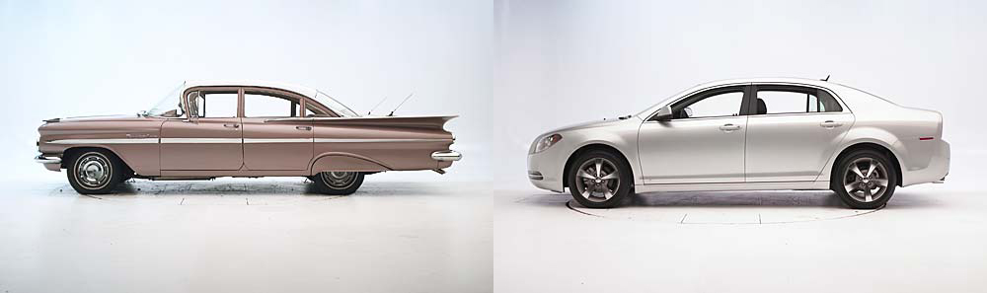

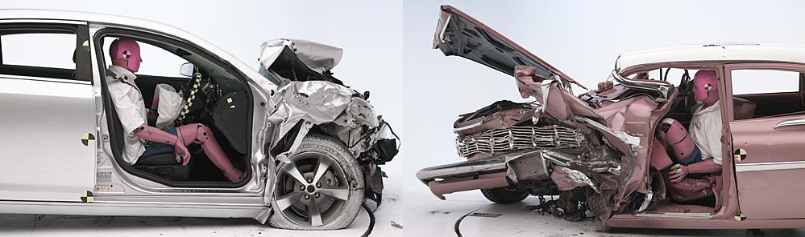
Better Safety !!!

Slide 6
To Do Things not Doable Before
Oil and Gas Wells Design, Drilling and Delivery
Reach Deep and Scattered Reservoirs
5 km +++ to 9 km +
Tap from Difficult to Access Reservoirs
Improve Well Production Life
Better Material Unavailability
Reduce Cost (Number of days required to drill a well, Size of the rig, Tools …….)
10 M USD to 360 M USD

Slide 7
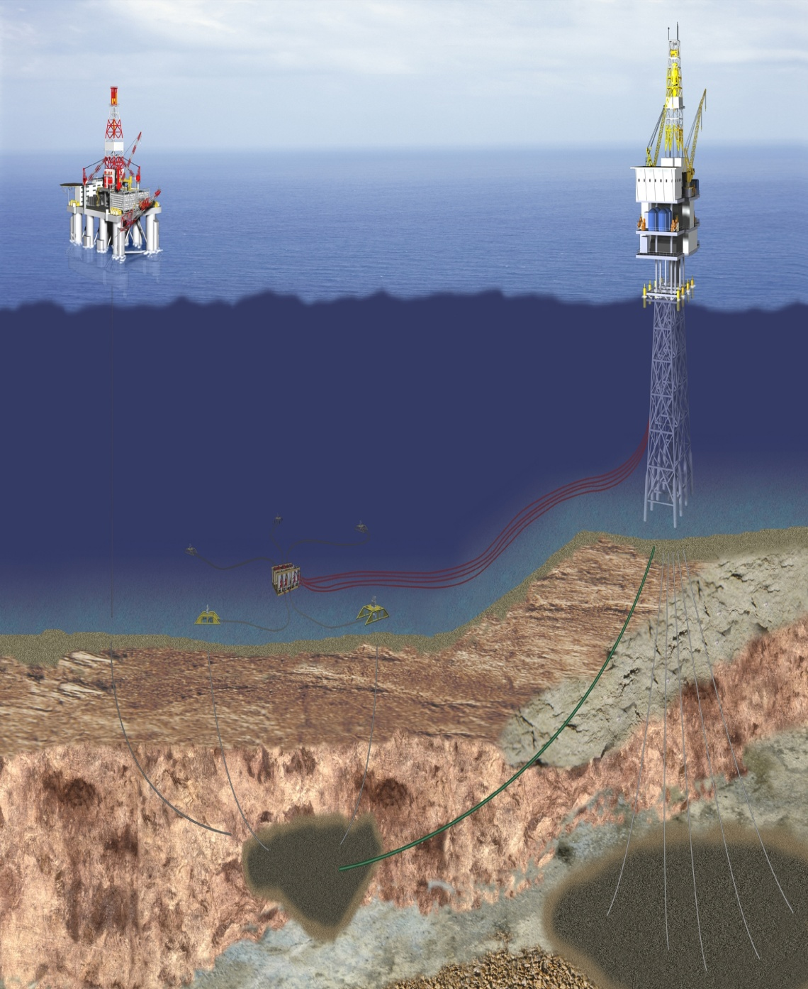
X
Eliminate floater &
Subsea tie-in - MoD

Slide 8
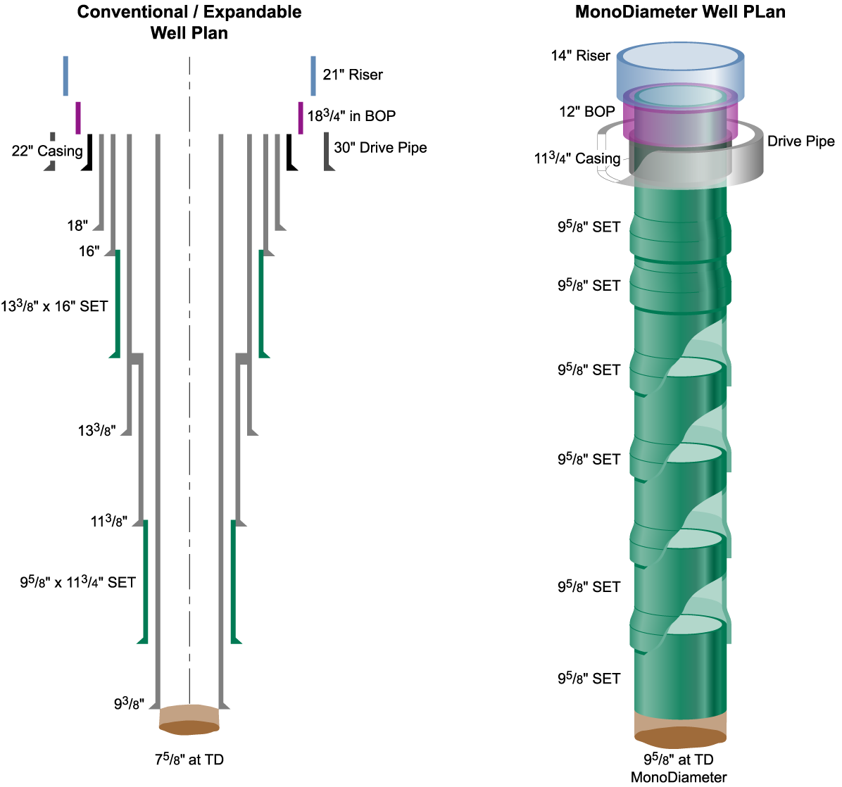
Slim-to-MoD Wells
Telescopic Well
Mono-diameter Well
S
L
I
M
Well
36"
26"
20"
16"
The Vision
13-3/8"
11-3/4"
9-5/8"
7"
5-1/2”
Benzie et al, 2002
TD = 5 Km +++

Slide 9
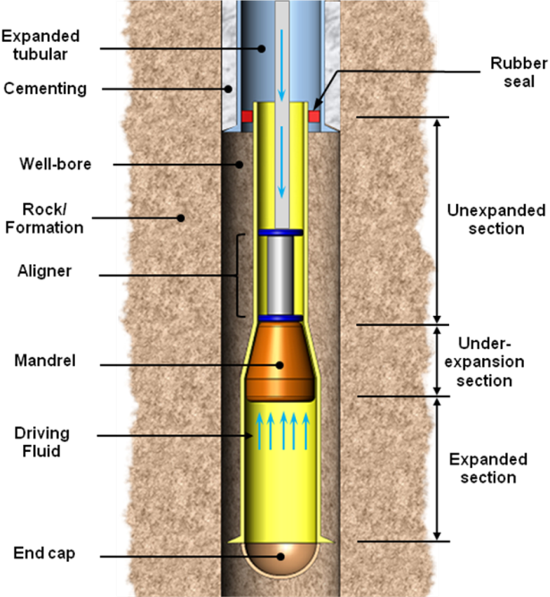
Game Changer
Solid Expandable Tubular Technology

Slide 10
Nature and Scale of Problems
Strength of Expandable Liner Hangers;
Mechanics of SET in Irregularly Shaped Boreholes;
Mandrel pop-out and its effect on well integrity;
Solid Tubular Expansion in Horizontal Wells;
Dynamic Effects on SET
Formation Flow Around Annular Barriers such as
Open Hole Clads or Scab Liners;
Design, construction, audit and commissioning of a
Expandable Tubular Test Rig (ETR)
Crystal Plasticity based FEM
Macro-scale Experiments
Microscopic Investigations
Understanding Macromechanics in terms of
Micromechanics (M3 Microstructure)

Slide 11
Expandable Tubular Test-Rig

Slide 12
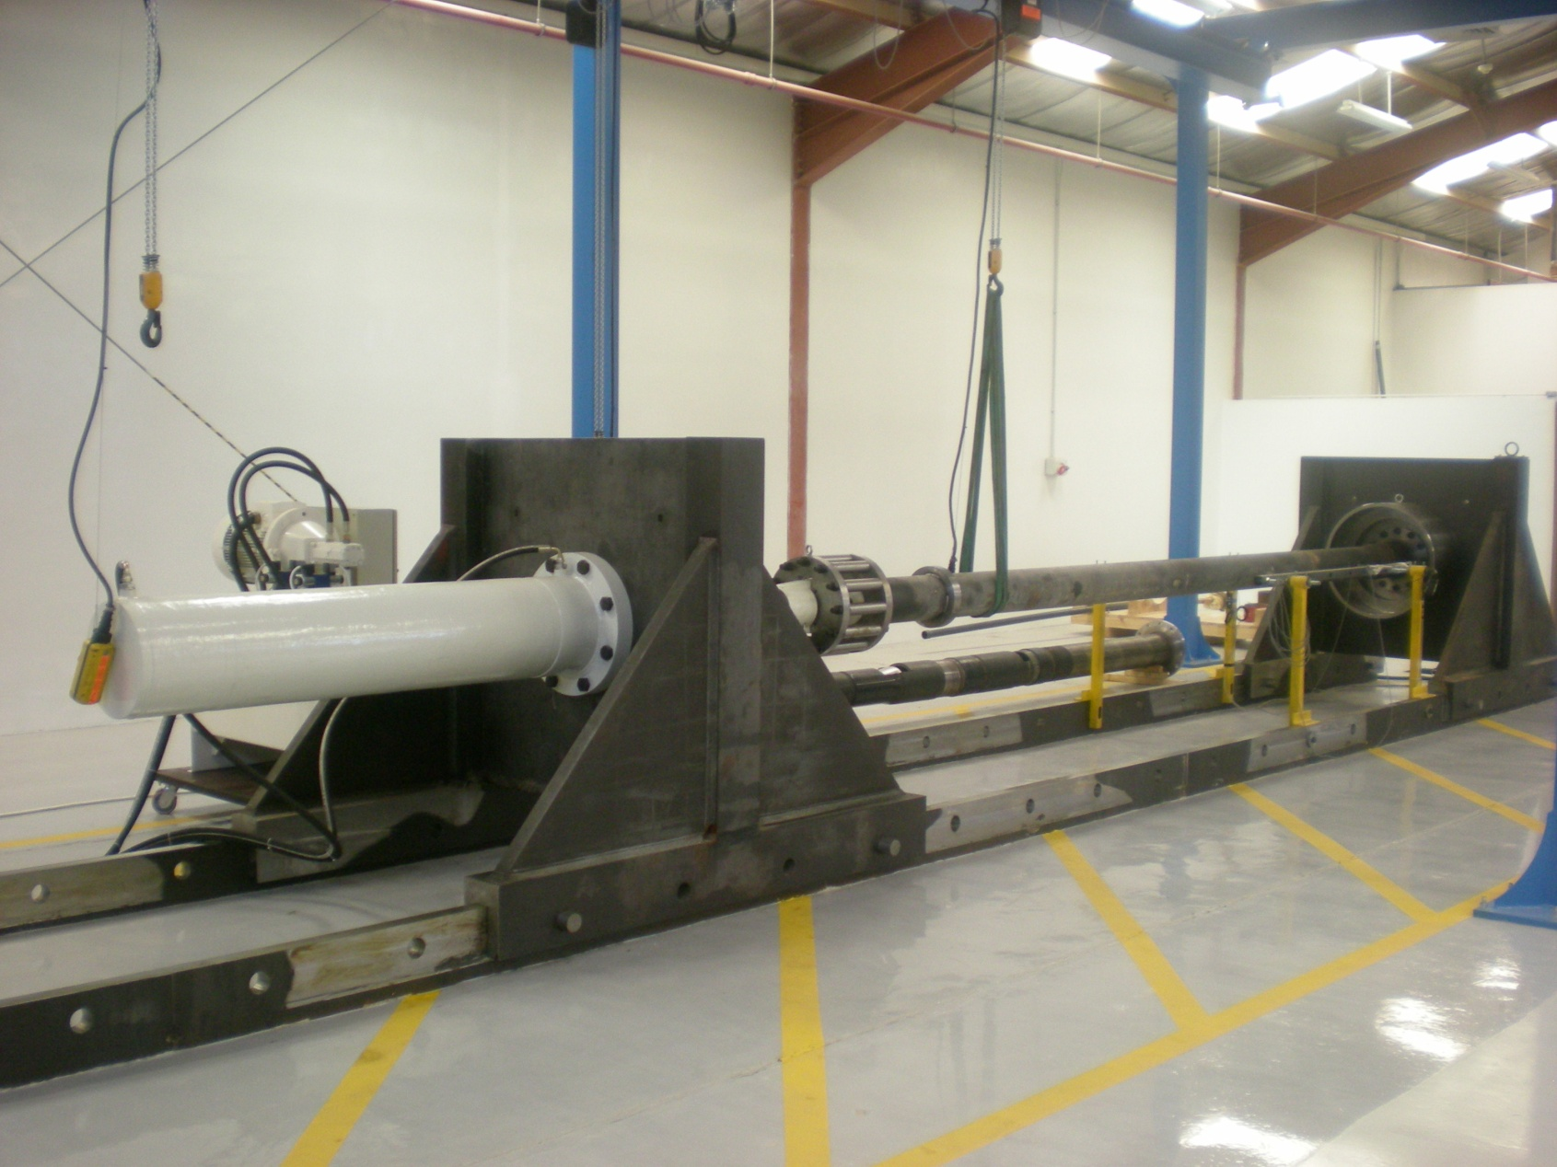
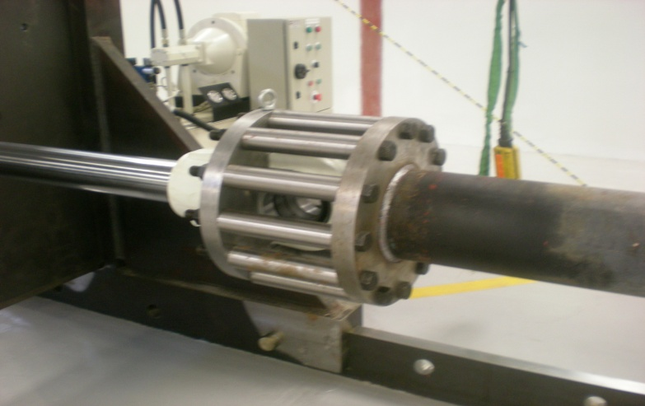
Expandable Tubular Test-Rig

Slide 13
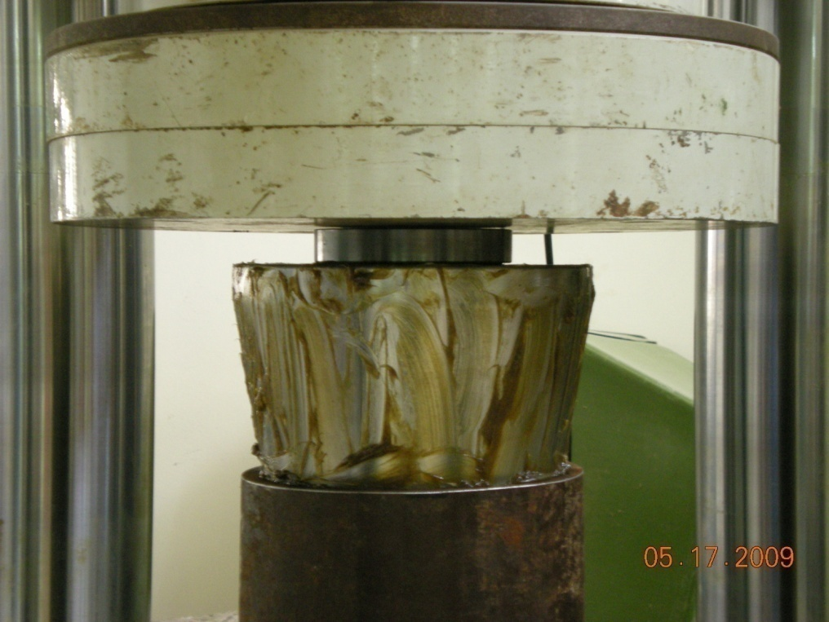
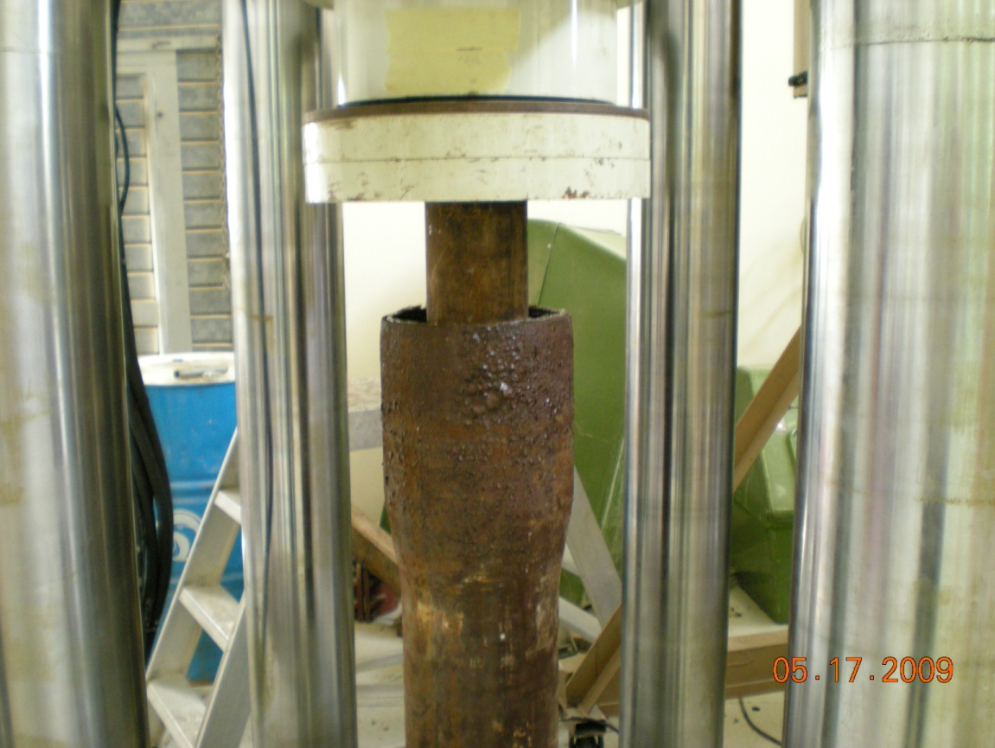
Expandable Tubular Test-Rig
Creating a launcher
400 Tons hydraulic press

Slide 14
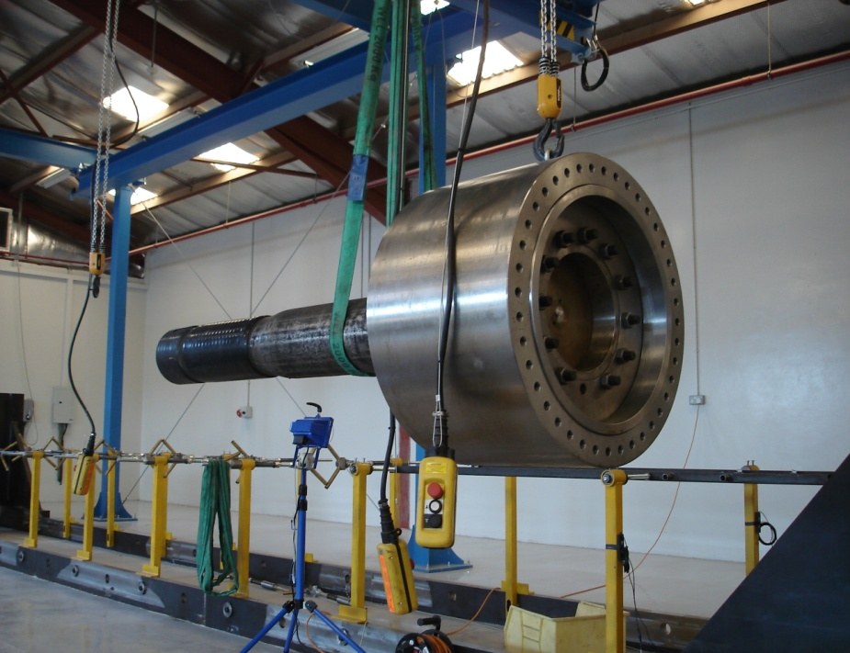
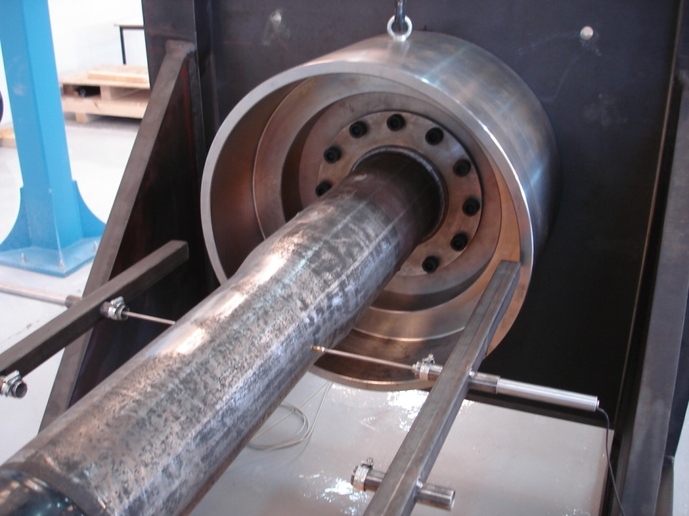
Expandable Tubular Test-Rig
Mechanical Expansion Test of SET in SQU on May 21st 2008.
(7 5/8”, 15% ER,
OD actual 8.7” v/s Enventure’s 8.662”)

Slide 15
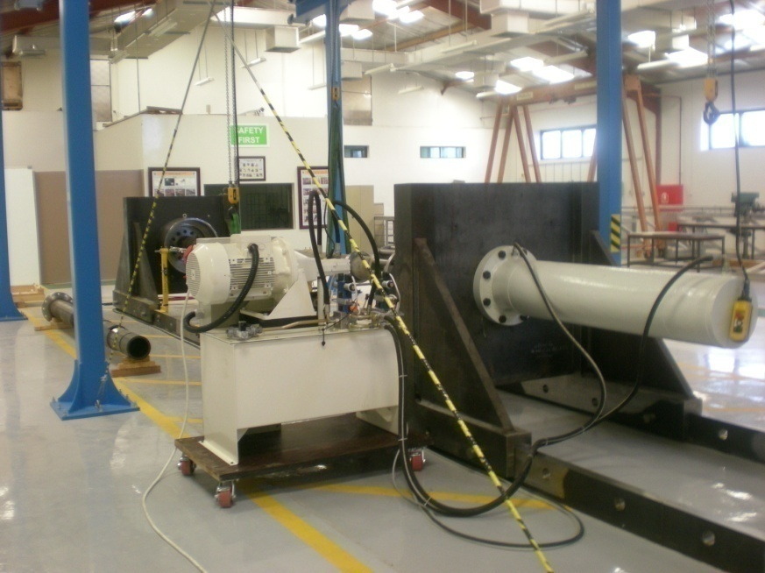
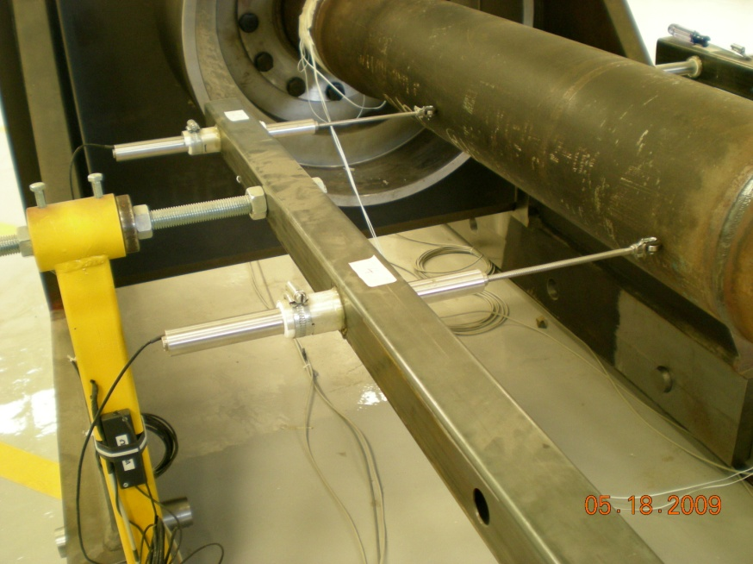
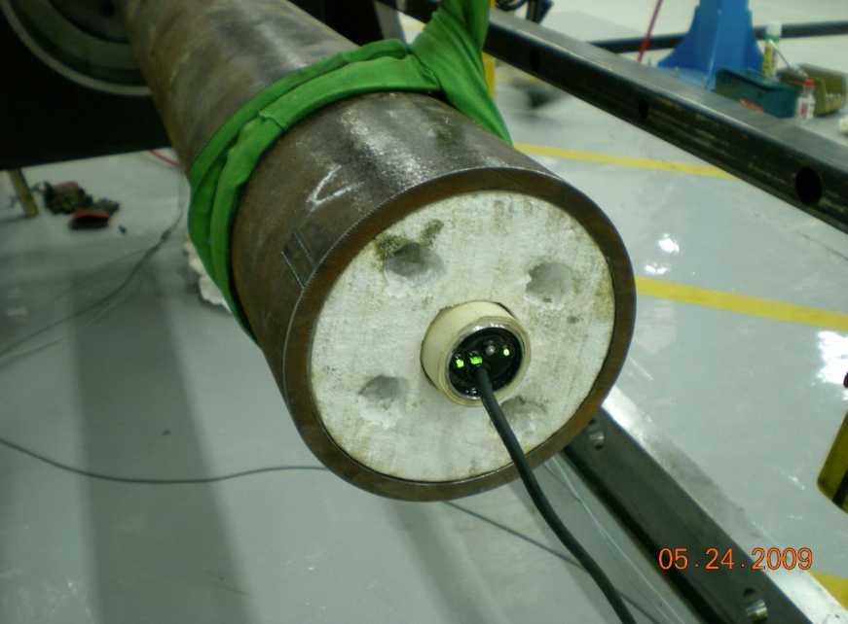
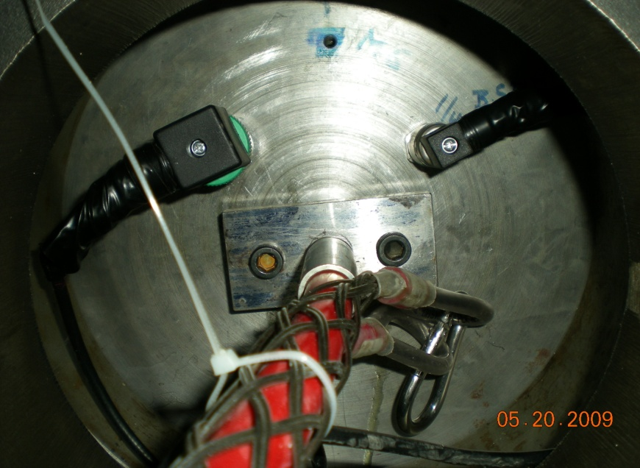
Expandable Tubular Test-Rig
Real Time Data Acquisition

Slide 16
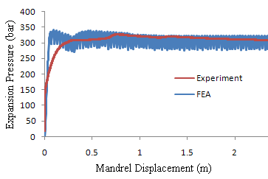
Some Results ........
Experimental
FEA
16

Slide 17
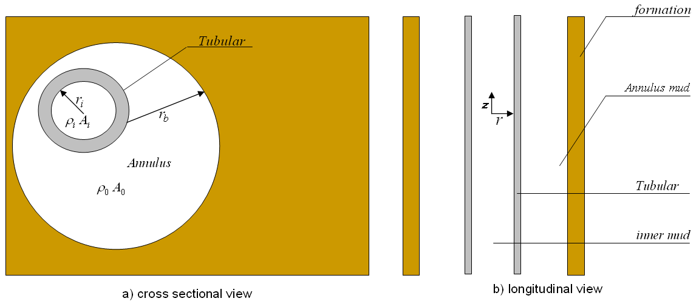
Pop-out Problem Formulation
The tubular, inner and outer fluid layers are uniform and homogenous.
The formation is impermeable.
Steady state fluid velocity is low.
Tubular material is elastic-perfectly plastic.

Slide 18
Mathematical Model
Using continuity of mass and momentum of fluids, and the equation of motion, the wave equations associated to the inner fluid, elastic-perfectly plastic tubular and the outer fluid can be expressed as follows:

Slide 19
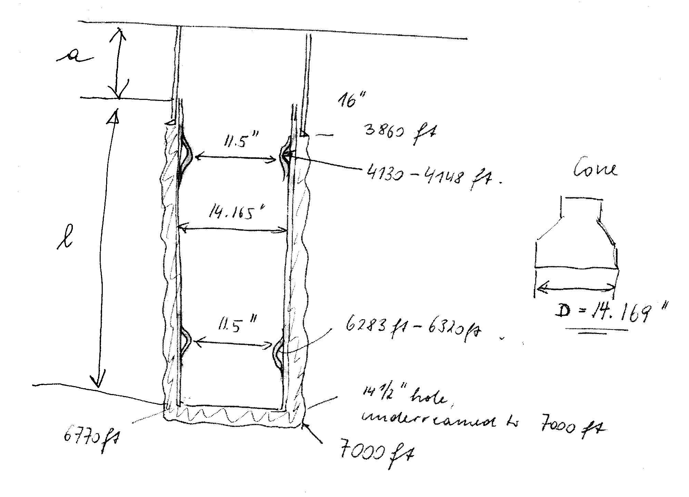
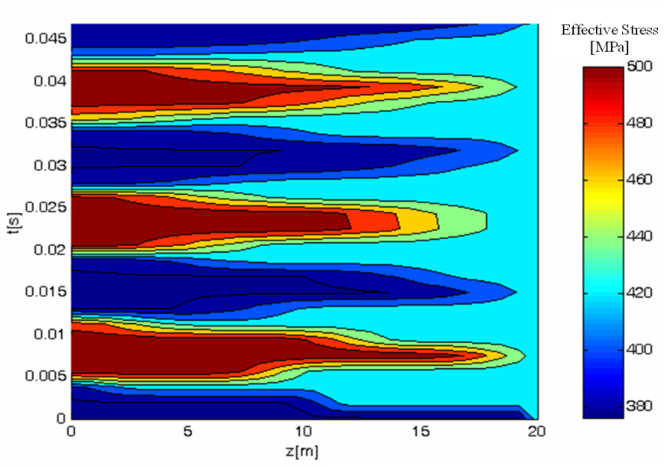
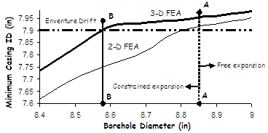
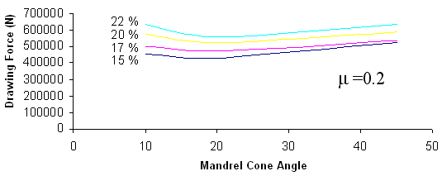
Some Results ........
7.625” OD SET, 14.1% expansion, 7.902” Drift

Slide 20
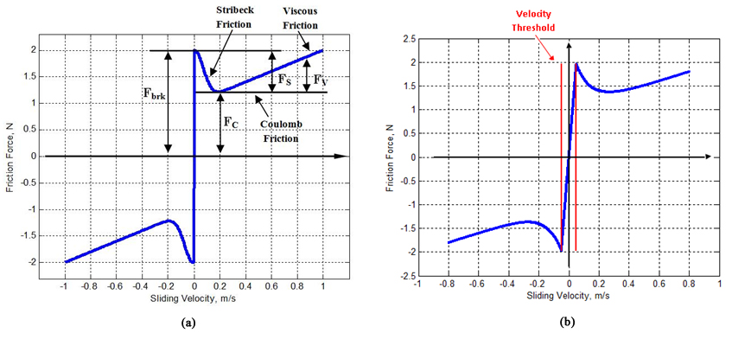
Dynamics of Stick-Slip
Governing Equations:
  Check stick criterion
  Velocity state equation
  Stick-time state equation
  Acceleration state equation
  Slip-time state equation

Slide 21
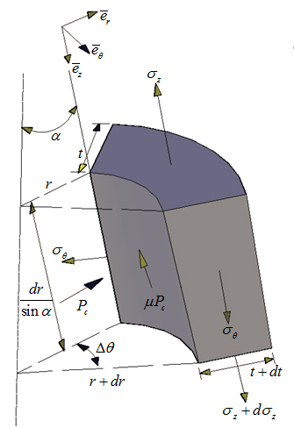
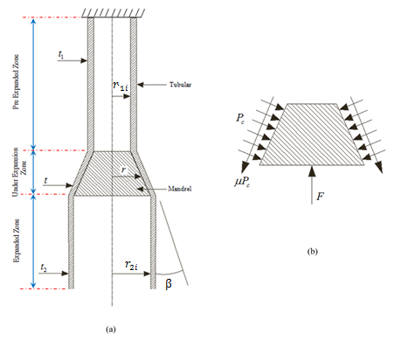
  Contact pressure:
  Expansion force:
  Thickness variation:
  Length variation:
  Static friction force:
  Kinetic friction force:

Slide 22
Some Results ........
ID=7.200”, OD=8.000”, t = 0.400”, ER= 20%

Slide 23
Issues and Challenges
Current Challenges
  Preserving structural integrity; current expansion leads to 50% reduction in collapse pressure rating making it unsuitable for well applications.
  Increased expansion ratio; desires to reach 30% and above; currently possible 28% in laboratory setup and 18.64% in field applications.
  Existing rig capacity; needs to reduce force required for expansion; current rigs with capacity of 250 tons are not suitable.
Search for New / Tailored Materials
  High strength and formability
  Reliability and Long Life
  Lower expansion force and reduced cost

Slide 24
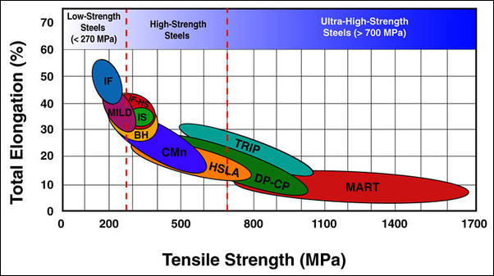
Current Research on X-Steel
Current Tubular/ Casing Steel
800
Intermediate strength, Low ductility
LSX80
Intermediate strength, hardening ????
700
Sour X70
600
DP
VM50
500
Stress, MPa
Current Area
X52
AHSS
400
of Research
DD13
300
200
Low strength, high ductility
100
0
0
5
10
15
20
25
30
35
40
Strain, %

Slide 25
New/Tailored Materials
Tailored AHSS can provide extremely high-strength, while maintaining the minimum limit of formability required for large expansions
AHSS were developed based on selected chemical compositions and multiphase microstructures through precisely controlled heating and cooling processes
Phases of interests are Austenite, Martensite, Ferrite/Bainite, and retained austenite after transformation of phases due to TRIP and/or TWINNING

Slide 26
New/Tailored Materials
Harder & tougher phase
Tailored material properties
Martensite
Forms in plates/laths
Preferred orientation of laths
Makes it like composite
26

Slide 27
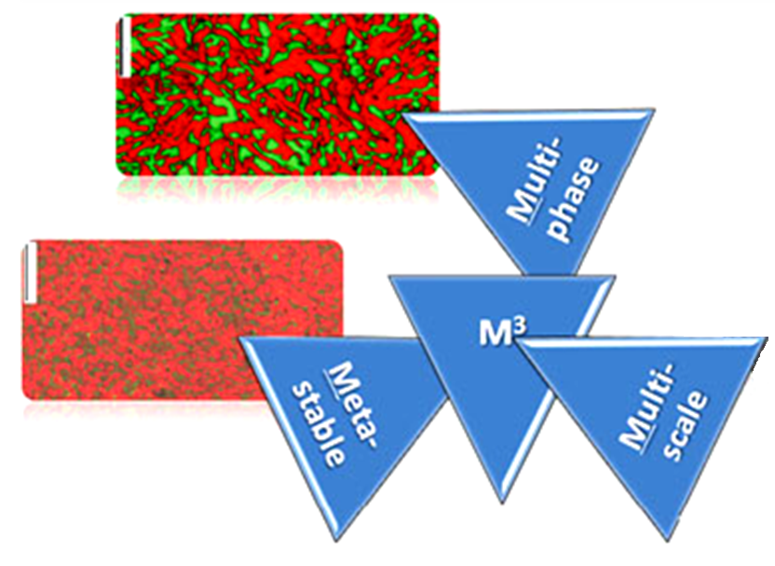
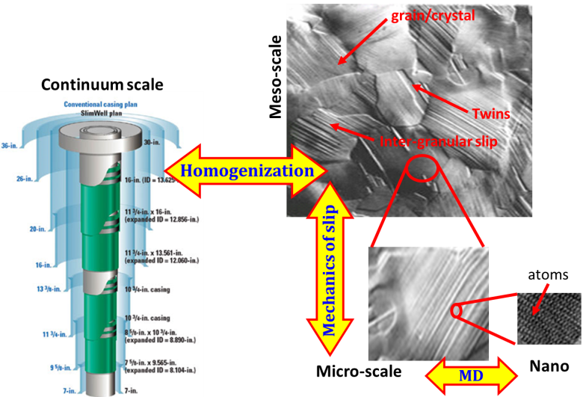
M³ Microstructure
Understand macromechanics in terms of micromechanics

Slide 28
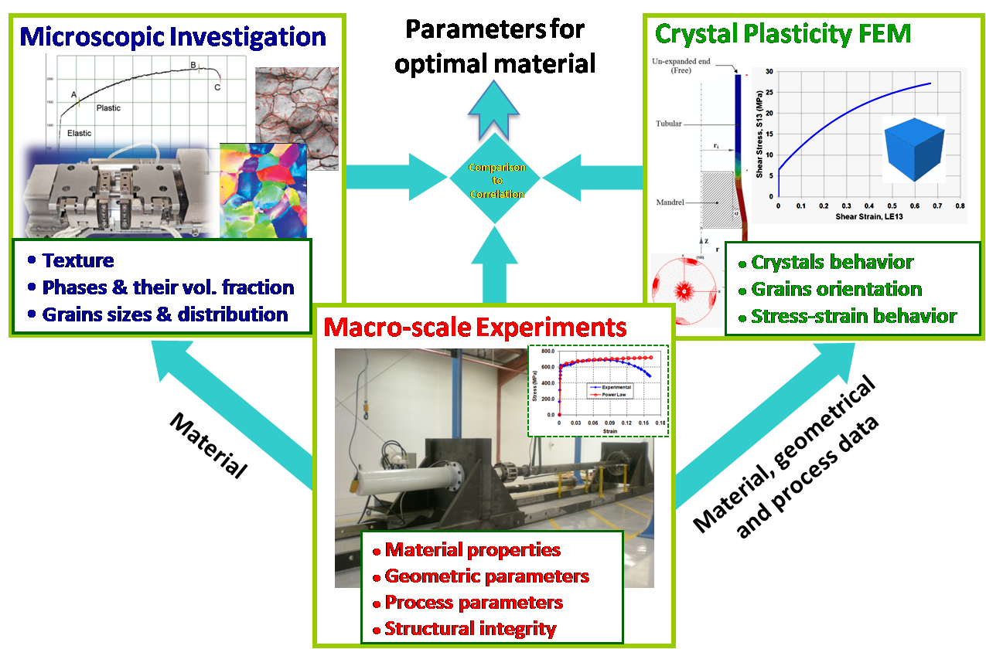
Research Methodology

Slide 29
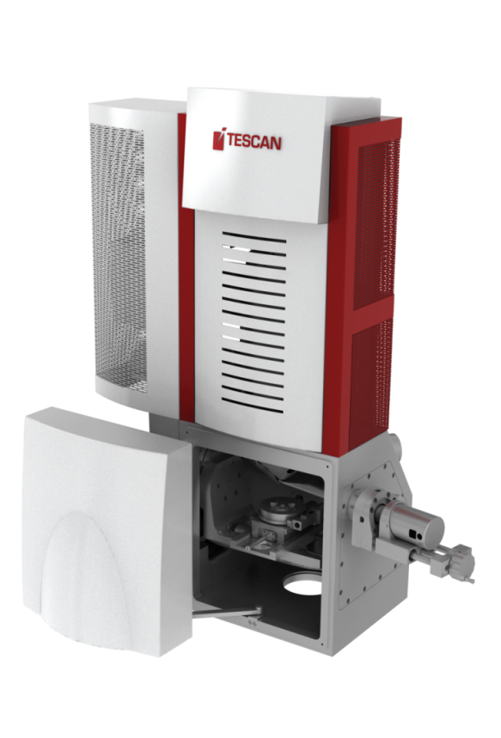
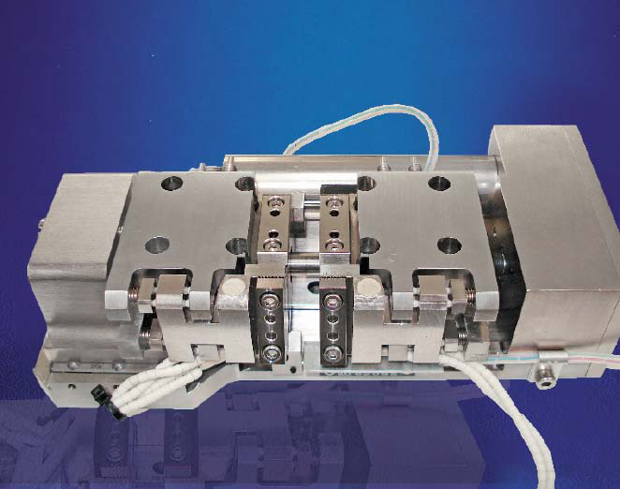
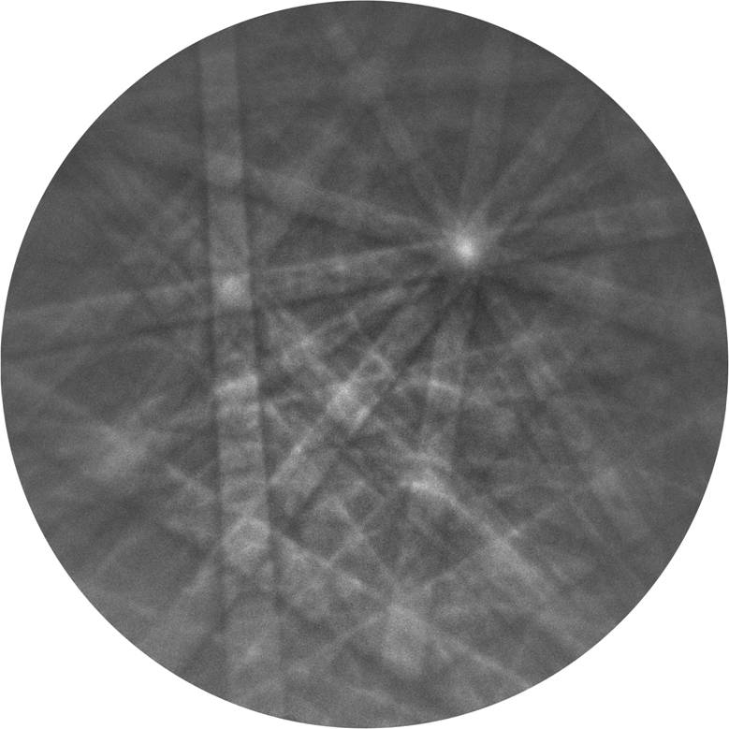
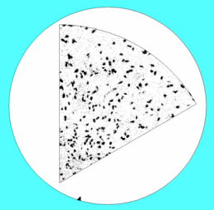
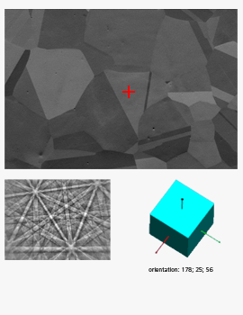
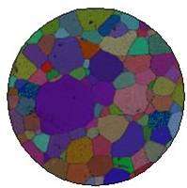
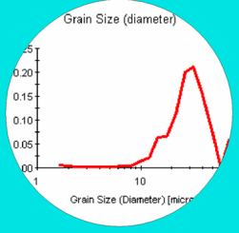
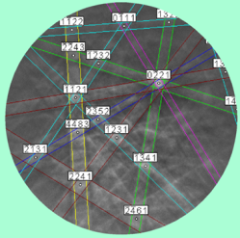
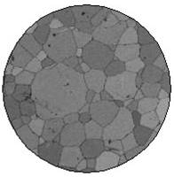
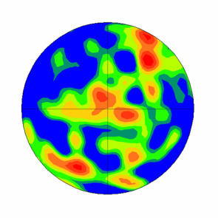
Microscopic Investigations
³
¹
⁶
⁴
¹
⁵
²
EBSD on polycrystalline

Slide 30
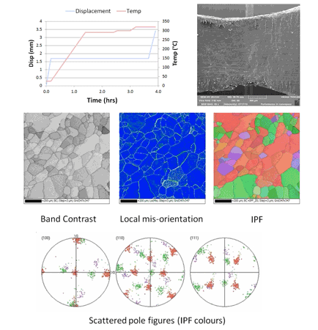

Slide 31
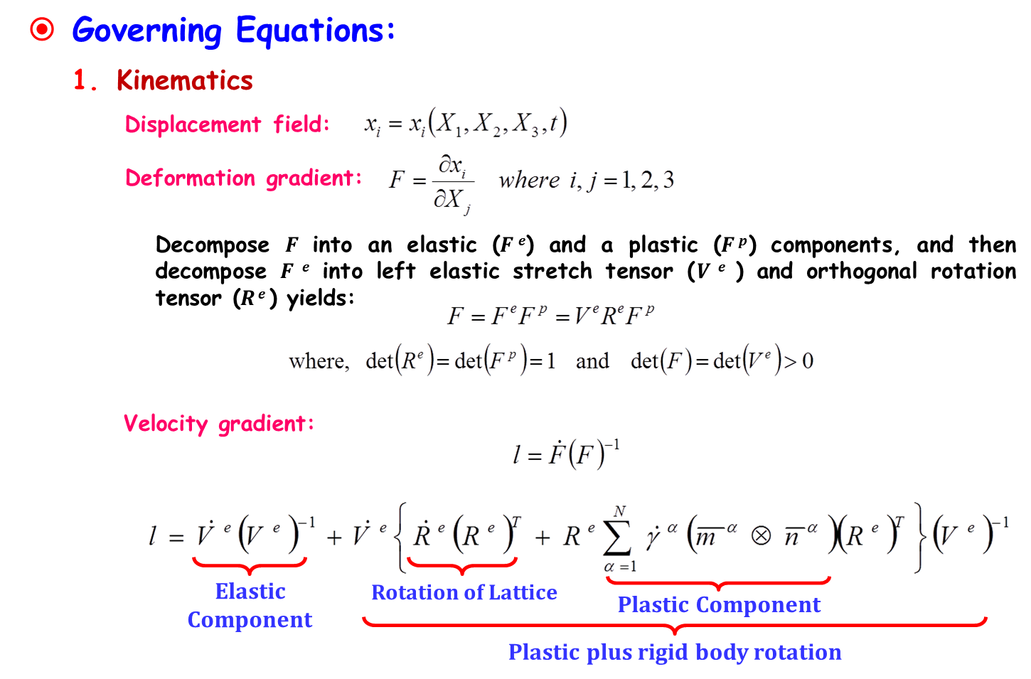
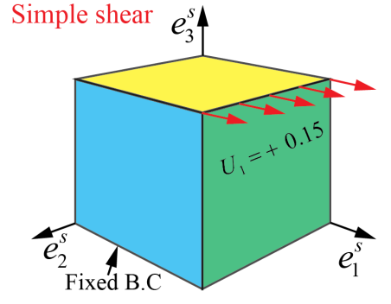
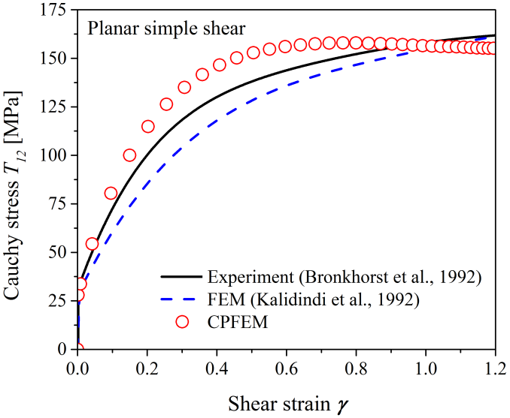
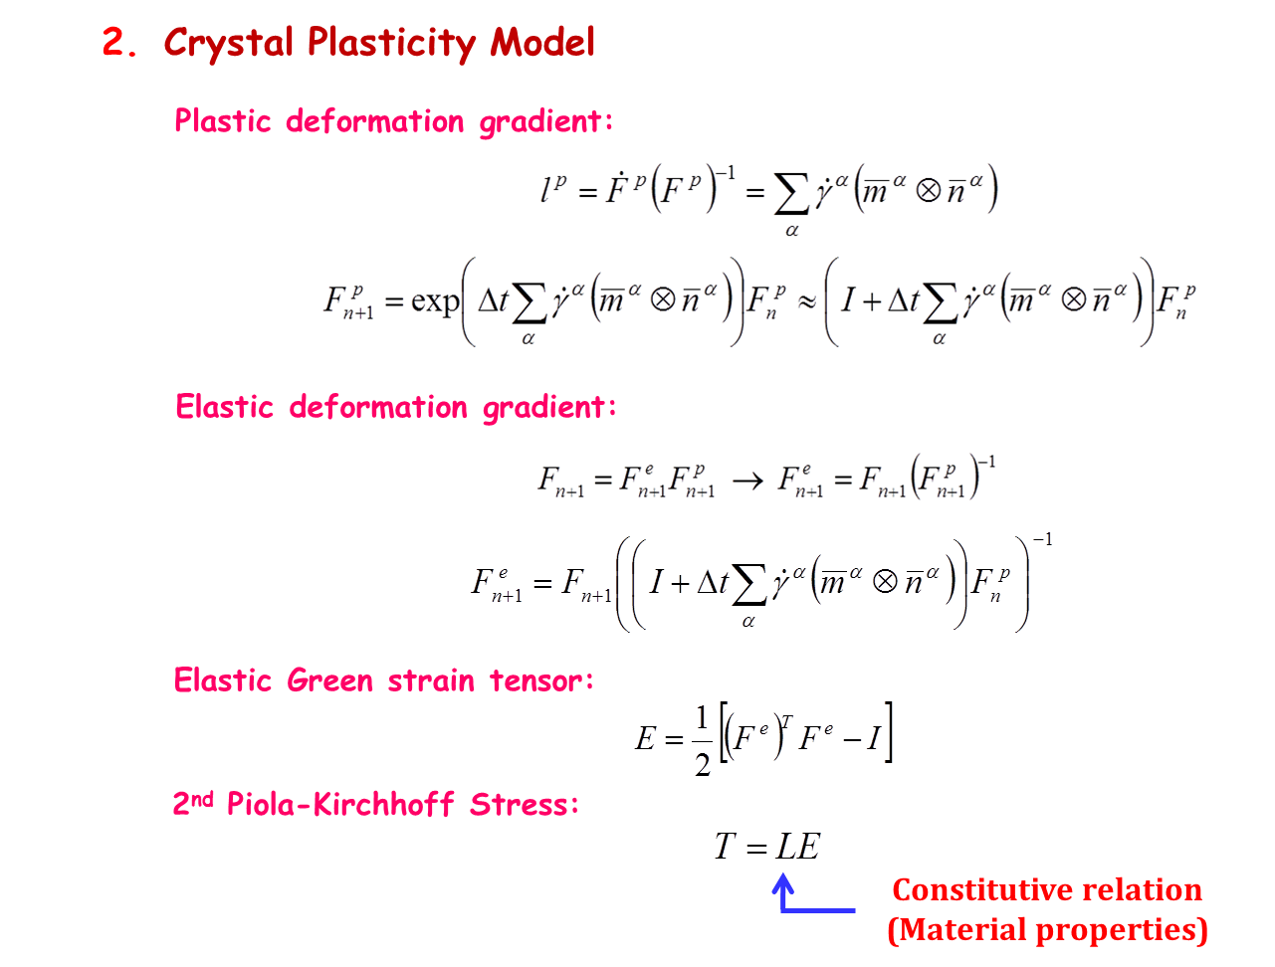
Crystal Plasticity FEM

Slide 32
Conclusions
Analytical, macro/micromechanical models are developed and finite element simulations are done to predict the elastic-plastic behavior of single and polycrystalline materials
Models are in good agreement with the available experimental and simulation results
CPFEM model can be used to simulate behavior of many crystalline materials at macro-level taking into consideration its micro-level characteristics including: crystal type, texture information, etc.
State-of-the-art experimental testing facility that can be used to study materials at submicron-level under various thermo-mechanical loading conditions will help in establishing a better understanding of the material behavior at macro-level making the tailored material approach more visible

Slide 33
Acknowledgements
Many thanks and appreciation to TRC/PDO for funds.
Special thanks go to doctoral and Master students’ for their dedication, hard-work and perseverance to obtain excellent research outcomes
Special thanks to Said Al-Houqani, Bader Al-Abri, Mark van de Velden, Victor Ogoke, Dr. Paul Francis, Dr. Franz Marketz, Sulaiman Al-Mandhari, Abdulsattar Al-Murshidi, Shaikhan Al-Khoudori for their direct and indirect valuable comments and discussions.
We cannot forget the valuable discussions with Shell research team as and when we needed their assistance, particularly Mr. Ton Wubben.
Last but not the least is the support of our families, who are still bearing with us for long after-office work hours.
“To all the team members of AM²RG”

Slide 34





Thank you for your attention

Slide 35
Thank you very much for your presence

Slide 36
New/Tailored Materials
Stress
2
UTS
4
Stress
c
d
1
YS
a
b
3
Working envelope
Strain
Strain
Oil & gas industry needs those metals which have high strength and good formability properties
Deform Easily and
Retain Strength & Integrity

Slide 37
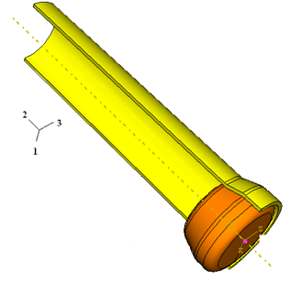
Tubular Material Behavior
Grain Mechanics
Macro Level
Micromechanics
Meso Level
Kinetics & Kinematics
Micro Level
Crystal Level
M A
Adopted Approach

