Slide 1
Optimization of a PV-Wind Hybrid Electrical System for Schools in the Coastal Region of Sindh-Pakistan
Anjum Khalid
Anwar Anis Ahmed
Syed Ahmad Raza

Slide 2
Introduction
National energy crisis is affecting every aspect of economy
Schools in Sindh province are can improve their standard if reliable electricity supply is ensured
Renewable energy technologies like PV and wind turbine can help

Slide 3
Our renewable Resources
On the average we have more than 300 sunny days in year
The annual average solar radiation intensity in Karachi is 5.4kW/m²-day
Sind coastal area has good wind energy resource Sindh Wind-Energy-Corridor has a potential of about 20GW

Slide 4
Wind energy potential of Pakistan

Slide 5
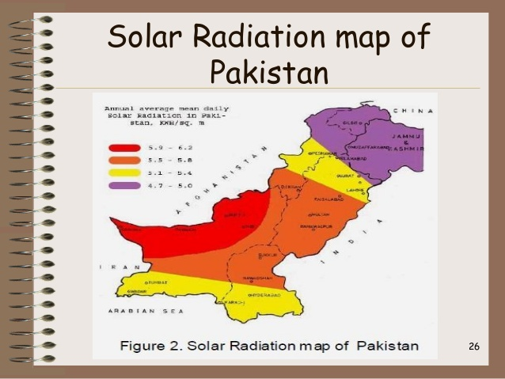
Solar Energy Resources of Pakistan

Slide 6
HOMER
Peak of solar radiation occurs at day time while wind peaks in the afternoon
The operation hours of PV-wind hybrid system are thus increased
HOMER renewable energy system optimization software was chosen to determine the size of the hybrid system

Slide 7
Type School Monthly Electrical Load

Slide 8
Stand-alone hybrid PV-wind system HOMER configuration

Slide 9
Hybrid PV-wind system HOMER output
 | Amount | Units
Electricity generated | 10,189 | kWh/year
Excess electricity: | 3,359 | kWh/year
Unmet electric load: | 266 | kWh/year
Renewable fraction: | 1.00
PV Capacity factor | 19.3 | %
PV hours of operation | 4,400 | hr/year
Turbine Capacity factor | 50.6 | %
Turbine hours of operation | 7,895 | hr/year
Levelized cost of electricity | 0.312 | $/kWh

Slide 10
Monthly electricity production is given the bar graph below.

Slide 11
Cash Flow

Slide 12
Conclusion
HOMER software showed that wind-PV hybrid electric system will meet the power requirement of the schools more than 95% of the time in a year.
More than 10 MWh/year of electricity can be generated using the proposed system, with approximately 3.3 MWh/year of excess electricity.
The levelized cost of electricity generated by hybrid system at USD 0.27/kWh is lower than diesel generated electricity at USD 0.31/kWh,
The hybrid renewable energy system is more attractive for use in coastal region schools.

Slide 13
END

