Slide 1

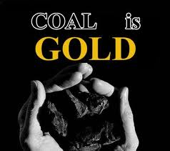
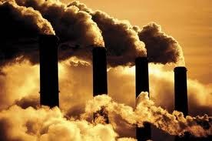
Energy, Sustainability and Mechanical Design
CHEMICAL LOOPING COMBUSTION (CLC):
A novel technology for energy production from coal with inherent CO₂ capture
Dr. MOHAMMAD YOUNAS
ASSOCIATE PROFESSOR
MS, PhD (France), Postdoc (The Netherlands)
m.younas@uetpeshawar.edu.pk
Department of Chemical Engineering
University of Engineering and Technology, Peshawar

Slide 2
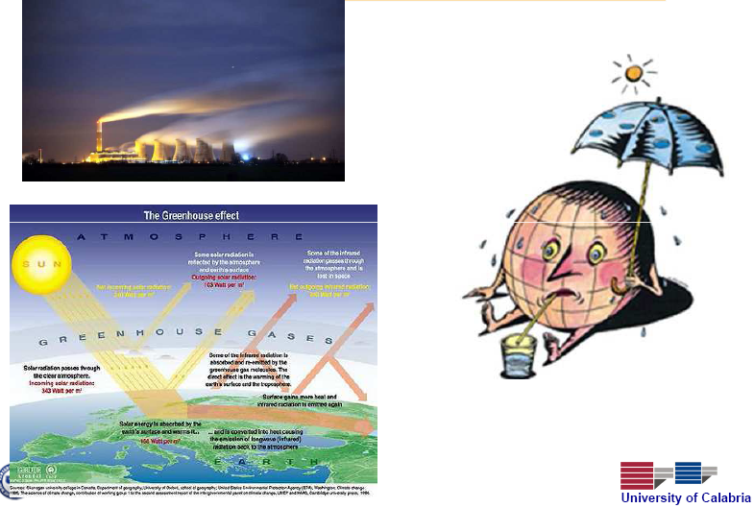
WHY????
GLOBAL WARMING
Global warming
Page 2

Slide 3
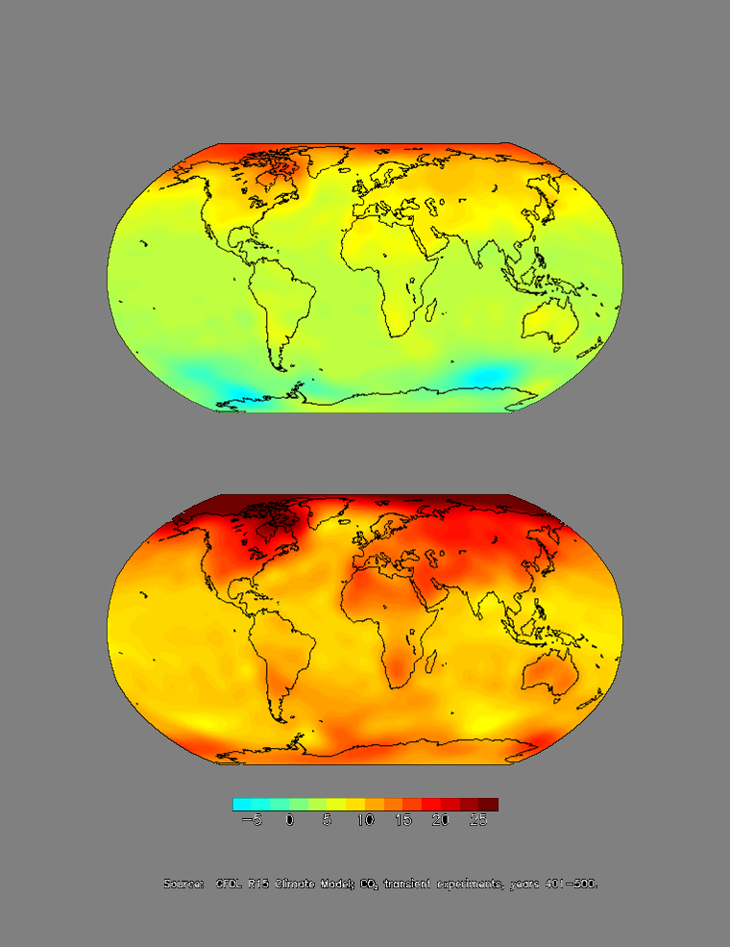
What will Happen with More CO₂?
2x CO₂
4x CO₂
°F
Page 3

Slide 4
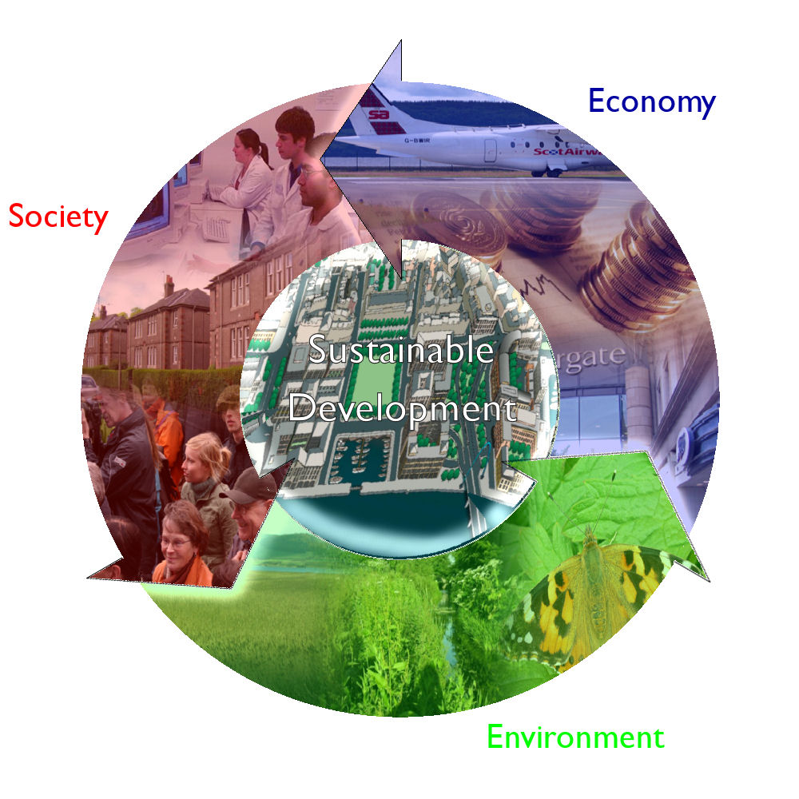
SUSTAINABILITY
meets the needs of the present without compromising the future generations needs
Use natural resources with the speed as nature is producing them
“ triple P ”
people, planet, profits
*A.G. Fane / Desalination 202 (2006)
Page 4
Notes:
Foremost, the sustainbimity and sustainable devleopment has been discussed. “ Sustainable ’ development is the development that meets the needs of the present without compromising the ability of future generations to meet their own needs. ”
Sustainable development is a consideration of three impact areas: (1), environmental, (2) economic, and (3) societal, or “ people, planet, and profits”

Slide 5
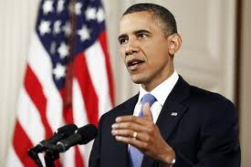
SUSTAINABILITY
“The country that will dominate the sustainable energy economy will become the country that will dominate the world economy and America must be that country” - Barack Obama
Sustainability
Page 5

Slide 6
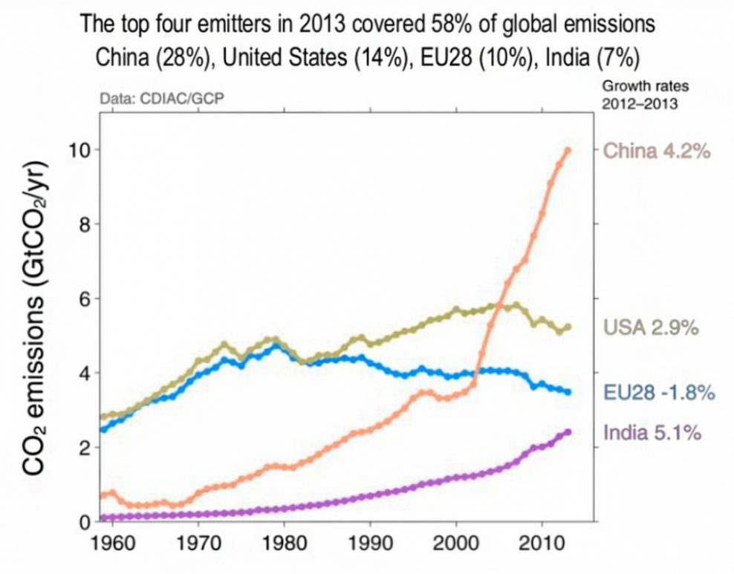
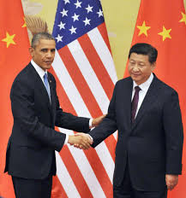

SUSTAINABLE ENERGY
Recent emissions agreement between the US and China was seen as an historic breakthrough (11/18/2014).
A 40% reduction of their greenhouse gases from 1990 levels by 2030.
UN members agree deal at Lima climate talks, (12/14/2014)
An "ambitious agreement" in 2015 that reflects "differentiated responsibilities and respective capabilities" of each nation
Page 6

Slide 7
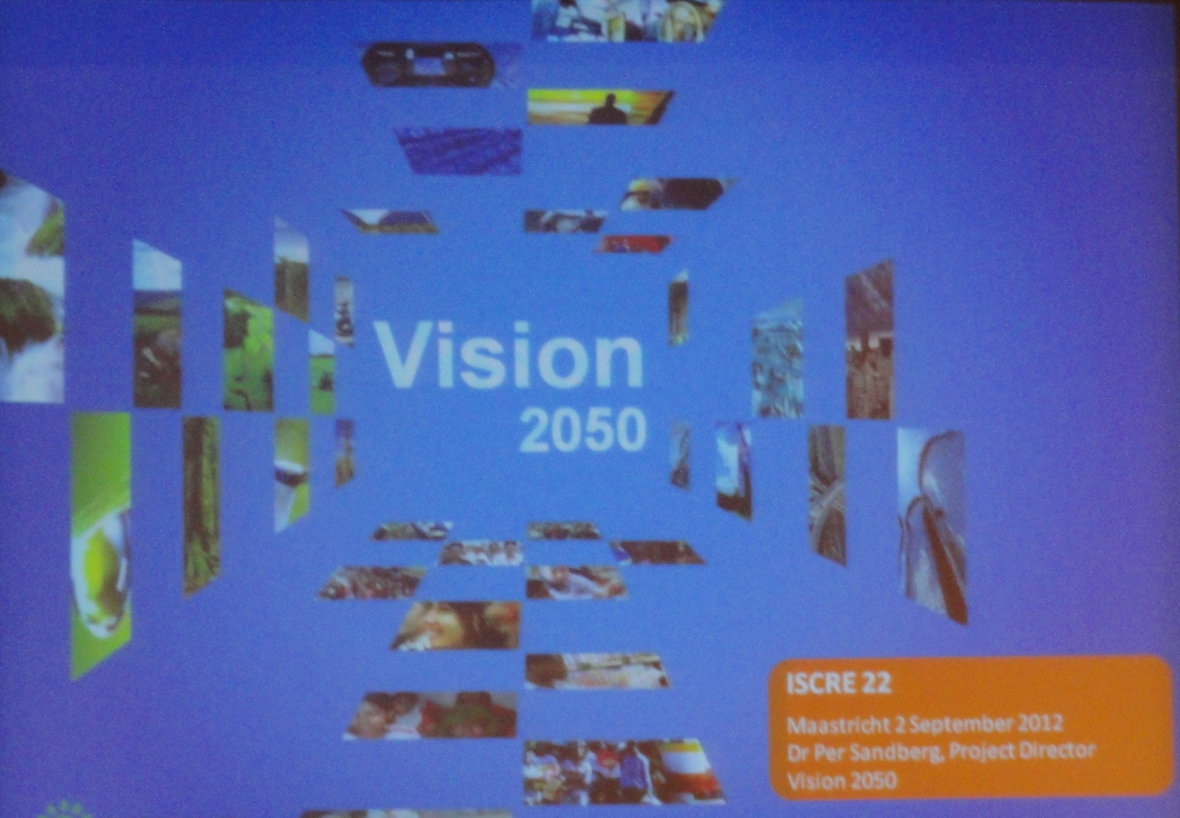
VISION 2050
Sustainability
Page 7

Slide 8

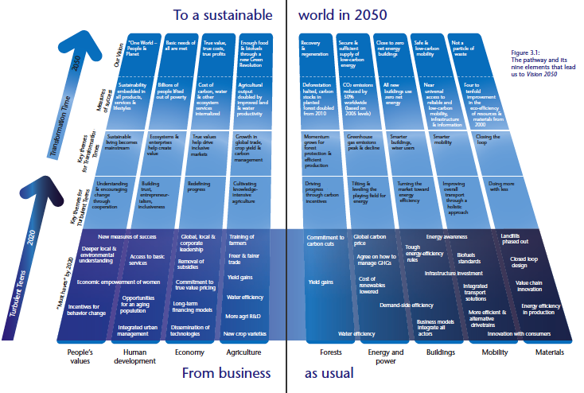

VISION 2050
CO₂ emissions reduced by 50%
Sustainability
Page 8

Slide 9
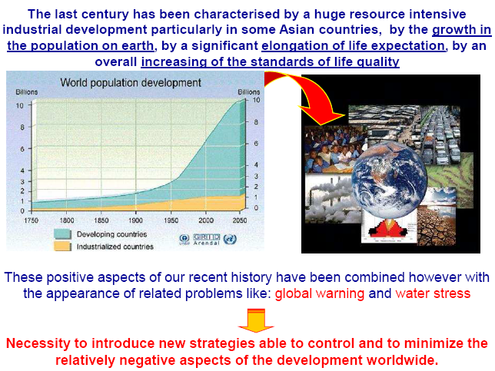
WHY????
Page 9

Slide 10



SOCIO-ECONOMIC & TECHNOLOGICAL CONTEXT
wealth
population
Energy demand & emissions
food
water
ecosystem
Page 10

Slide 11
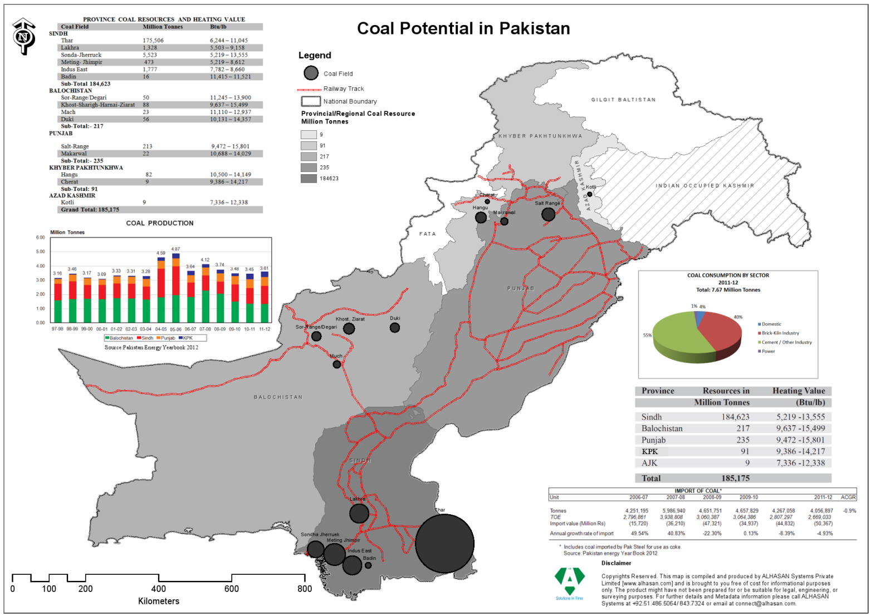


What fossil fuel source to be used? OIL
MOTIVATION
Best alternative fossil energy source? CH4 / COAL
  ⇒ Natural gas: high H/C ratio = low CO₂ emission
Motivation
Page 11

Slide 12



REMEDY ???
Reduce energy use
  Of course, if possible, but no solution:
  Is it fair to deny developing countries our way of living?
Long term: (new) alternative energy sources:
  Solar energy
  Biomass (closed carbon cycle)
‘Short’ term: higher overall carbon-efficiency from fossil fuels with CCS
(CCS = Carbon Capture & Sequestration)
Page 12
Notes:
While energy conservation, improving efficiency, alternate fuels and renewable energy are all options for lowering GHG (CO2) emissions, fossil fuels will continue to be the dominant energy source for the global economy.

Slide 13
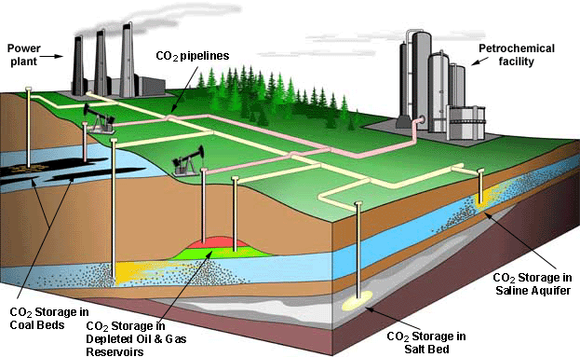
CO₂ CAPTURE AND STORAGE (CCS)
CO₂ capture and storage:
  Mitigation of climate change via long-term isolation of CO₂,
  Storage in geological formations (e.g. depleted gas/oil fields),
  Capture of carbon dioxide (suitable with especially the power sector!),
    High purity CO₂ is needed,
    Energy efficiency penalty must be minimized.
Page 13
Notes:
In this fossil fuel-dominated economy where Power plants mostly run on coal is the biggest source for CO2 emissions, Carbon Capture and Storage (CCS) technologies have the potential to allow us to use fossil fuels with reduced CO2 emissions. The well proven are carbon capture and sequestration, pipeline transportation and injection into geologic formations. New and more expensive technology makes it possible to build coal-burning power plants that could be adapted to sink the CO2 undergraound to keep it out of the atmosphere.

Slide 14
CO₂ CAPTURE AND STORAGE
IPCC (2005)
Page 14
Notes:
This schematic diagram illustraes the primary routes for Carbon Capture. While post-combustion and pre-combustion capture processes are proven at a smaller scale, oxyfuel processes are currently in development. Industrial processes have also inherent CO2 capture. However these technologies lead to significant energy penalties.

Slide 15
CLC: Chemical-looping Combustion
CHEMICAL-LOOPING COMBUSTION (CLC)
Air
MeO
CO₂, H₂O
I
II
N₂
Me
Fuel
I: 4 Me + 2 O₂ → 4 MeO (DH < 0)
II: 4 MeO + CH₄ → 4 Me + CO₂ + 2 H₂O (DH > 0)
Power production with inherent CO₂ separation
Direct contact between air and fuel is avoided
Page 15
Notes:
In this context, CLC is one of the most promosing technologies to carry out the CO2 capture at a low cost. Chemical looping combustion inherently combine power production with the capture of pure CO2 in a single process step. A metal/metal oxide is oxidized/reduced without direct contact of air and fuel.

Slide 16
PROCESS SCOPE
T=1200°C
p=20 bar
High pressures could be more easily applied
  Higher efficiency can be achieved
More optimal use of oxygen carrier
→ smaller reactor is required
Page 16
Notes:
CLC is based on the transfer of the oxygen from air to the fuel by means of a solid oxygen carrier. In dynamically operated packed bed reactors, the OCM remains stationay and the gas flow is periodically switched. This process consists of alternat oxidation and reduction cycles. The oxidation of the oxygen carrier is strongly exothermic, which is used to heat an air stream to very high temperature. In reduction cycle, often endothermic, only CO2 ans steam are formed which are easily separated via condenstation.

Slide 17


PROCESS OBJECTIVE
A medium sized (500 kW) fixed bed reactor will be designed, built, operated and integrated in the existing Integrated Gasification Combined Cycle power plant at Elcogas, Spain.
Evaluation of the feasibility of chemical-looping combustion with dynamically operated packed bed reactors for Syngas combustion over ilmenite as oxygen carrier:
  Oxidation cycle
    An air stream with a very high and constant temperature
    must be generated
    Oxidation cycle efficiency
  Reduction cycle
    CO₂ capture efficiency must be maximized
    Methane slip must be avoided
  Process operation over multiple cycles
Page 17

Slide 18
Modelling Packed Bed CLC
CHEMICAL-LOOPING COMBUSTION (CLC)
Oxidation cycle:
N₂/O₂
Description of concentration/ temperature profiles
Description of particle behaviour
(shrinking core/ two-zone model)
Air
Me
MeO
Page 18

Slide 19
Modelling Packed Bed CLC
CHEMICAL-LOOPING COMBUSTION (CLC)
CO₂/H₂O
Reduction cycle:
Maximization of CO₂ capture efficiency
Efficient use of fuel
Selectivity to CO₂ and H₂O
Process is stopped before complete regeneration
is achieved
CH₄
MeO
Me
Page 19

Slide 20
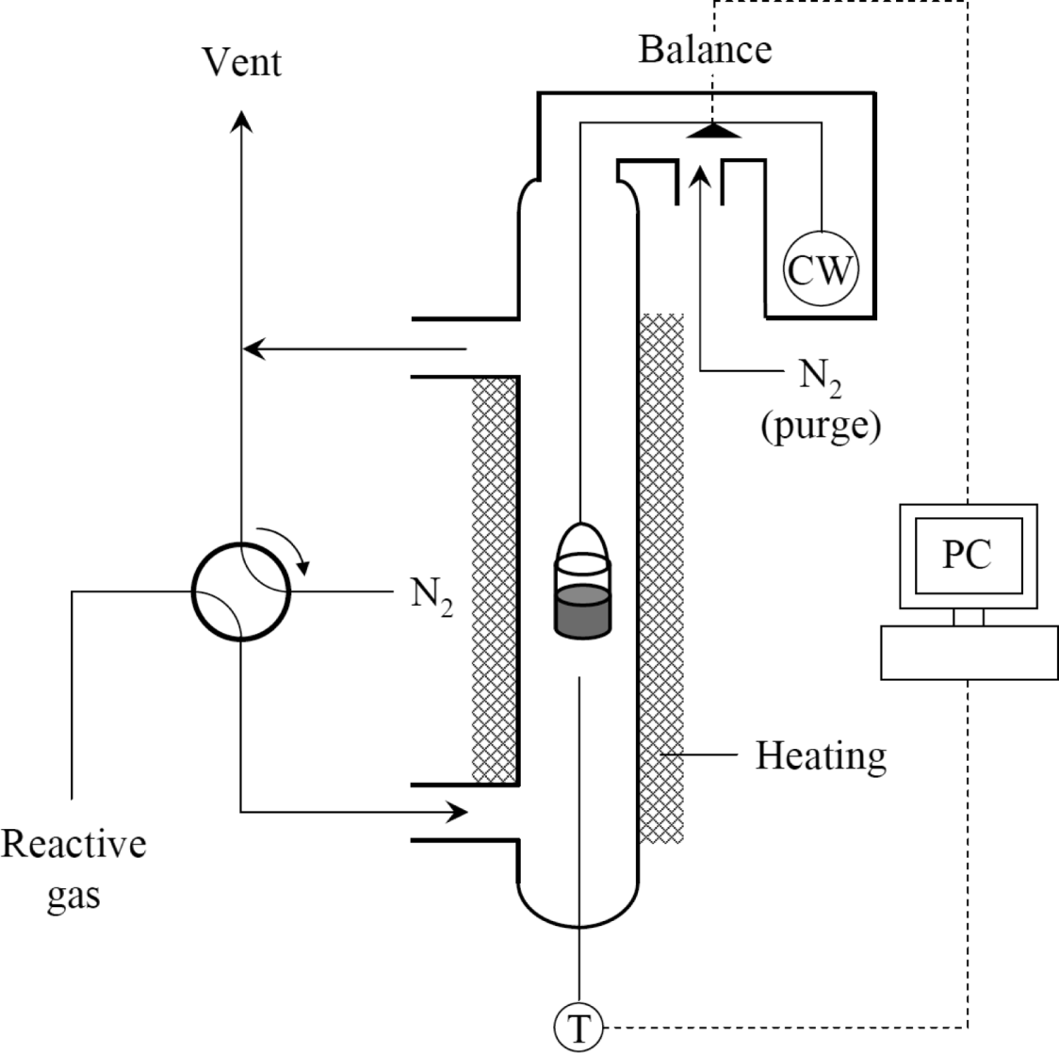
OXYGEN CARRIER SELECTION
Thermo Gravimetric Analysis (TGA)
Gas velocity: 8 mL/s
Sample: 100 mg
Page 20

Slide 21
OXYGEN CARRIER SELECTION
Oxidation cycle: Tuning temperature increase with weight content active material
active weight in oxidized state [kg/kg]
Page 21

Slide 22
CLC - Modeling
1-D Pseudo-homogeneous packed bed CLC model:
  Plug flow with superimposed axial dispersion:
(gas phase)
(solid phase)
(energy)
  Intra-particle effects ignored at first
  Modelling system: Me/MeO
More information:
Noorman et al, Packed Bed Technology for Chemical-Looping Combustion.
Ind. Eng. Chem. Res. 2012, 46, 4212-4220.
Page 22

Slide 23
Experimental validation
CLC
Model description
Experimental results
Oxidation reaction:
(Cu/CuO, w_{act} ≈ 0.1)
(t = 0, 6, 12, 18, 24, 30 s)
Model
Exp.
Improvements:
Correct implementation of heat losses in the model
Coupling of particle model and reactor model
ΔT_{max} [K]
195
199
✓
w₂ [cm/s]
1.53
1.58
✓
w₁ [cm/s]
0.13
0.15
✓
Page 23

Slide 24
CLC - Modeling
Oxidation cycle:
Axial concentration and temperature profiles
Me + ½ O₂ → MeO (ΔH<0)
Page 24

Slide 25
CLC – Temperature rise
Oxidation cycle: Evolution of outlet temperature
Reaction fronts
Regenerative heat exchanger
Air stream of high and constant
temperature can be produced
No influence of reaction kinetics and flow rate!
ΔT can be tuned with amount of active material (ω_{act})
Sharp front approach (no dispersion)
with infinitely fast kinetics:
Page 25

Slide 26
Heat production: realistic situation
Oxidation cycle
N₂/O₂
Temperature rise:
No influence of reaction kinetics or throughput
Air
An air stream of high, constant temperature is
produced and can be directed to the gas turbine
Page 26

Slide 27
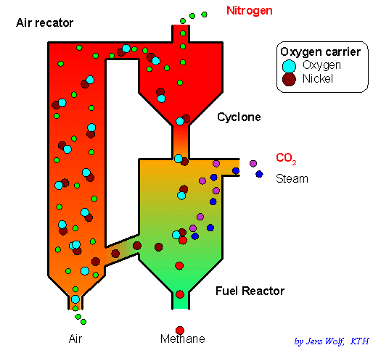
Reactor concepts
FUTURE WORK/OUTLOOK
Recirculation or stationary solids?
Air Reactor
Circulating fluidized bed:
+ Continuous power production
+ Proven technology
− Recirculation of particles
− Gas-solid separation
Alternatively: packed bed CLC (?)
Air
N₂/O₂
(n ≥ 2)
Coal or Methane
(T_{ex} = 1200 ⁰C, p = 25 bar)
CH₄
CO₂/H₂O
Page 27

Slide 28
Conclusions
CONCLUSION
Chemical-looping combustion:
  Potential for (very) high CO₂ capture efficiency without
  efficiency penalty for separation
Page 28

Slide 29




CRISIS
Current crisis:
system crisis / financial crisis
Energy & climate crisis yet to come
Production & consumption
Exhaustion of natural resources
Transformative change is indispensable
Page 29
Notes:
The dilemma is that current economic frameworks may not necessarily lead to systems or modes of operation that satisfy sustainability development. Quality of life has been increased but with a negative impact that the natural resouces are being diminishing, therefore transformative change is indispensible.

Slide 30
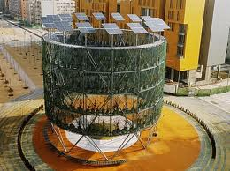



TRANSITION
Structure:
Institutional, economic, physical infrastructure
Culture:
Collective set of values, paradigms
Practices:
Routines, behaviour, ways of handling, research methodology
Fundamental shift in thinking & acting at the system transition
Means to achieve a sustainable society
– NOT DONE, MUST BE DONE!
Challanges
Page 30
Notes:
The transition is needed in the structure, culture, and practices within the society, academia and process industry. This universe is ours and we should act as role model for the society.

Slide 31
CHALLANGES
Raw materials
Products
Energy
Non Renewable:
Petroleum
Coal
Ores
Minerals
Renewable:
Plants
Animals
Chemical and physical transformations
Fuels
Materials
Plastics
Pharmaceuticals
Food
etc
Byproducts and waste, environmental impact
Product and process
affect sustainability
Challanges: Cleaner processes: increased atom, mass, energy efficiency, improved safety,
ability to scale-up
Making environmentally benign processing profitable
Page 31
Notes:
The start of the 21st century has found the process engineering as enabling technology for a sustainable growth for water and energy. In chemical engineering, wherein raw materials are passed through physical and chemical transformations to make the useful products, Rapid industrialization, urbanization, population growth and technology advancement have resulted in a threatened clean environment.
Cleaner production and right choice of manufacturing process with less pollution or less raw materials are the challenges for the todays chemical engineer.

Slide 32

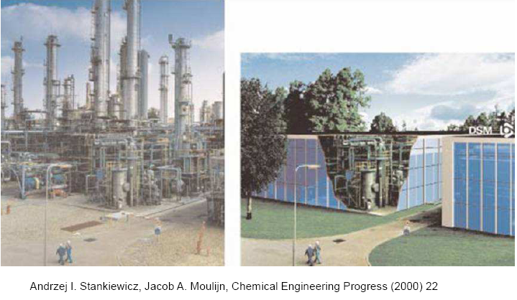
FUTURE
Page 32
Notes:
Current social-economical and technological contest driving the transition towards a knowledge intensive system to guarantee a sustainable growth. in future the environment will be green and traditional chemical plant will be more compact and environment friendly.
Sustainable development has become an important environmental benchmark for both process industries and the service industries. In this context the collaboration among all the stack holders from academia, industry and sponsoring agencies becomes inevitable. This seminar provided an apportunity to achieve this goal.
The Department of Chemical engg, UET Pesh is committed to contribute her part to scientific and technological advancement and will play a crucial role for the sustainable development . The focus will be on impact rather than quantity,

Slide 33
ACKNOWLEDGEMENT
Collaboration and financial Assistance
Institut Européen des Membranes, Montpellier France
Chemical and Environmental Engineering ,University of Toledo, USA
Technical University of Eindhoven, The Netherlands
HEC Islamabad
Directorate of Science & Tech: Peshawar
PhD Students
Engr. Waheed Ur Rehman
Engr. Imran K. Swati
Engr. Wajid Ali
Engr. Amir Muhammad
MSc Students
Engr. Waheed Zeb,
Engr. Qaiser A Khan
Engr. Sher Ahmad
Engr. Iftikhar Ahmad
Engr. M. Fawad
Engr. Aimal Khan
Page 33

Slide 34




Slide 35
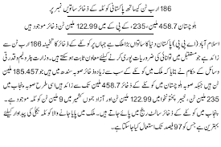


Slide 36
Temperature change during reduction with syngas (T_{initial} 600°C)
At 600°C. In contrary with CH₄, mostly exothermic
Page 36

