Slide 1
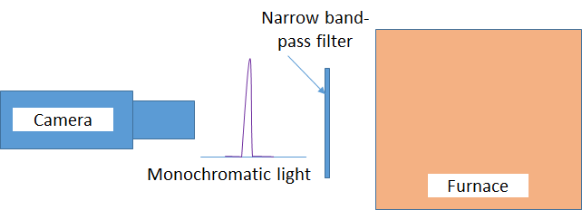
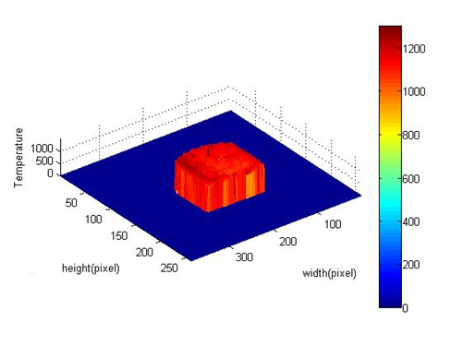
TEMPERATURE PREDICTION OF A SOLID BODY BY TWO-COLOR METHOD USING IMAGE-PROCESSING TECHNIQUE
5th INTERNATIONAL MECHANICAL ENGINEERING CONGRESS, 9th & 10th MAY, 2015, Karachi-Pakistan
Dr Sohaib Zia Khan, Dr. Muhammad Ali Khan, Hamza Ahmed, Ali ZainUl Abedeen, Tayyab Gulfaraz, Hassaan Ul Haq
Department of Engineering Sciences, NUST-PNEC

Slide 2
Temperature prediction by two color method
Contents
Identification and significance of the problem
Theoretical background
Experimental Work
Results and Conclusion

Slide 3
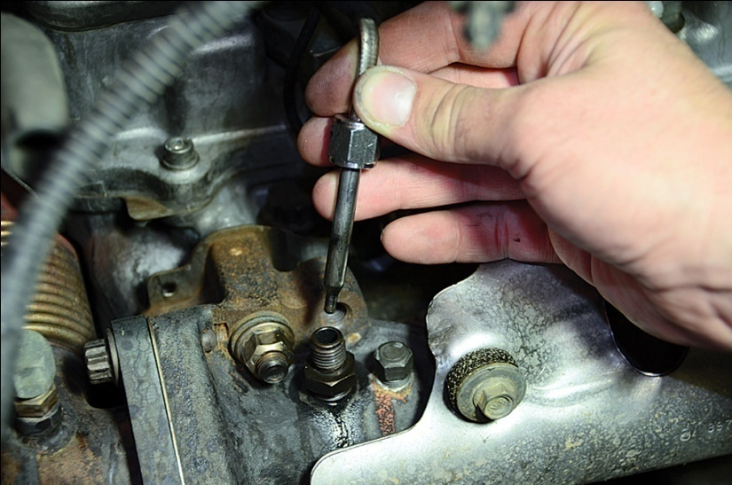
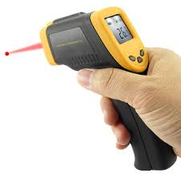
Temperature prediction by two color method
Temperature Measurement in industrial equipments – Simple or Complex????
Measurement methods: Contact and Non Contact
Contact: Physical contact at the point of interest;
Highly accurate but can only provide the temperature at the mounted location.
- Thermometers & Thermocouples...
Non-Contact: Not physically in contact at the point of interest; Fairly accurate; Can provide the temperature of multiple locations.
- Laser based temperature measurement guns

Slide 4
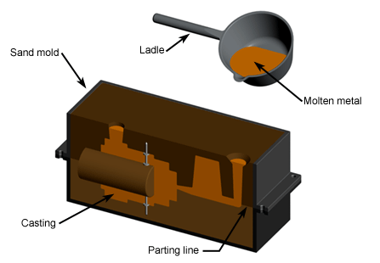
Temperature prediction by two color method
Temperature Measurement in industrial equipments – Simple or Complex????
Problem arises when we need temperature values of a whole body at any given instant of time.
For Example: Sand Casting
If you need temperature distribution across the mold ???
In Real time
At your own set sample times
At least with fair accuracy
Similar examples: Heat treatment furnace, Combustion chambers….

Slide 5
Temperature prediction by two color method
Temperature Measurement in industrial equipments – Simple or Complex????
Work done in academic research domain
- Infrared pyrometers convert the energy radiated by the target to electrical signals which are then interpreted as temperature.
- Measured emitted intensity of source at different wavelengths and then calculating the emissivity and temperature by using curve fitting techniques.
- The distribution of temperature can be calculated from the ratio between the grey-scale levels of corresponding pixels within two images captured at selected wavelengths of the equipment of interest by a camera. Known as Two color method.
Extensive applications of this method:
Flame Temperature and soot concentration of combustion chambers.
Predict temperatures on a brake disc and the die casting tooling surface.
Still needed:
Software technique that can workable with low cost image capturing devices and provide temperature measurement in near real time.

Slide 6
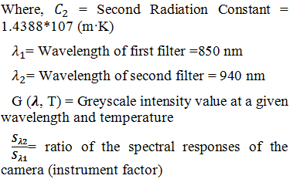
Temperature prediction by two color method
Theoretical Background of two color method
- The radiation of an object is governed by Planck’s radiation law:
- Formula used for calculation of temperature in two color method as per previous research.

Slide 7
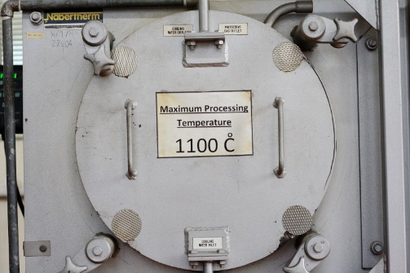
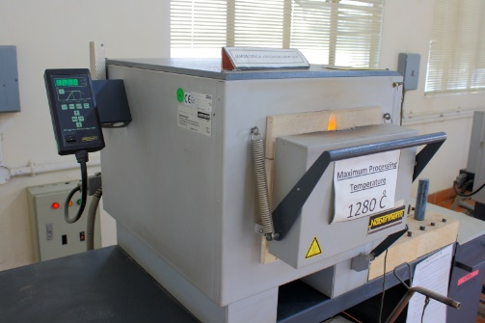
Temperature prediction by two color method
Experimental Work
- Experiments were conducted to predict the inside temperature of two different electric furnaces.
(a)
(b)
Furnace A
Furnace B
Electrical furnaces to measure inside wall temperature (a) Furnace A with maximum temperature of 1100ᵒC and (b) Furnace B with maximum temperature of 1280ᵒC.

Slide 8
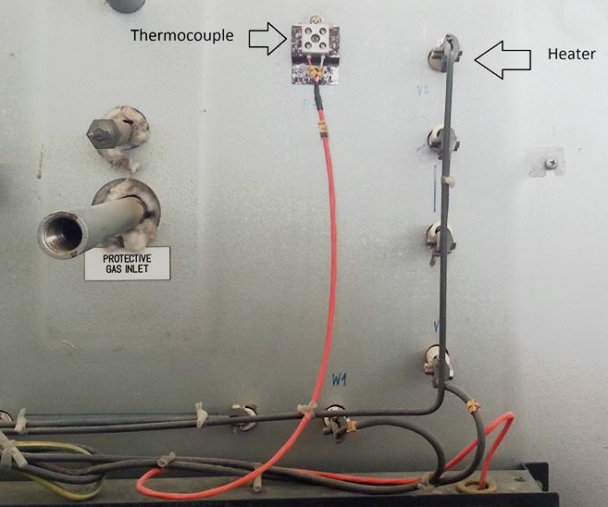
Temperature prediction by two color method
Experimental Work
- Thermocouples are also attached to measure temperature at a specific pt in the inside wall for comparison.
Thermocouple
Heater

Slide 9
Temperature prediction by two color method
Experimental Work
- Hardware Schematic
The camera used in this work was Canon Rebel XTi which has 10.1 megapixel CMOS sensor. Work has also been verified by using simple web cam.
The narrow band-pass filters allowed to pass only the wavelengths of 850±10 nm and 940±10 nm.

Slide 10
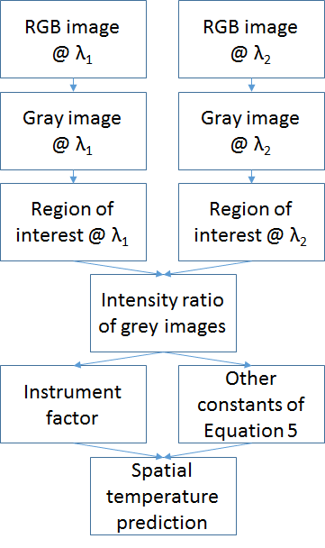
Temperature prediction by two color method
Experimental Work
- Soft code schematic

Slide 11
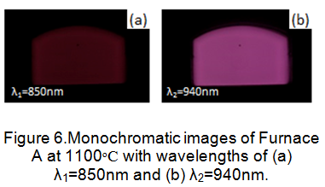
Temperature prediction by two color method
Results and Conclusion
Measurement at Furnace A
- On furnace A, three experiments were performed at the temperature of 1000ᵒC, 1050ᵒC and 1100ᵒC, respectively.

Slide 12
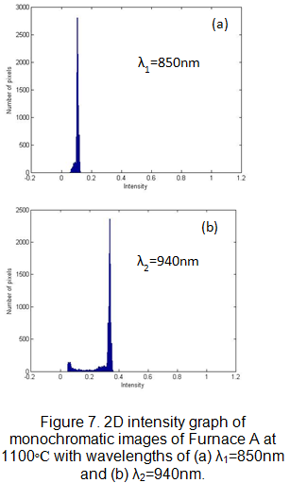
Temperature prediction by two color method
Results and Conclusion
Measurement at Furnace A

Slide 13
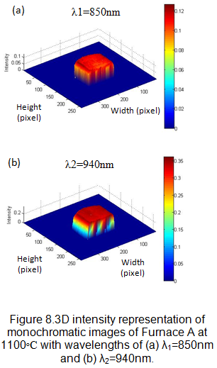
Temperature prediction by two color method
Results and Conclusion
Measurement at Furnace A

Slide 14
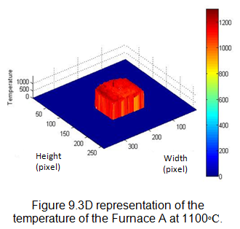
Temperature prediction by two color method
Results and Conclusion
Measurement at Furnace A

Slide 15
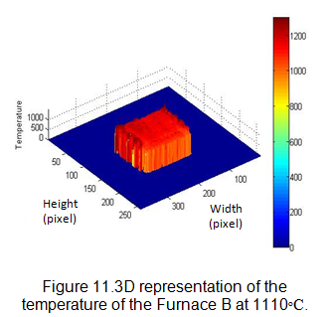
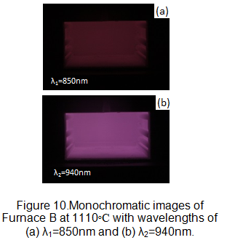
Temperature prediction by two color method
Results and Conclusion
Measurement at Furnace B

Slide 16
Temperature prediction by two color method
Results and Conclusion
Measured Temperature °C | Average Predicted temperature °C
Furnace A
1000 | 1006
1050 | 1061
1100 | 1114
Furnace B
1110 | 1118
1150 | 1042
1210 | 1191
1280 | 1272

Slide 17
Temperature prediction by two color method
Results and Conclusion
Results have shown that the method is good enough for industrial application.
The use of this technique can be beneficial in industries where temperature measurement is an imperative requirement.
This may provide a long-term solution to the industry as a non-contact technique and the system would have high working life than ordinary contact techniques.
However, error in predicted results can be reduced by taking the images from both filters with out any delay.

Slide 18
Temperature prediction by two color method
CONTACT ME:
Dr. Muhammad Ali Khan
Assistant Professor
Engineering Sciences Department
Room 105, Post Graduate Building
PNS JAUHAR, Pakistan Navy Engineering College
National University of Sciences and Technology
makhan@pnec.nust.edu.pk
021-99240752

