Slide 1
SILVER NANOPARTICLES - SYNTHESIS, CHARACTERISATION AND THEIR APPLICATION AS POLYMER REINFORCEMENT
FIMEC 2015
Humair Ahmed*, S.M Mohsin and M. Faizan
Lecturer
Department of Materials Engineering,
NED University of Engineering & Technology, Karachi, Pakistan

Slide 2
* Motivation
* Objective(s)
* Literature Review
* Design of Experiment
* Experiment (Silver Nanoparticles)
* Characterisation
* Design of Experiment
* Experiment (Reinforcement in Polyester)
* Characterisation
* Conclusion and Future Recommendation
* References
CONTENTS

Slide 3
In order to synthesise Silver Nanoparticles -Ag Nps with appreciable yield and quality, a simple and easy method should be devised.
The unique characteristics of Silver Nanoparticles -Ag Nps (Optical, Chemical etc), lends them great potential for reinforcement for polymeric resins.
So far, for strengthening of Composite (say GFRP), only fibers are being modified or treated to increase the overall strength (Rule of mixtures), why can’t resin be modified to do the same.
MOTIVATION

Slide 4
1: Synthesis of Silver Nanoparticles using Chemical Reduction method.
2: Addition of synthesised Silver Nanoparticles in Polyester resin to check the accompanying changes in the mechanical properties.
OBJECTIVE(S)

Slide 5
1. Nano Technology:
Nanotechnology is the understanding and control of matter at dimensions of roughly 1 to 100 nanometers, where unique phenomena enable novel applications.”
“Encompassing nanoscale science, engineering and technology, nanotechnology involves imaging, measuring, modeling, and manipulating matter at this length scale.”
National Nanotechnology Initiative, 2007
LITERATURE REVIEW

Slide 6
1.1 Nano Particles:
* Nanoparticle definition, a microscopic particle of matter that is measured on the nanoscale, usually one that measures less than 100 nanometers.
* They have variety of applications due to their unique properties at Nano level.
1.1 Silver Nanoparticles:
* Noble metal nanoparticles have exceptional electrical, optical, physical, chemical and magnetic properties and are always in highlight for their attractive biophysical, biochemical, and biotechnological applications [1]
* Apart from excellent chemical stability, silver nanoparticles also exhibit scattering in the range of visible spectrum [1]
* Chemical methods are usually preferred to synthesis of silver nanoparticles (Ag nps) and among them chemical reduction is an appropriate choice of making stable, colloidal solution of silver in water or organic solvents [1,2]
LITERATURE REVIEW (continued)

Slide 7
2. Composites:
A composite can be defined as a combination of two or more materials that results in better properties than those of the individual components used alone.
The main advantages of composite materials are their high strength and stiffness, combined with low density, when compared with bulk materials, allowing for a weight reduction in the finished part.
Structural Composite Materials
F.C. Campbell
ASM International®
LITERATURE REVIEW (continued)

Slide 8
3. Modification of Resin:
Ronghui Lin et al. reported modification of Phenol–formaldehyde (PF) resins by nanosised copper particles during situ polymerisation process. It results in remarkable increase in thermal and mechanical properties. [3]
Stephan Sprenger reported modification of epoxy resin by silica nanoparticles, due to which fatigue properties of epoxy were enhanced. [4]
LITERATURE REVIEW (continued)

Slide 9
DESIGN OF EXPERIMENT :
SYNTHESIS OF AG NPS
Figure No. 1

Slide 10
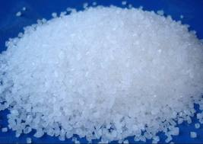
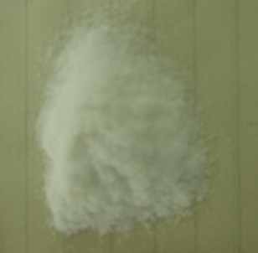
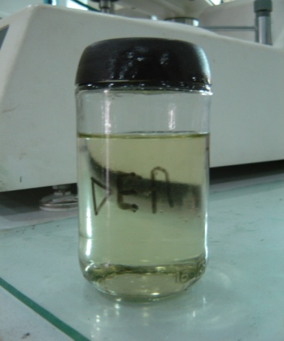
Experimental work: Synthesis of Silver Nanoparticles
Chemicals used:
Silver Nitrate - AgNO₃
Glucose – C₆H₁₂O₆
Diethyl Amine (DEA)
Figure No.2
Silver Nitrate
Figure No.3
Glucose
Figure No.4
Diethylamine

Slide 11
Synthesis of Silver Nanoparticles
Concentration of Chemicals
Table No. 1: Reaction parameters for AgNPs synthesis [5]
Concentration of AgNO₃ (mM) | Concentration of Glucose (mM) | Concentration of DEA (mM)
3 | 5 | 115

Slide 12
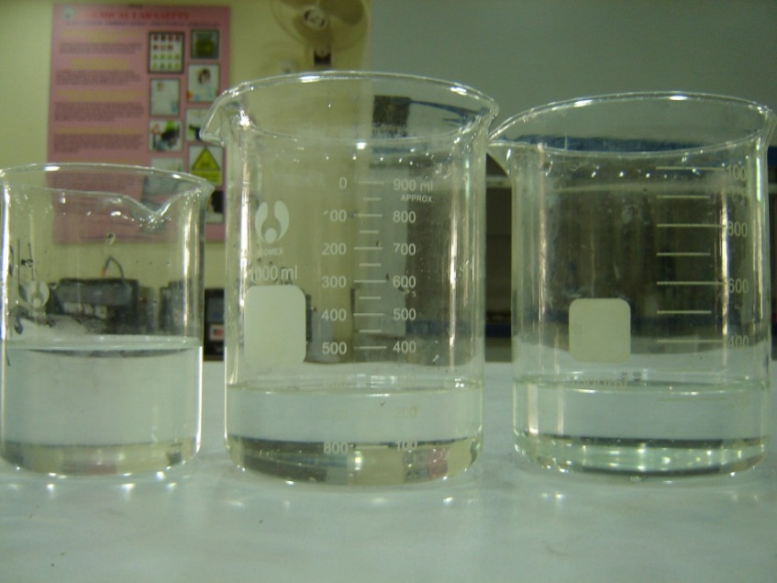
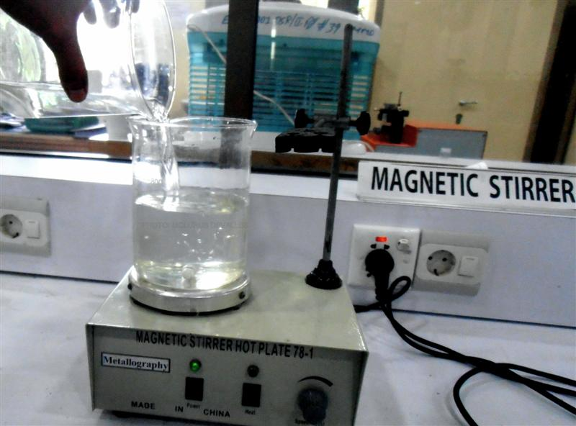
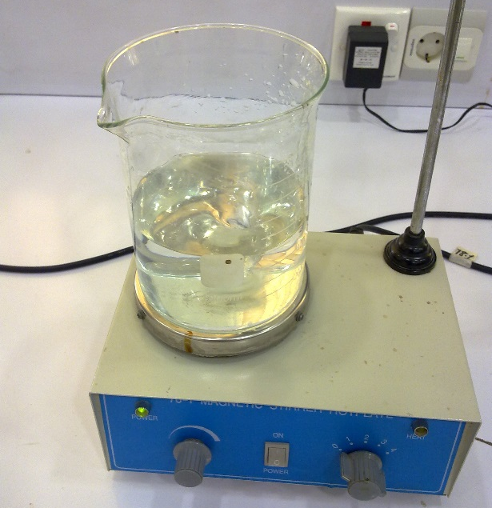
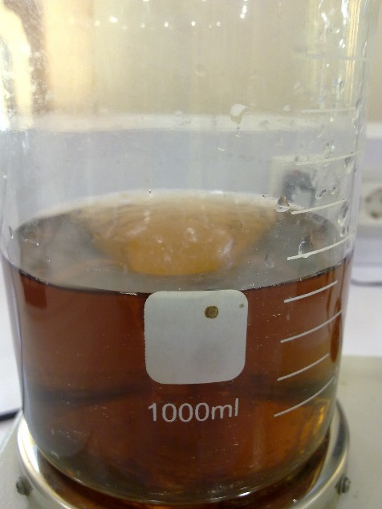
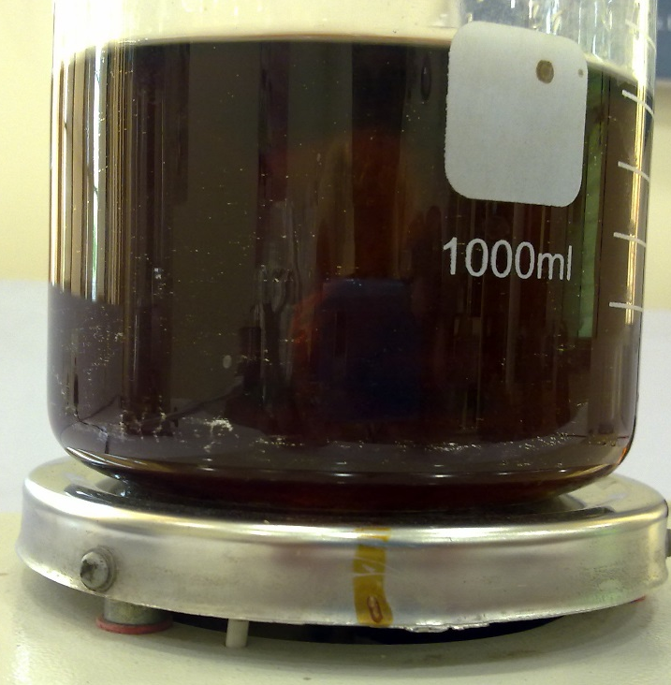
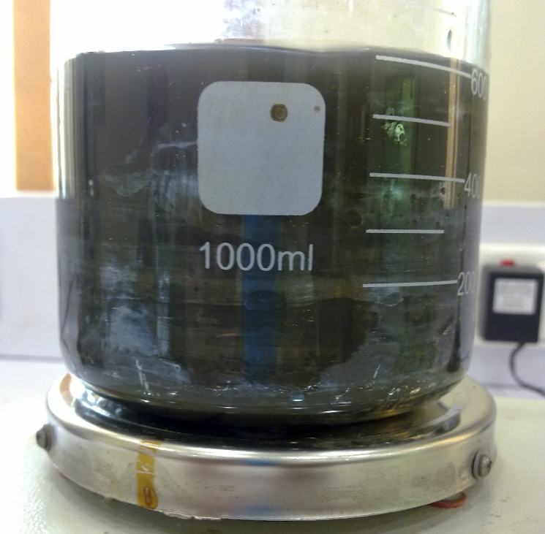
Procedure
Aqueous Solution of the three chemicals; Silver Nitrate(left), DEA(center), Glucose(right)
Solutions being mixed while being stirred vigorously, followed by change of colour
Dark Colored solution
Silver Patches Appeared on glass wall

Slide 13
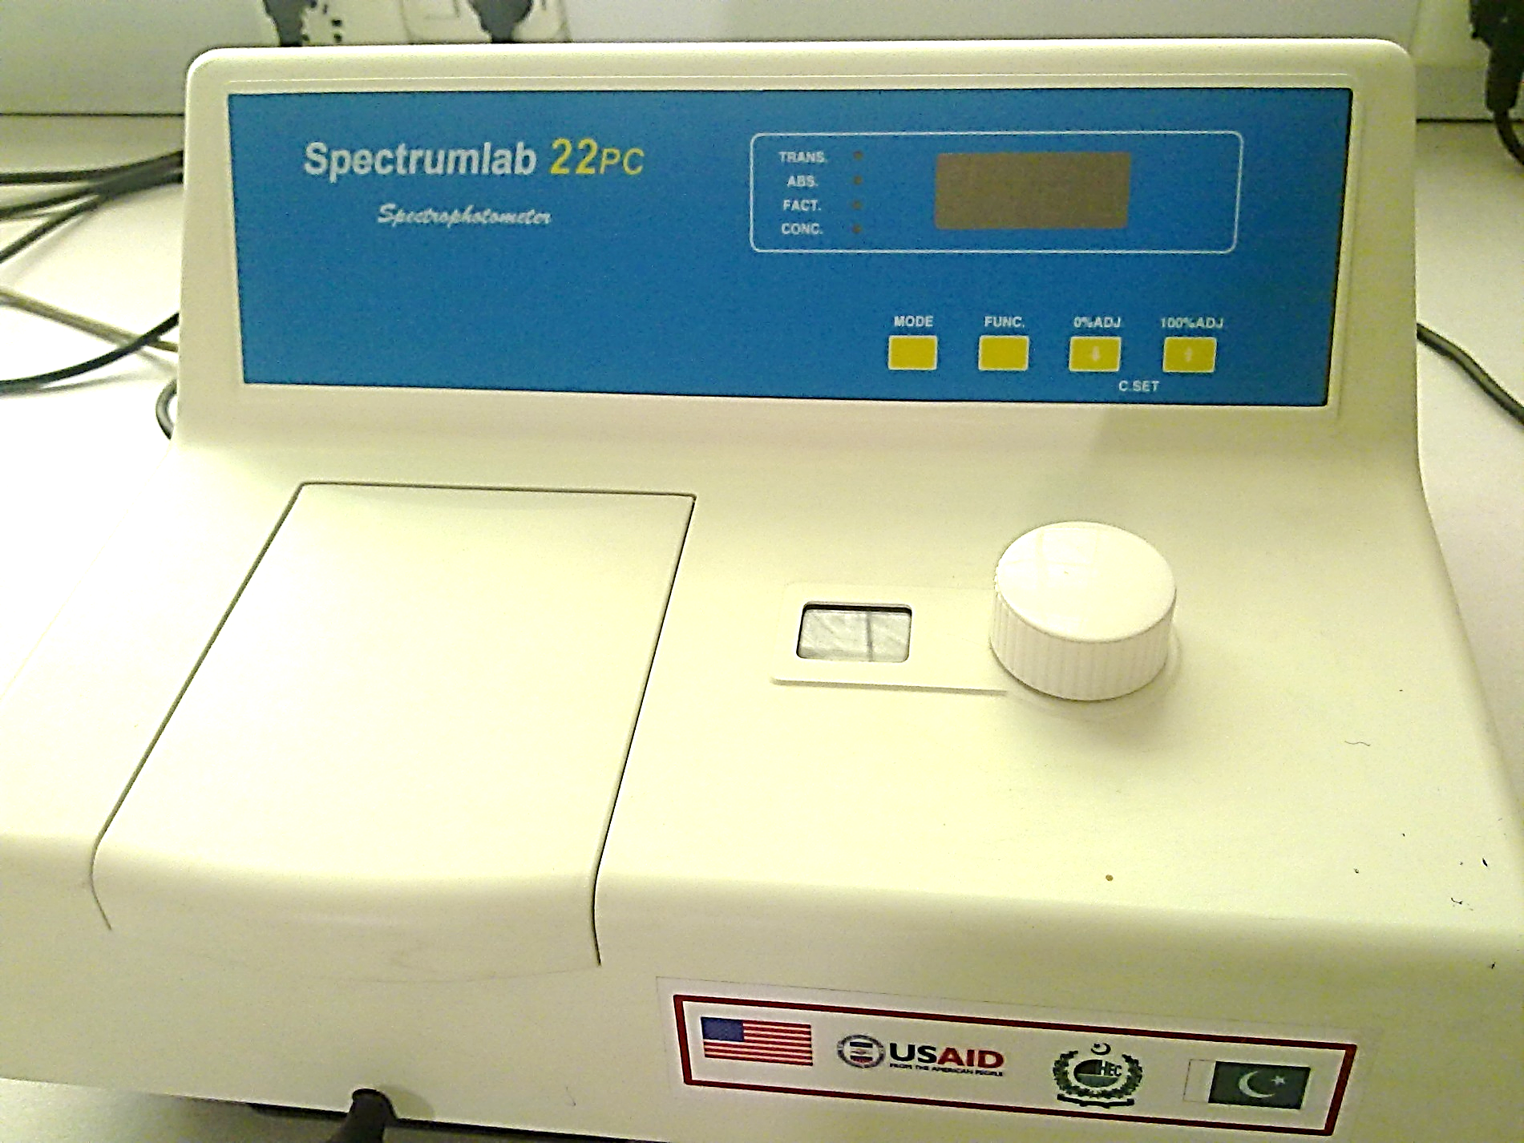
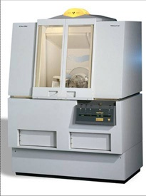
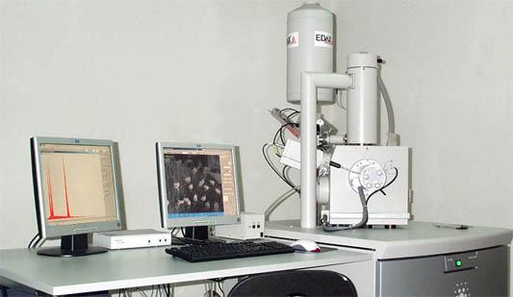
Characterisation of Silver nanoparticles
UV-Vis Spectroscopy = for Confirmation of Silver NPs
XRD = for Chemical and Size determination
SEM = for Structural and Size determination
Figure No.5 Figure No.6 Figure No.7
UV-Visible Spectrophotometer XRD (MMD, NEDUET) SEM (MMD, NEDUET)
(MMD, NEDUET)

Slide 14
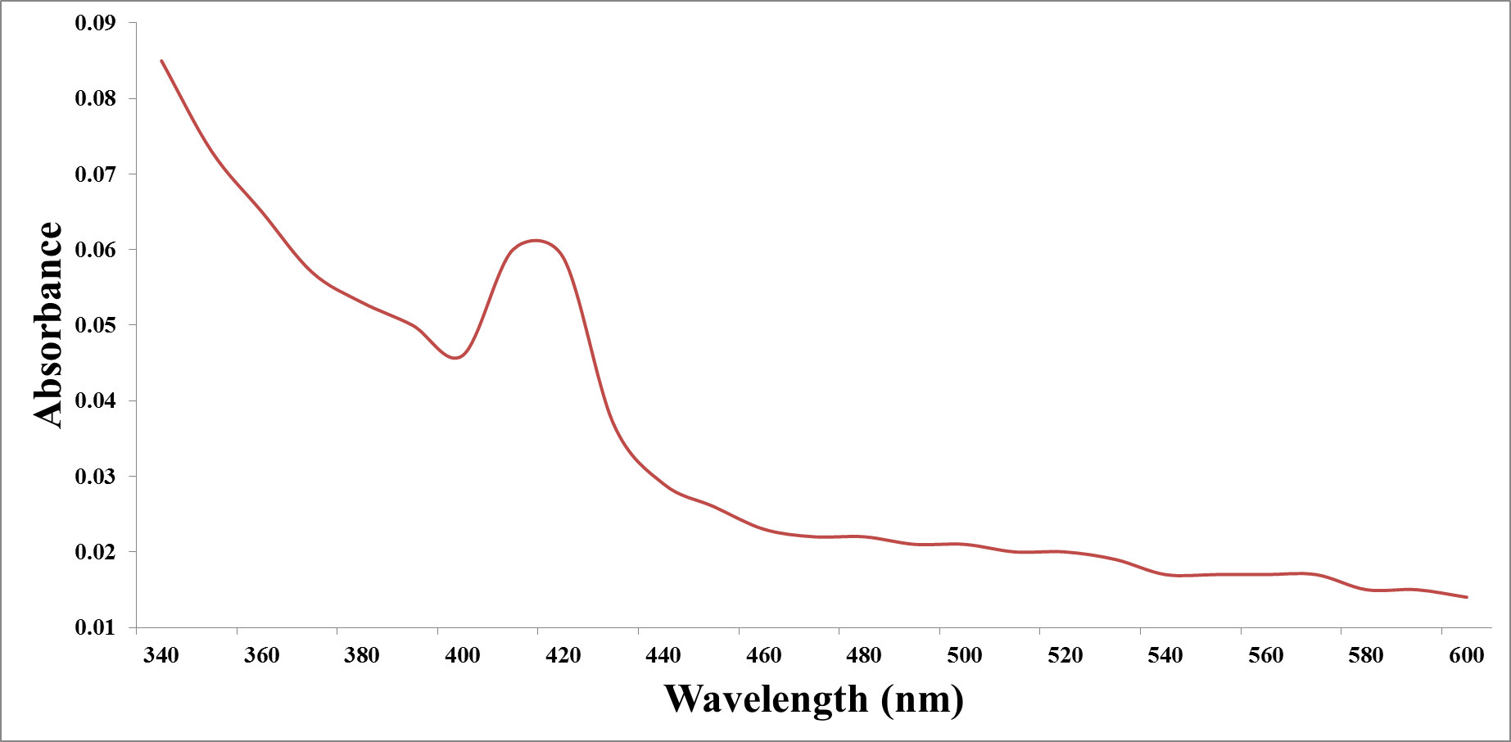
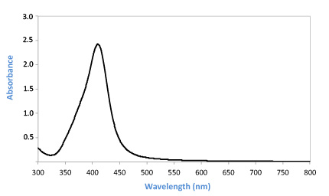
UV-Vis Spectroscopy
The UV/Vis absorption spectra of “Synthesised” Ag nano particles
Standard UV/Vis absorption spectra of Ag nano particles
Peak : 410 – 418 nm

Slide 15
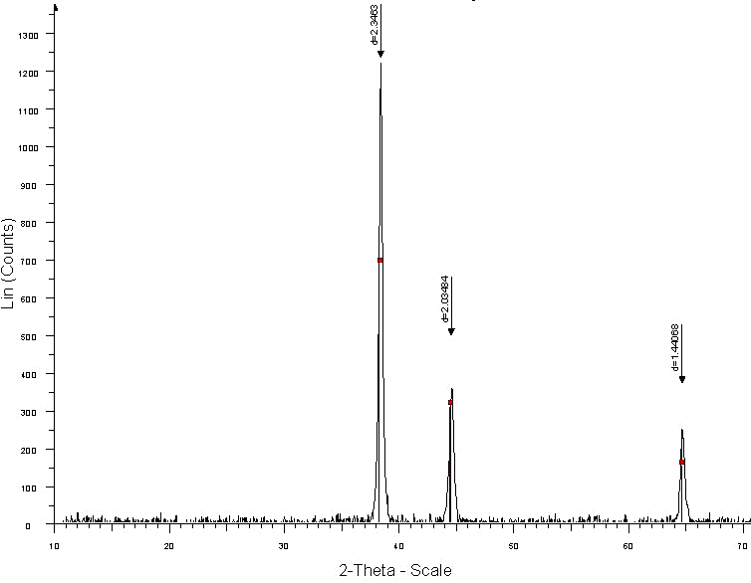
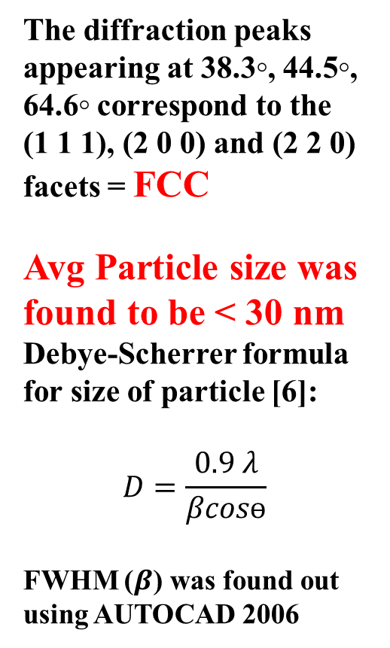
XRD ANALYSIS
The diffraction peaks appearing at 38.3◦, 44.5◦, 64.6◦ correspond to the
(1 1 1), (2 0 0) and (2 2 0) facets = FCC
Avg Particle size was found to be < 30 nm
Debye-Scherrer formula for size of particle [6]:
$$D=\frac{0.9 λ}{βcosɵ}$$
FWHM ($β$) was found out using AUTOCAD 2006
Figure No.8 XRD Pattern

Slide 16
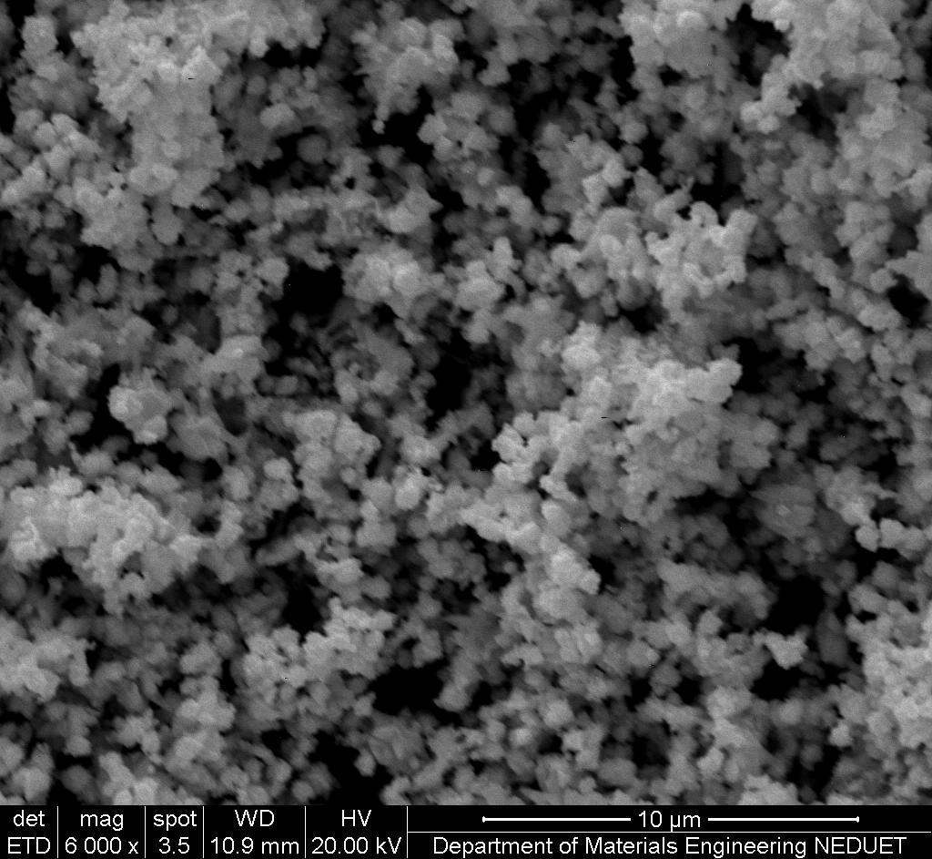
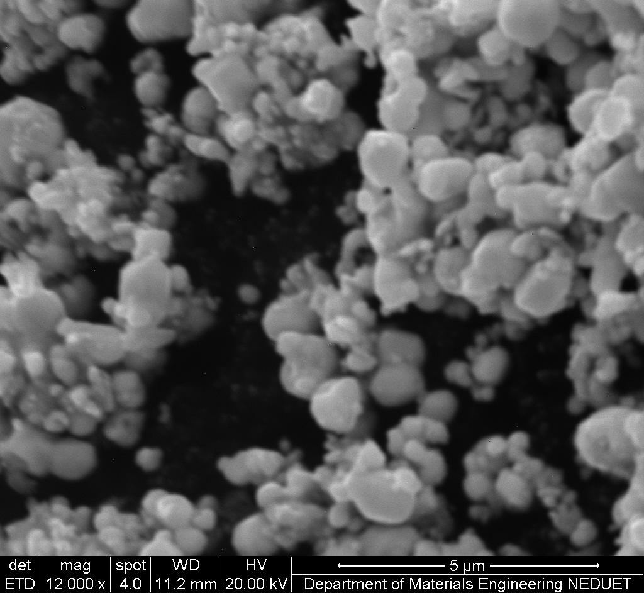
SEM ANALYSIS
Figure No 9 a & b
Both these images shows agglomerated, smooth surfaced, spherical particles of Ag Nps.

Slide 17
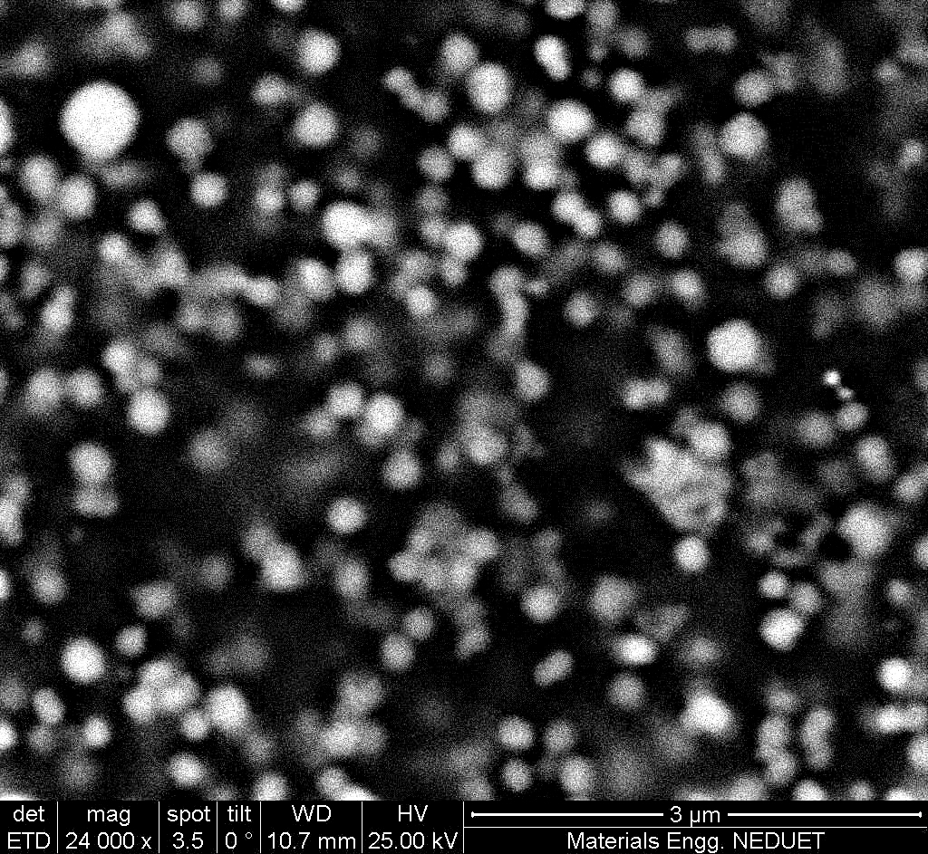
SEM ANALYSIS
Figure No 10
Image at 24000x, showing the Nano particles of Silver

Slide 18
DESIGN OF EXPERIMENT : POLYMERIC REINFORCEMENT

Slide 19
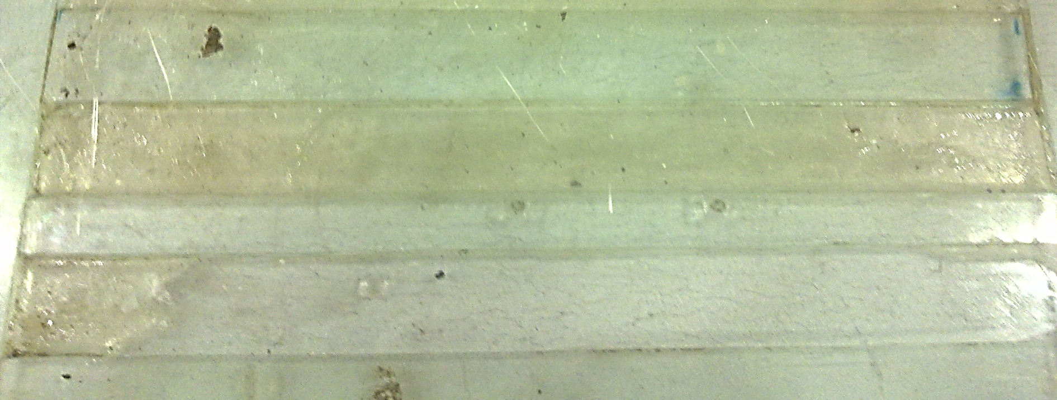
Experimental work: Application of Ag Nps as Nanofillers
Materials used:
Unsaturated Polyester Resin
Hardener: Methyl Ethyl Ketone Peroxide (MEKP)
Accelerator: Cobalt Octoate (2%)
Nano fillers: Synthesised Ag Nps
For casting of resin, a Glass mould (203.2 x 20.32 mm) was prepared
203.2 mm
20.32 mm

Slide 20
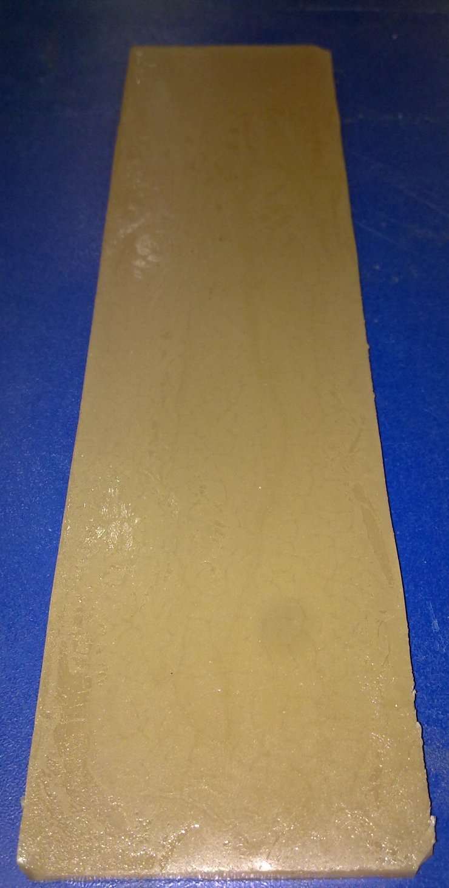
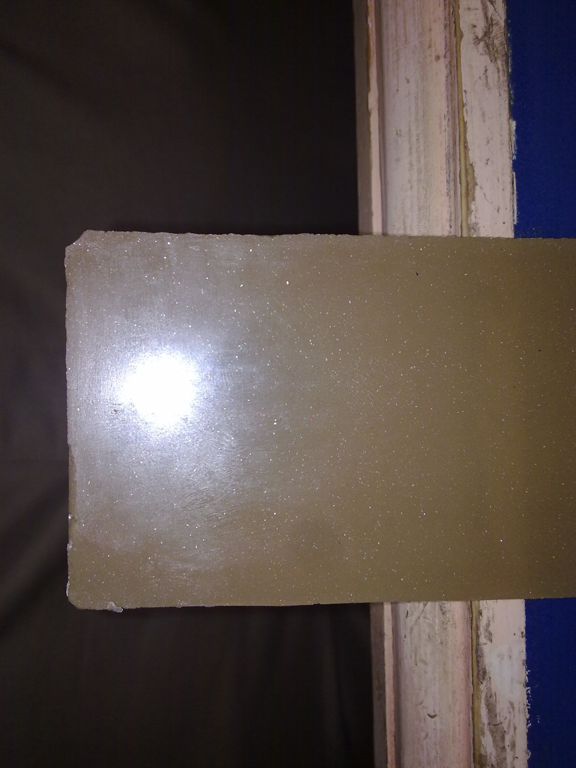

SAMPLES
Figure No 11 a, b, c Sample obtained after modification

Slide 21
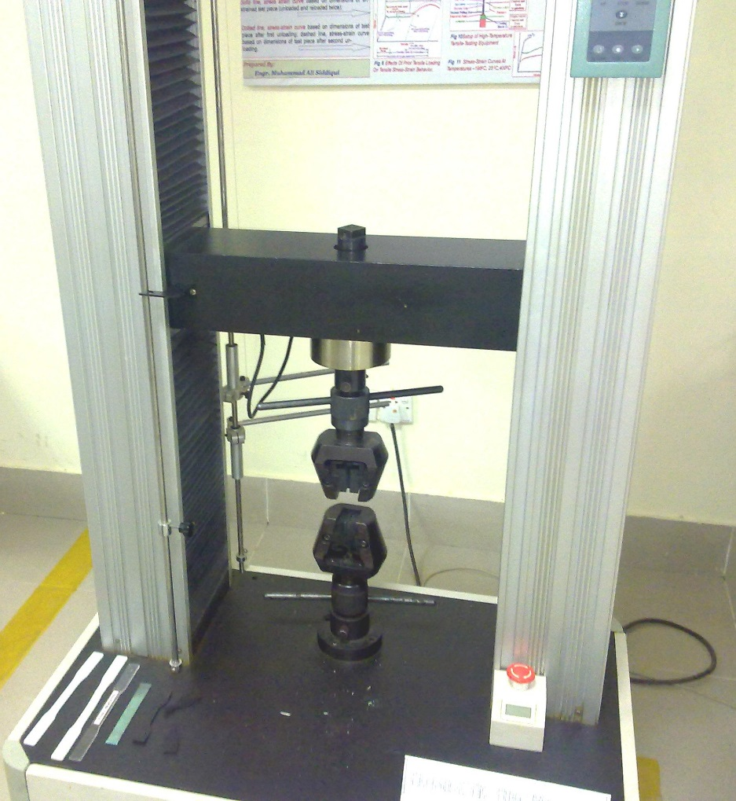
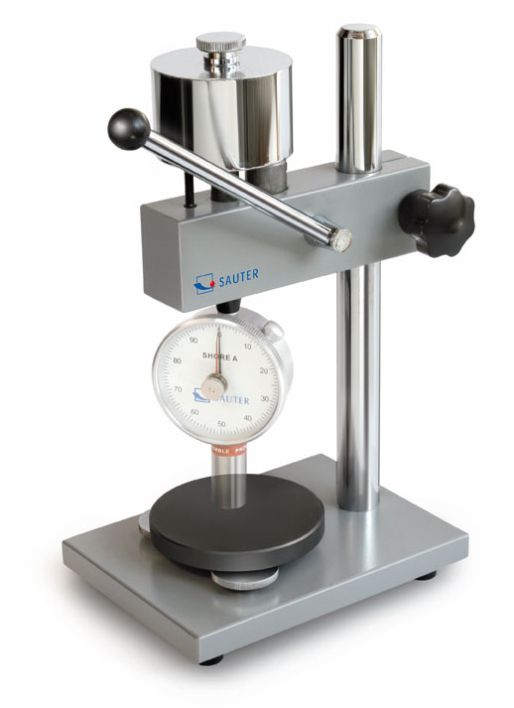
Characterisation of Reinforced Polyester
Visual Examination= for transparency variations
Tensile Testing = for changes in tensile properties
Shore Hardness = for hardness variation
Figure No. 12
Tensile Testing Machine for
Polymeric Materials
(MMD, NEDUET)
Figure No. 13
Shore Hardness
Tester
(MMD, NEDUET)

Slide 22
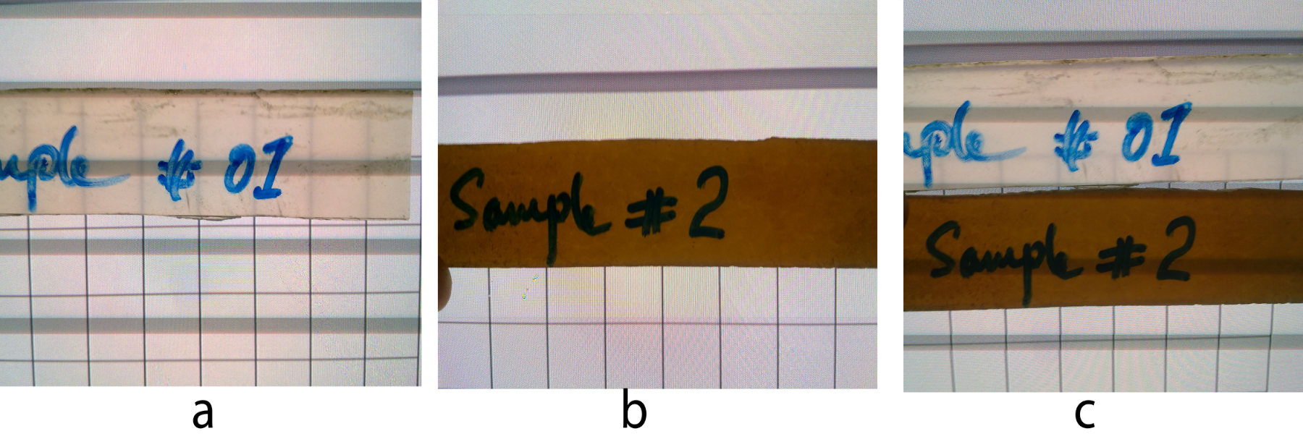
Visual Examination
Figure No. 14 a, b, c
Proper dispersion of Silver Nanoparticles was observed, with a significant change in the transparency of polyester resin

Slide 23
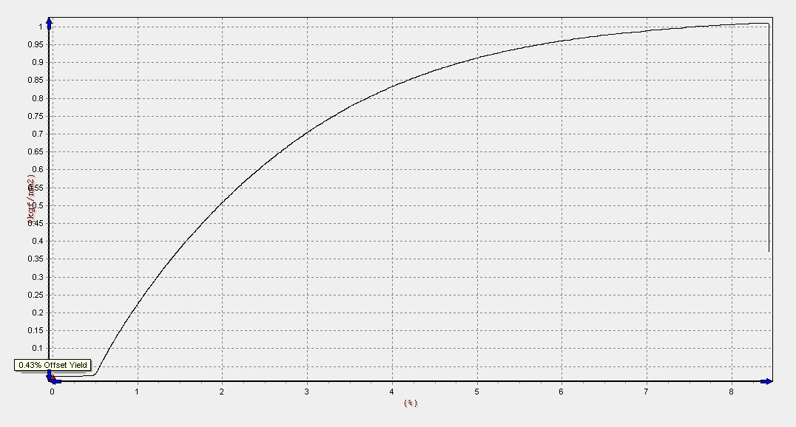
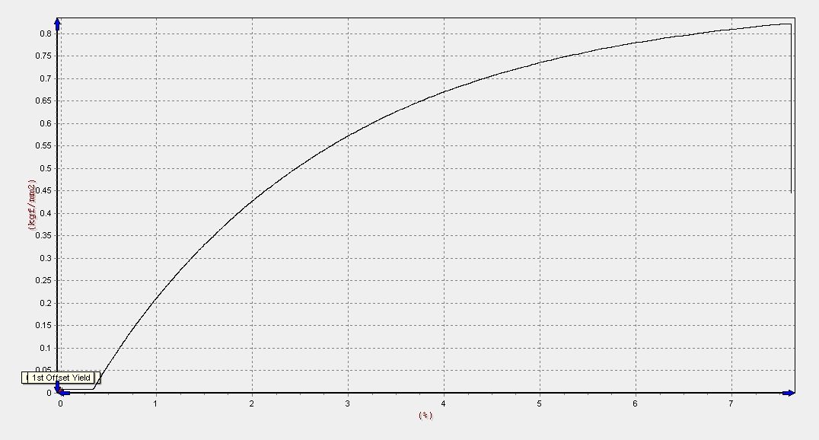
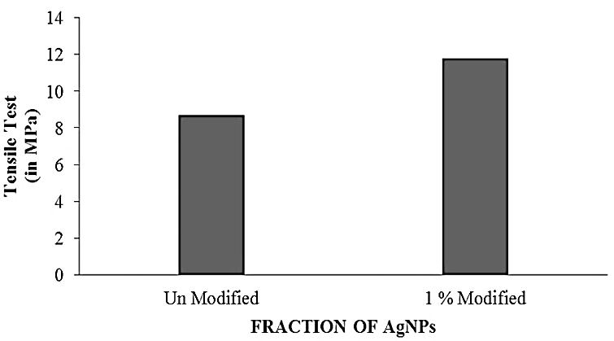
Tensile Testing
UNMODIFIED
1 % MODIFIED
Figure No. 15
Modification by 1% showed a remarkable, approx. 39%, increase in the tensile strength of Polyester resin.

Slide 24
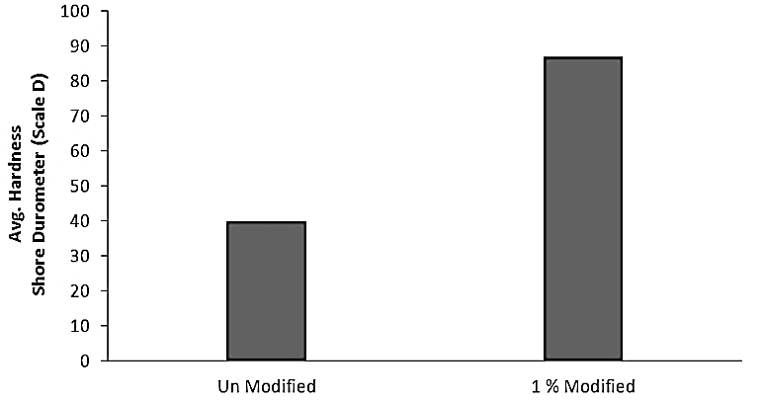
Hardness Testing
Figure No. 16
Modification by 1% showed more than 100% increment in the hardness value of Polyester resin.

Slide 25
Change in Fracture Pattern
Figure No. 17 Figure No. 18
Unmodified resin Modified Resin
Increase in crystallinity is the factor responsible for changing this behavior

Slide 26
Conclusion and Future Recommendations
As Nano fillers, AgNPs were proved to be a handy option for strengthening of resin, which is an indirect method of strengthening composite, however there is a wide window open for other researchers to explore and establish, a relation ship of particle size of Ag Nps with that of increased tensile strength and hardness.
One additional area of research, which needs to be explored is the effect of Nano filling on the electrical conductive and adhesive properties of resin as researcher believe, Nano silver could be used in the making of conductive polymers and adhesives
After confirmation from XRD, SEM and spectrophotometer, it could be established that the adopted process is one of the easiest and efficient process of yielding Ag Nps., however researcher suggest to compare the green synthesis of Ag Nps with this chemical reduction method, as green methods of synthesising Ag Nps are some what promising for the applications of Sun block creams and other human related products.

Slide 27
References
[1] Khalaf Ali Abdul Rahman, Raouf Dayah N. “Preparation of Silver Nanoparticles by Pulsed Laser Ablation in Liquid Medium” Engg. & Tech. Journal. 29 (2011) 3058-3066.
[2] Chargot M.S., Gruszecka A., A. Cytawa Smolira, J., MichalaL. k “Mass- spectrometric investigations of the synthesis of silver nanoparticles via electrolysis” Vacuum. 82 (2008) 1088–1093
[6] Theivasanthi T. and Alagar M.. “Nano Biomedicine and Engineering Electrolytic synthesis and characterisation of silver nanopowder” Nano Biomedicine and Engineering 01 (2012):58-65
[5] Janardhanan Revathi et al.; “Synthesis and surface chemistry of silver Nanoparticles”; Polyhedron (2009); 28; pp 2523
[4] Sprenger Stephan; “Epoxy resins modified with elastomers and surface-modified silica nanoparticles”; Polymer (2013) pp 4790–4797
[3] Lin Ronghui et al.; “Study on Phenolic Resins Modified by Copper Nanoparticles”; Polymer Journal (2006) 38, pp 178–183

Slide 28
Thank you
Any Question/Query

