Slide 1
EFFECT OF TEMPERING TEMPERATURE ON SUSCEPTIBILITY OF INTERGRANULAR CORROSION OF AUSTENITIC STAINLESS STEEL (AISI 304)
Authors
MUHAMMAD RIZWAN (Lecturer Department of Metallurgical Engineering)
IFTIKHAR AHMED (Lecturer Department of Metallurgical Engineering)
MUHAMMAD ALI (Lecturer Department of Metallurgical Engineering)
MUZAMMIL YOUNUS (Graduate of Department of Metallurgical Engineering)
DEPARTMENT OF METLLURGICAL ENGINEERING
NED UNIERSITY OF ENGINEERING & TECHNOLOGY

Slide 2
PRESENTATION LAYOUT
ABSTRACT
INTRODUCTION
EXPERIMENTAL WORK
RESULTS AND DISCUSSION
CONCLUSION
REFERENCES

Slide 3
ABSTRACT
Austenitic stainless steels undergo intergranular corrosion, when they are heated in the range of 500ºC to 850ºC, and then slowly cooled. Intergranular corrosion is the cause of many failures in Austenitic stainless steel which causes the material to fail in a brittle manner.
In this study, the effect of tempering temperature on susceptibility to Intergranular corrosion has been examined in AISI 304 by Double loop Electrochemical Potentiokinetic Reactivation test according to ASTM standard G108 and microscopic examination is carried out by oxalic etch test according to ASTM standard A262 Practice A.
The result acquired through this research showed a linear behavior between increase in temperature and the resultant corrosion of samples.
Keywords: Intergranular Corrosion, AISI 304, DLEPR

Slide 4
INTRODUCTION

Slide 5
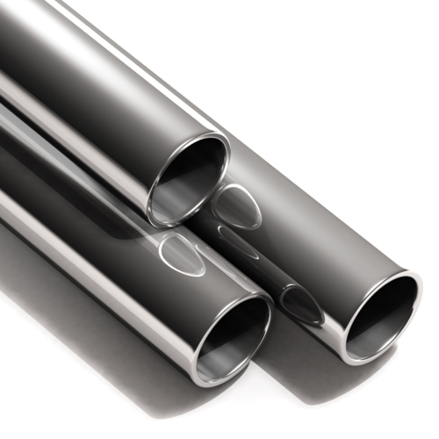
INTRODUCTION (CONT..)
AUSTENITIC STAINLESS STEEL
The grade selected for this study is AISI 304SS
It is a general purpose steel, cost effective, contains higher carbon content (0.065%) which aids in the research work for better sensitization evaluation
The exposure, in the temperature range of 450-850°C leads to the grain boundary precipitation of chromium rich carbides Cr23C6 and to the formation of chromium depletion regions
Austenitic Stainless Steel Tube

Slide 6
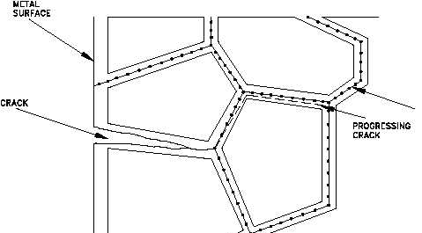
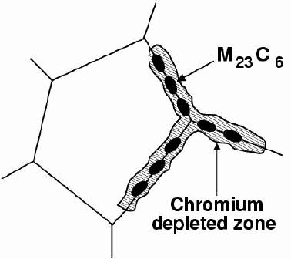
INTRODUCTION
INTERGRANULAR CORROSION
Intergranular corrosion is a form of relatively rapid and localised corrosion associated with a defective microstructure containing carbide precipitates
The gathering of carbide precipitates along grain boundaries leads to the susceptibility to corrosion attack due to depletion of chromium adjacent to the grain boundary region. This phenomena is called as sensitization
The effects of intergranular corrosion can also lead to intergranular stress corrosion cracking
Carbide precipitates
Crack propagating through depleted zones

Slide 7
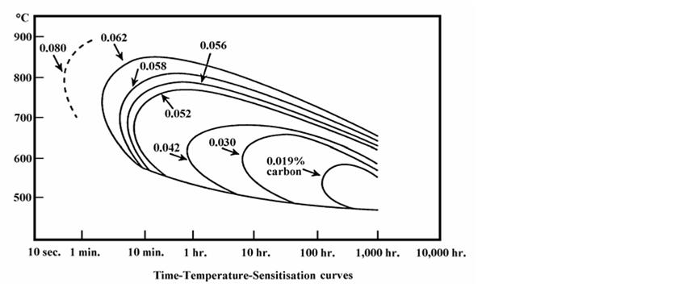
INTRODUCTION (CONT..)
INTERGRANULAR CORROSION OF AUSTENITIC STAINLESS STEELS
What is Sensitization?
Precipitation of chromium carbide at the grain boundaries, resulting in the formation of chromium-depleted zones adjacent to the grain boundaries
What is TTS diagram?
The curve of 0.062% carbon content is nearest to chose material. The time to cause sensitization is comparitively less than other grades of Austenitic stainless steel 304L,316,316L etc.
Time Temperature Sensitization curves
7

Slide 8
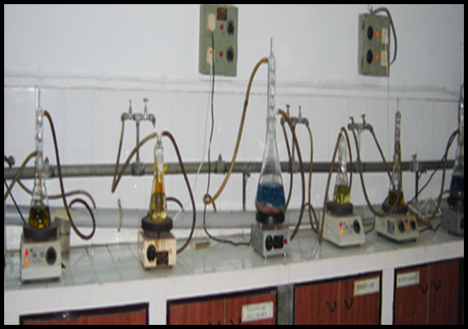
INTRODUCTION (CONT..)
TEST FOR SENSITIZATION
ASTM A262
According to ASTM A262 there are 5 tests for determining sensitization:
Oxalic etch test
Ferric Sulfate–Sulfuric Acid Test
Nitric Acid Test
Copper–Copper Sulfate–Sulfuric Acid Test
Copper–Copper Sulfate–50 % Sulfuric Acid Test
These practices have three draw backs:
They are only qualitative
Destructive
Time-consuming (except practice A)
ASTM A262 Test Apparatus

Slide 9
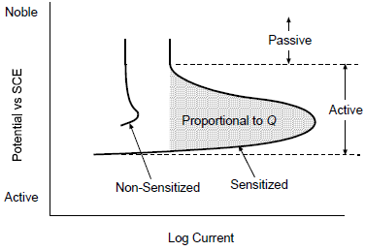
INTRODUCTION (CONT..)
TEST FOR SENSITIZATION
Another test method according to ASTM G108:
Electrochemical potentiokinetic reactivation (EPR) test
Electrochemical techniques were developed to determine the degree of sensitization
Having following benefits:
Rapid and Fast
Non-destructive
Quantitative results
Single loop EPR
Only one loop i.e. reactivation loop is obtained, the amount of charge associated with the corrosion of
the chromium-depleted regions surrounding chromium carbide is measured by the area under the loop
Limitations
Necessity of measuring grain size
Polishing with 1 micron diamond paste
Single loop EPR test curve

Slide 10
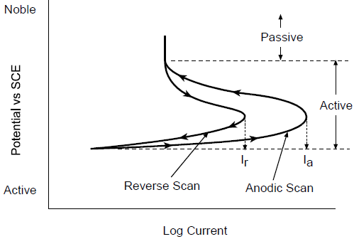
INTRODUCTION (CONT..)
TEST FOR SENSITIZATION
The limitations of Single Loop EPR test lead to the development of:
Double Loop EPR
Two loops are generated activation loop and reactivation loop and the peak currents are used to evaluated the degree of sensitization
Double loop EPR test curve
Advantages:
A ratio (Ir:Ia) is used instead of area under reverse scan as in single loop test
It is also not necessary to normalize the ratio of maximum current with the grain size
Relatively rough 120-grit finish is enough

Slide 11
EXPERIMENTAL WORK

Slide 12
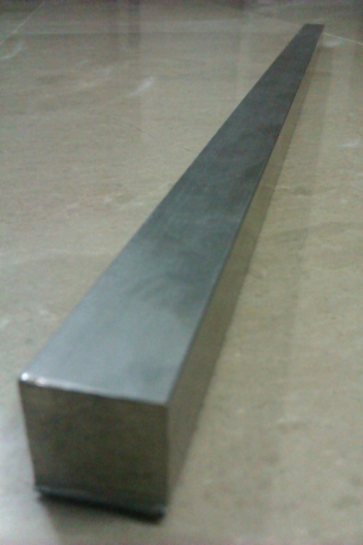
EXPERIMENTAL WORK
Material Selection
A square cross-sectional bar of AISI 304 stainless steel having a cross-section of 16mm x16mm is purchased from the market with the assurance of the Mill test certificate.
The chemical composition of the material is shown below:
16x16mm AISI 304 SS bar
Elements | C | Si | Mn | P | S | Ni | Cr
Specification | MAX 0.08 | MAX 1.00 | MAX 2.00 | MAX 0.045 | MAX 0.03 | 11.00 8.00 | 20.00 18.00
Composition | 0.065 | 0.43 | 1.83 | 0.027 | 0.024 | 8.02 | 18.60

Slide 13
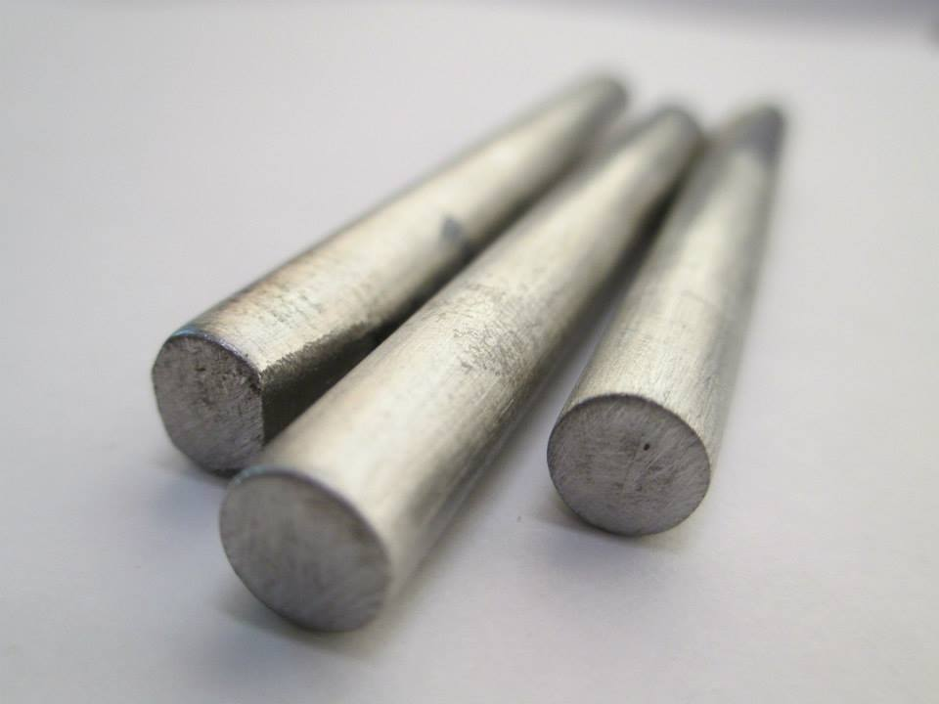
EXPERIMENTAL WORK (CONT..)
SAMPLE PREPARATION
Two types of samples were prepared:
For the testing of sensitization by Double loop EPR test
For oxalic etch test
Oxalic etch test Sample
DL-EPR Sample

Slide 14
EXPERIMENTAL WORK (CONT..)
HEAT TREATMENT
Heat treatment cycles are designed according to the sensitization range of AISI 304 stainless steel. The samples were austenized at 1050ºC followed by quenching in water. Then tempering at different temperatures is carried out, keeping the time constant (i.e. 40 minutes)
S No. | Code of the Specimen | Heat Treatment time and temperature
1. | SA | Austenized at 1050°C for 40 minutes and water quench
2. | T600 | Heat treated at 600°C for 40 minutes and Air cool
4. | T675 | Heat treated at 675°C for 40 minutes and Air cool
6. | T750 | Heat treated at 750°C for 40 minutes and Air cool
7. | T800 | Heat treated at 800°C for 40 minutes and Air cool

Slide 15
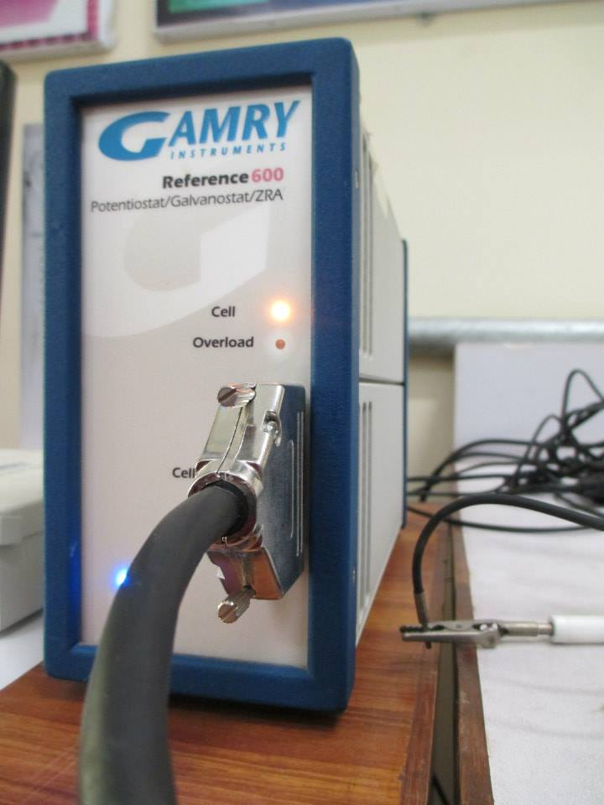
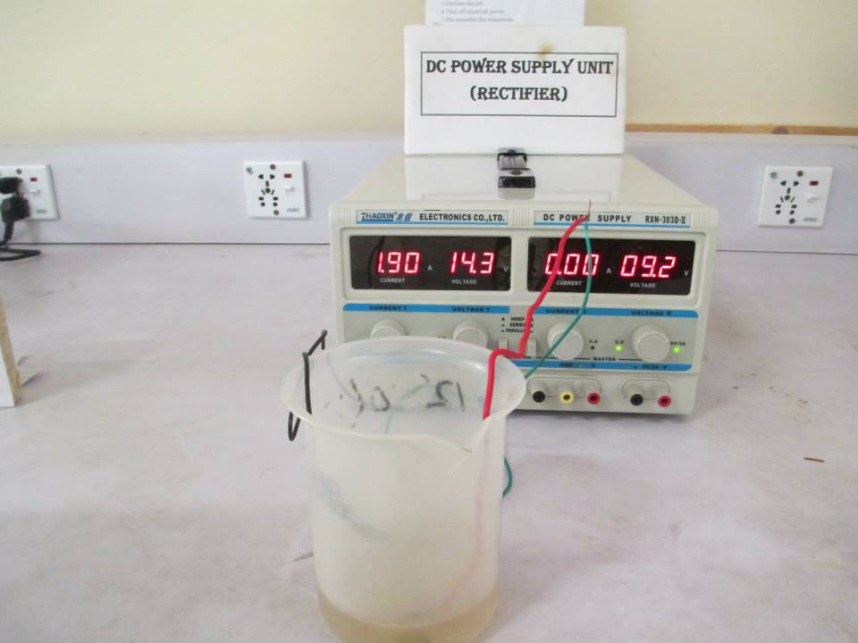
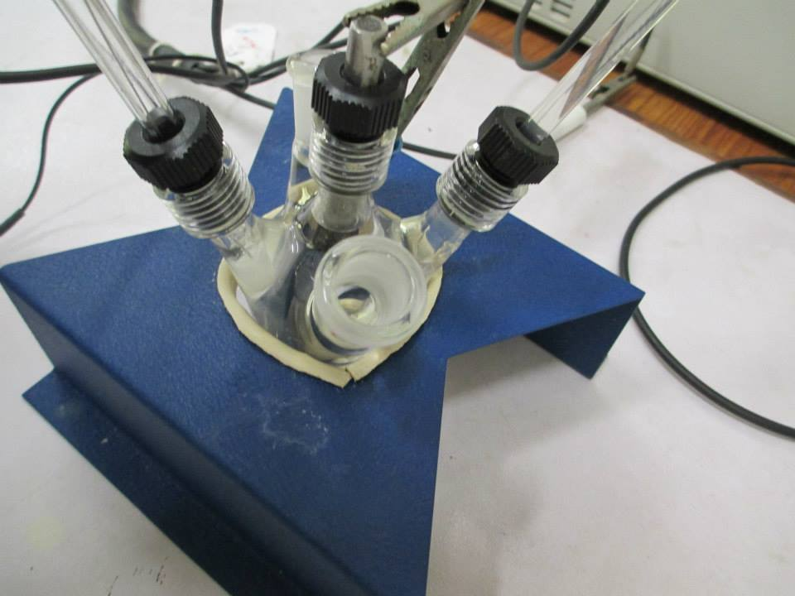
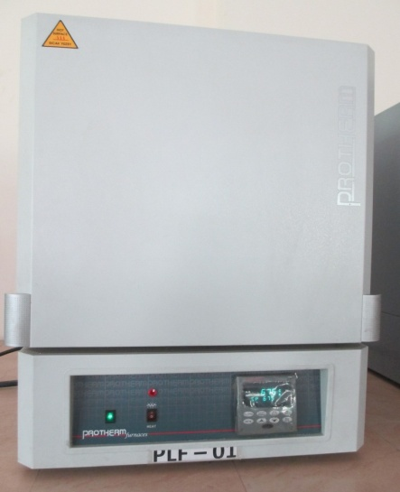
EXPERIMENTAL WORK (CONT..)
TESTING EQUIPMENTS
Following testing equipments were used:
Electrochemical polarization cell
Potentiostat
DC voltage supply
Metallography apparatus
Optical Microscope
Furnace for heat treatment
Potentiostat
DC voltage supply
Bob’s cell
Furnace for heat treatment

Slide 16
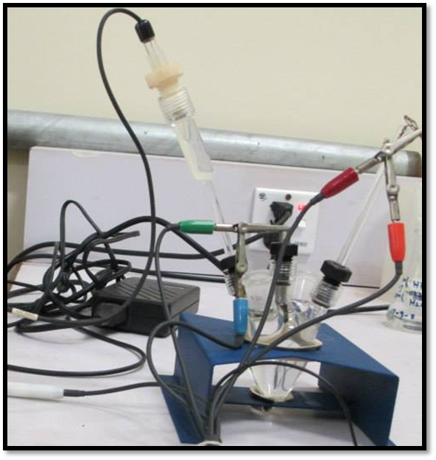
EXPERIMENTAL WORK (CONT..)
TESTING PROCEDURE:
Double loop EPR Test:
The test solution was prepared according to standard ASTM G108-94, the test solution consists of 1L of 0.5M H2SO4 + 0.01M KSCN + distilled water
First the Specimen was subjected to open circuit condition for 2 min so that Ecorr develops
Then sample is polarized and voltage is scanned anodically from Ecorr to + 0.3 V vs SCE with scan rate 1.667 mv/sec, after which it is reversed back at the same scan rate to Ecorr
The polarization curves forms were then examined to determine peak current
Dr. Bob’s cell

Slide 17
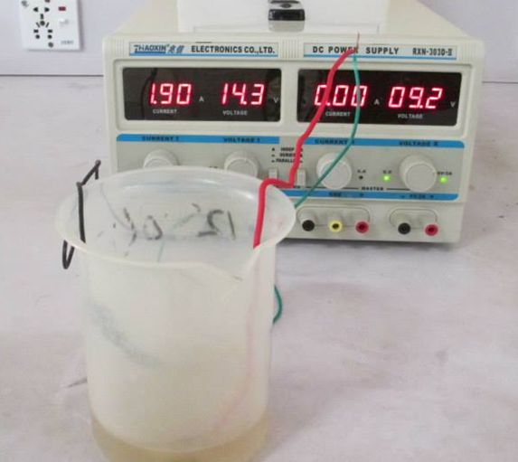
EXPERIMENTAL WORK (CONT..)
TESTING PROCEDURE:
Oxalic Acid Etch Test:
Oxalic acid test was performed according to ASTM A262 Practice A.
Sample was connected to positive terminal while cylindrical piece of stainless steel is made cathode.
current density of 1 Amp/cm² for 1.5 min according to ASTM A262 Practice A.
The etched surfaces were examined under metallurgical microscope at different magnifications.
Oxalic Acid test equipment

Slide 18
RESULT AND DISCUSSION

Slide 19
RESULTS AND DISCUSSION
EPR TEST RESULTS
The degree of sensitization is determined by equation:
The results are as follows:
S. No. | TEMPERATURES (in ºC) | Time (min) | Ia (mA) | Ir (mA) | %DOS (Ir/Ia)x100
1. | Solution annealed | 40 | 148.6 | 2.18 | 1.46
2. | 600ºC | 40 | 209.6 | 5.075 | 2.4
3. | 675ºC | 40 | 171.7 | 23.77 | 13.8
4. | 750ºC | 40 | 211.5 | 39.92 | 18.87
5. | 800ºC | 40 | 189.9 | 39.29 | 20.68
DLEPR test results for AISI 304 type stainless steel

Slide 20
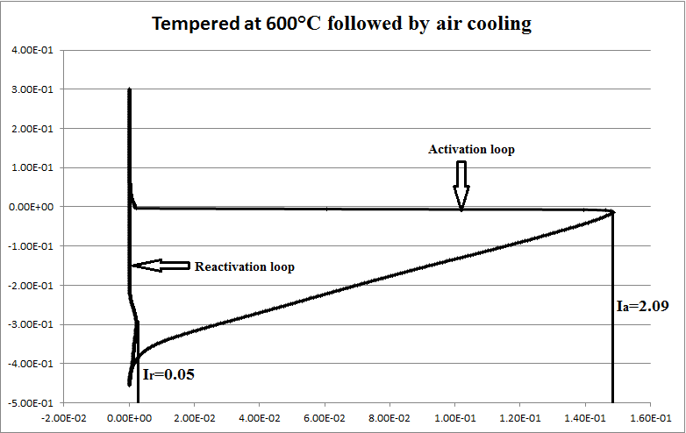
RESULTS AND DISCUSSION (CONT..)
DLEPR CURVES
DLEPR curve of AISI 304 austenize at 1050ºC for 40min followed by quenching:
Solution Annealed
Potential v/s SCE (volts)
Ia=1.48
Ir= 0.02
I (Amperes/cm²)
The anodic current (Ia) is found to be 1.48expˉ¹ A and the reactivation current (Ir) is 0.02 expˉ¹ A, therefore the degree of sensitization for this curve is calculated as:

Slide 21
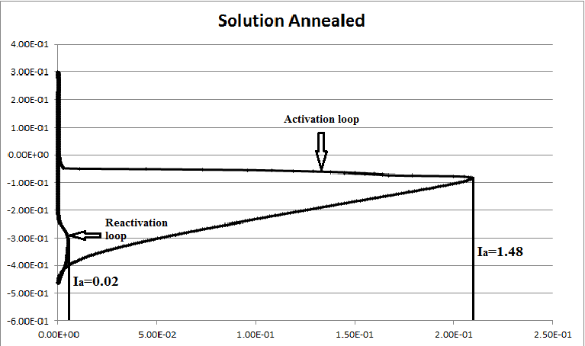
DLEPR curve of AISI 304 tempered at 600ºC for 40min followed by air cooling:
RESULTS AND DISCUSSION (CONT..)
DLEPR CURVES
Tempered at 600ºC followed by air cooling
Potential v/s SCE (volts)
Ia= 2.09
Ia= 0.05
I (Amperes/cm²)
The anodic current (Ia) is found to be 0.05expˉ¹ A and the reactivation current (Ir) is 2.09 expˉ¹ A, therefore the degree of sensitization for this curve is calculated as:

Slide 22
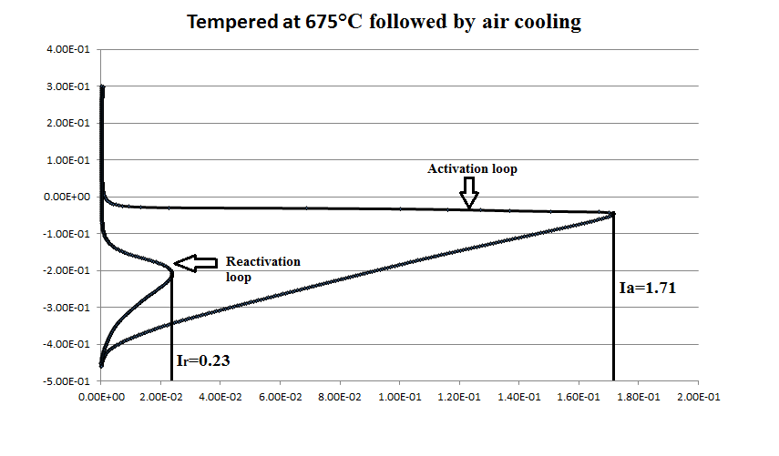
DLEPR curve of AISI 304 at tempered 675ºC for 40min followed by air cooling:
RESULTS AND DISCUSSION (CONT..)
DLEPR CURVES
Potential v/s SCE (volts)
I (Amperes/cm²)
The anodic current (Ia) is found to be 1.71expˉ¹ A and the reactivation current (Ir) is 0.23expˉ¹ A, therefore the degree of sensitization for this curve is calculated as:

Slide 23
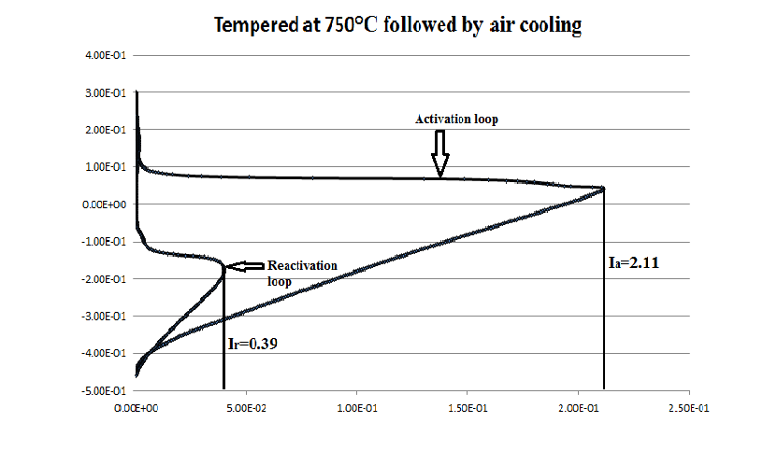
DLEPR curve of AISI 304 tempered at 750ºC for 40min followed by air cooling:
RESULTS AND DISCUSSION (CONT..)
DLEPR CURVES
Potential v/s SCE (volts)
I (Amperes/cm²)
The anodic current (Ia) is found to be 2.11expˉ¹ A and the reactivation current (Ir) is 0.39expˉ¹ A, therefore the degree of sensitization for this curve is calculated as:

Slide 24
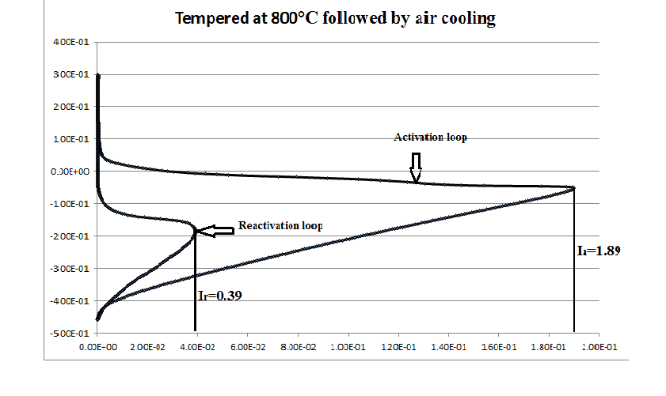
DLEPR curve of AISI 304 tempered at 800ºC for 40min followed by air cooling:
RESULTS AND DISCUSSION (CONT..)
DLEPR CURVES
Potential v/s SCE (volts)
I (Amperes/cm²)
The anodic current (Ia) is found to be 1.89expˉ¹ A and the reactivation current (Ir) is 0.39expˉ¹ A, therefore the degree of sensitization for this curve is calculated as:

Slide 25
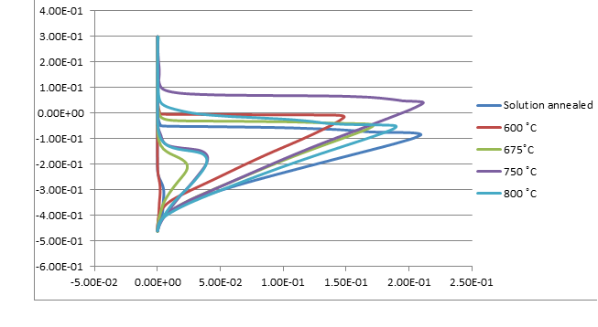
Comparison between DLEPR curves tempered at different temperatures followed by air cooling :
RESULTS AND DISCUSSION (CONT..)
DLEPR Result’s Discussion
Potential v/s SCE (volts)
Potential v/s SCE (volts)
I (Amperes/cm²)
I (Amperes/cm²)
It can be seen that 600ºC temperature curve showed no such degree of sensitization as this temperature is quite low for carbide precipitation to occur
On the other hand 750ºC and 800ºC curves show more reactivation currents than 675ºC indicating the increase of degree of sensitization with respect to temperature

Slide 26
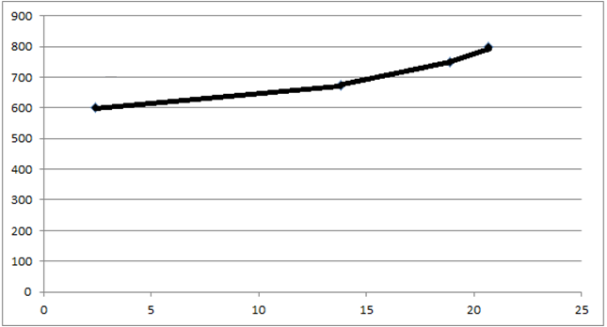
Graph showing tempering temperature as a function of degree of sensitization :
RESULTS AND DISCUSSION (CONT..)
DLEPR Result’s Discussion
Tempering Temperature (⁰C)
Degree of Sensitization (%)
The graph pattern indicates the increase in degree of sensitization as the tempering temperature increases, this has also been reported by Ayo S. Afolabi et al

Slide 27
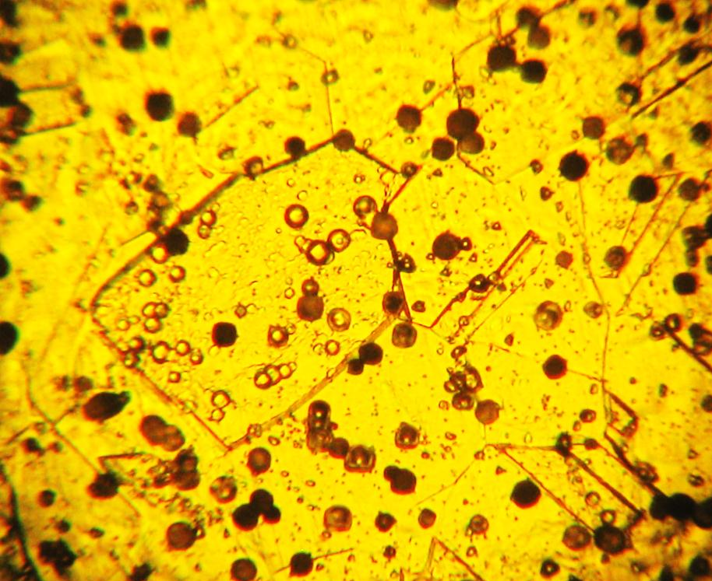
RESULTS AND DISCUSSION (CONT..)
The optical micrographs obtained after electrolytic etching in 10wt% oxalic acid (by dissolving 10gram oxalic acid into 100ml water) according to ASTM A262 Practice A, are shown below in the figures:
Oxalic acid etch test results
Micrograph of AISI 304 sample at 1050ºC at 400x (solution annealed)

Slide 28
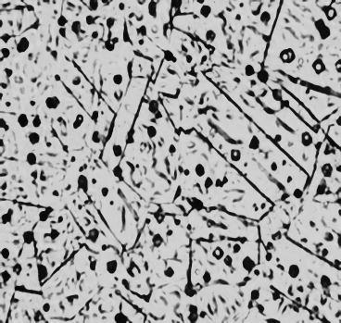
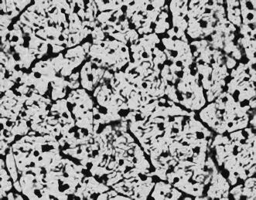
RESULTS AND DISCUSSION (CONT..)
The optical micrographs of AISI 304 obtained after electrolytic etching in 10wt% oxalic acid, are shown below in the figures:
The microstructure of T600 sample shows minimum signs of carbide precipitation, while T675 sample shows some signs of carbide precipitation on grain boundaries
Oxalic acid etch test results
(a)
(b)
Micrograph of AISI 304 sample tempered at (a) 600ºC at 400x (b) tempered at 675ºC at 400x, followed by air cooling

Slide 29
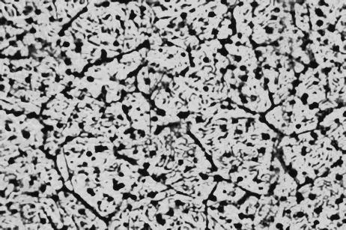
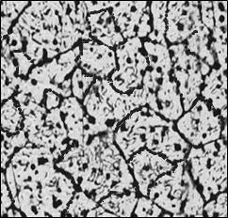
RESULTS AND DISCUSSION (CONT..)
Oxalic acid etch test results
The optical micrographs of AISI 304 obtained after electrolytic etching in 10wt% oxalic acid, are shown below in the figures:
The microstructure of T 750 is characterized as dual structure while that of T 800 is a ditch structure where one or more grains are completely surrounded by Cr₂₃C₆ .
(a)
(b)
Micrograph of AISI 304 sample tempered at (a) 750ºC at 400x
(b) 800ºC at 400x, followed by air cooling

Slide 30
RESULTS AND DISCUSSION (CONT..)
Oxalic acid etch test result’s Discussion
In all the above micrographs, there are several black spots present on the sample. These black spots are pits on the sample. We use KSCN as an activator. It is used for breaking of passivation and to corrode the sample. Drawback of using KSCN is that it introduces pitting corrosion in the sample. After oxalic etching, these pits are clearly visible
It is evident from above micrographs that the carbide precipitation along grain boundary increases as step, dual and ditch structures with increasing the tempering temperature. Similar features are noticeable by the results of DLEPR test.

Slide 31
CONCLUSION

Slide 32
CONCLUSION
Based on the results obtained and the observations made during the course of this work, the following conclusions are to be made:
The DLEPR test results show that the degree of sensitization increases with increase in tempering temperature. The duration of 40minutes treatment is also sufficient for carbide precipitation to occur at some temperatures.
The microstructures obtained through oxalic etch test showed the occurrence of carbide precipitation, with the increase in tempering temperatures. Pitting corrosion was also observed because of KSCN that acts as an activator in the test solution.

Slide 33
REFERENCES
[1] N. Parvathavarthini: Corrosion of Austenitic Stainless Steels: Mechanism, Mitigation and Monitoring, ed. by H. S. Khatak and Baldev Raj, Woodhead Publishing House, Cambridge, England, (2002), 287.
[2] Aydogdu, G.H., 2004. Determination of Susceptibility to Intergranular Corrosion in AISI 304l and 316l Type Stainless Steels, Journal of Corrosion science 48 (2006) 3565–3583.
[3] ASTM G108: Standard Test Method for Electrochemical Reactivation (EPR) for Detecting Sensitization of AISI Type 304 and 304L Stainless Steels.
[4] Michael F. Mc Guire, Stainless steel for design engineers, American Society for Metals, Metals Park, OH,2008.p.76-77.
[5] Schluter, J.M., Chivinsky, J.A., 1985. ASTM A 262, in: Laboratory Corrosion Tests and Standards: A Symposium by ASTM Committee G-1 on Corrosion of Metals, Babel Harbor, FL 14-16 Nov. 1993. p. 455.
[6] Leiva-García, R., Muñoz-Portero, M.J., García-Antón, J., 2011. In-Situ Study of Single and Double Loop Reactivation Methods during the Characterization of the Degree of Sensitization of a Duplex Stainless Steel (UNS 1.4462) Using a Minicell and a Confocal Microscope. Int. J. Electrochem. Sci 6, 830–846.
[7] Afolabi, A.S., Potgieter, J.H., Abdulkareem, A.S., Fungura, N., 2011. Effect of tempering temperature and time on the corrosion behavior of 304 and 316 austenitic stainless steels in oxalic acid. International Science Index Vol:5, No:7, 2011 waset.org/Publication/518

Slide 35
Questions may now be asked

