Slide 1
Evaluation of maintenance management practices in automotive industries of Pakistan Javeria Younus¹, Dr. Muhammad Fahad¹ and Dr. Maqsood A.Khan¹ Department of Industrial & Manufacturing Engineering, NED University of Engineering & Technology, Karachi, Pakistan

Slide 2
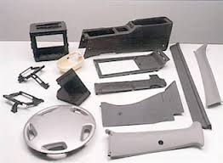
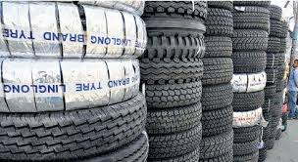
automotive industry-greatest engine of industrial & economic Growth
State and local government revenues
Foreign direct investment
Improves trade
Research , development and innovation
Quality of life
OICA

Slide 3
automotive industry-greatest Engine of industrial & economic Growth
Links with other sectors
Oil and gas sector
Raw materials
Manufacturers of small parts
Repair industry
Insurance industry
OICA

Slide 4
automotive industry-greatest Engine of industrial & economic Growth
Jobs,Jobs,Jobs
About 9 million people are directly linked with auto industry.
5% the world’s total manufacturing employment.
Each direct auto job supports at least another 5 indirect jobs in the community.
More than 50 million jobs owed to the auto industry.
International organization of Motor Vehicle Manufacturers (OICA)
OICA

Slide 5
automotive industry of pakistan
“Automotive industry steers the growth in large scale manufacturing sector of Pakistan.”
Auto Industry Development Program (AIDP)
Contributes about 4.6% to the overall Gross Domestic Product (GDP)
State Bank of Pakistan Annual Report 2013-14
EMPLOYMENT
Direct | 400,000 skilled workers
Indirect | 2 million
Total | 2.4 million

Slide 6
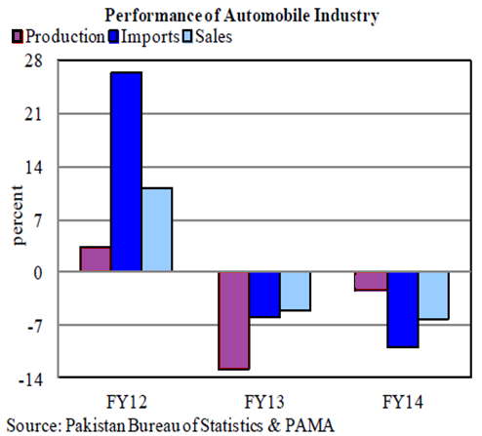
automotive industry of Pakistan
Performance of automotive industry of Pakistan

Slide 7
Maintenance
“The combination of all technical, administrative and managerial actions during the life cycle of an item intended to retain it in, or restore it to, a state in which it can perform the required function”
(BS EN 13306)
Manufacturing & maintenance are two key functions of a manufacturing firm, which if working effectively complement each other to get the desired output.
(Robson et al., 2013)
Primary production input
Primary production output
Production
Potential production capacity
Maintenance
Demand
Maintenance
Production & maintenance, (Gits,1992)

Slide 8
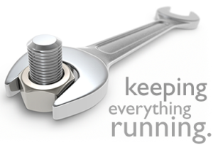
Maintenance Management
Management of all the asset owned by a company based on maximizing the return of investment in the assets.
(Wireman 1998 )
It has been found that maintenance represents from 15 to 40% of the total product cost.
Improving maintenance &
decreasing unnecessary
maintenance expenditures
by $1 million is considerably easier and more likely to occur than obtaining $3 million in new sales.!! (Wireman 1998)

Slide 9
Methodology
Selection of maintenance blocks for evaluation
Data analysis
Evaluation of results
Selection of industries
Data collection
Use of questionnaire
Cars and LCVs
Two & three wheeler
Tractors, trucks & buses
Vendor industry
Accessories & part manufacturers
Questionnaire filled by different concerned personnel belonging to same firm.

Slide 10
Blocks of Maintenance Management
Preventive maintenance
Computerized maintenance management system usage
Reliability centered maintenance
Total productive maintenance
Asset care & Continuous improvement
Asset life cycle analysis & replacement optimization
Inventory & Purchasing
Maintenance
work order
Optimization of the preventive maintenance policy

Slide 11
Selected Industries
 | Industry 1 | Industry 2 | Industry 3 | Industry 4 | Industry 5
Origin | Multinational company | Multinational company | Multinational company | Local company | Local company
Nature of company | Original equipment manufacturer | Original equipment manufacturer | Original equipment manufacturer | Original equipment manufacturer | Vendor
Years in service | 26 | 22 | 28 | 13 | 36
Installed Capacity (Nos. per annum) | 54,000 | 150,000 | 750,000 | 55,000 | 1,000,000
Turnover (Rs. In million/year) | 57,000 | 51,000 | 44,000 | 1000 | -
Products | Car, LCVs | Car, LCV, two wheelers, part manufacturer & suppliers | Two wheelers, part manufacturer & suppliers | Trucks, buses, LCVs | Part manufacturer & suppliers

Slide 12
Preventive Maintenance
Use/time-based maintenance activities that are executed according to a plan.
Key to improve the maintenance process.
Estimated savings to be as high as 1.2% of the total plant output.
On an average over all performance below WCB standards.
Industry 1,2 & 3 have showed performance better than WCB standards.
Industry 4 & 5 (Local industries) have scored low.

Slide 13
Preventive Maintenance
Use/time-based maintenance activities that are executed according to a plan.
Use of historic data
Mean time between failures
Date of last repairs
Causes of failure etc.
PM would only become a guess work
80% Preventive & 20% corrective
Organizations which include a higher percentage of their equipment to be covered by preventive maintenance program perform better.

Slide 14
Maintenance Work Orders
Provides necessary information for planning, monitoring and reporting maintenance work.
Tool to measure and control the maintenance function.
On an average over all performance below WCB standards.
Industry 1 & 3 have showed performance better than WCB standards.
Industry 4 & 5 (Local industries) have scored low.

Slide 15
Maintenance Work Orders
Provides necessary information for planning, monitoring and reporting maintenance work.
Tool to measure and control the maintenance function.
Categories
Required downtime.
Required craft hours.
Required materials.
Requestor’s name
Majority of the firms track only 25% or even less of the categories for the future use through work orders.
Historic Data
Forecasting failure
Optimizing maintenance strategy
Resource allocation
Making maintenance function cost effective and more efficient.

Slide 16
Maintenance Inventory & Purchasing
Provide spare parts where and when required.
Maintenance materials can range between 40% and 60% of the maintenance budget.
On an average over all performance below WCB standards.
Only Industry 2 has performance better than WCB standards.
Industry 1,3,4 & 5 have scored low.

Slide 17
Maintenance Inventory & Purchasing
Provide spare parts where and when required.
Updated inventory level
Correct reorder quantities
Prevents unnecessary high or low inventory
Reduced inventory cost
Responsive
Only Industry 2 has an inventory system that is efficient enough to provide spare parts when required
Industry 5 is not able to get the required spare part for even 50% of the times
On time availability of material
Responsive
Increase productivity
More reliable equipment
Customer satisfaction

Slide 18
Asset Care Continuous Improvement
Constantly looking for the little things that can make an organization more competitive.
Tremendously increase asset productivity
On an average over all performance below WCB standards.
Industry 1 & 2 have showed performance better than WCB standards.
Industry 3,4 & 5 have scored low.

Slide 19
Asset Care Continuous Improvement
Constantly looking for the little things that can make an organization more competitive.
Tremendously increase asset productivity
Strong
Role of management
Encourage
Performance audits
Feedback

Slide 20
Asset Care Continuous Improvement
Constantly looking for the little things that can make an organization more competitive.
Tremendously increase asset productivity
Utilization of emerging techniques and technologies such as Total Productive Maintenance (TPM) and Reliability Centered Maintenance (RCM) can have higher impact on the maintenance practices.
None of the evaluated organizations have positive attitude towards emerging techniques.!!!!
Are continuous improvement efforts tied to reliability engineering?

Slide 21
Conclusion
Companies that showed better maintenance practices
Multinational companies.
Sound infrastructure designed in conjunction with the international guidelines.
Preventive maintenance program in accordance with WCB standards.
Management and use of historic data.
Management support towards continuously evaluating and improving current scenario.
OICA

Slide 22
Conclusion
Some companies scored consistently low in the evaluated sections
Local companies.
Poor preventive maintenance program.
Companies reluctant of maintaining and using historical data.
Do not show positive attitude towards continuous improvement program.
OICA

