Slide 2
EROGONOMIC ANALYSIS OF A HUMAN BODY IN A RESTRICTED SPACE ENVIRONMENT
Dr Nadeem Shafi Khan
Engr Faria Mazhar
CAE,National University Of Sciences And Technology,
Pakistan.
Nadeem@gatech.edu
Fariamazhar3@gmail.com

Slide 3
Sequence
Literature review
RULA analysis
Methodology of the ergonomic analysis
Full and free movement of GTA
Results
Conclusion
References

Slide 4
Ergonomics
The word “ergonomics” comes from two Greek words “ergono” meaning “work” and “nomos” meaning” laws.
It is the scientific discipline concerned with the understanding of interactions among humans and other elements of a system.
Notes:
not forcing the worker to fit the job or the workplace
Nowadays ergonomics is taken as the science of “designing the job to fit in the worker”.
and the profession that applies theory, principles, data and methods to design in order to optimize human well-being and overall system performance.

Slide 5
Ergonomic Analysis
The definition of ergonomics is extended today to all human activities in which artifacts are implemented.
Ergonomists are in a constant search for comprehensive approaches in which physical, cognitive and social aspects of human activities can be considered.
Notes:
Ergonomic analysis is a multidisciplinary field which incorporates contributions from psychology, engineering, physiology and anthropometry.
Although ergonomists often work on different economic sectors or particular tasks, these application domains are constantly evolving, creating new ones and changing the perspective of the old ones
It basically means efficiency of people in their working environments

Slide 6
Tools For Ergonomic Analysis
Mantra, RULA, HAL-TLV, LUBA, OCRA, SNOOK tables and the NIOSH lifting equations.
For this specific paper RULA analysis was chosen.
It comes in ergonomic analysis workbench in CATIA software under activity analysis.
Notes:
There are various tools and techniques which are used for the ergonomic assessment e.g.
which exists in CATIA software under the ergonomic analysis workbench. RULA analysis helps in determining the stressed position and gives ways to solve those problems

Slide 7
RULA Analysis
For ergonomic analysis there are two modules
Posture analysis
Activity analysis
RULA analysis
Lift lower analysis
Push pull analysis
Carry analysis
Biomechanics single action analysis
Notes:
As already told The main software used for this project is catia which has a separate module dedicated for the ergonomic analysis. It has basically two modules for this. posture and activity analysis. The posture analysis will take ur or specify ur current posture, calculates or edits the angular limitations for different degree of freedoms while activity analysis will take all these parameters as input and based on rula or any other analysis calculates whether the posture is safe or not. Activity analysis has further four types of analysis from which we took only the rula and biomechanical because they have the ability to monitor the whole activity while the other three only take initial and final postures as inputs. And we have to monitor the whole activity within a cockpit.

Slide 8
RULA Analysis
RULA stands for Rapid Upper Limb Assessment.
It examine all the risk factors like the number of movements, muscle work, working posture etc.
All these factors combine to provide a final score that ranges from 1 to 7.
Green (1&2)
Yellow (3&4)
Orange (5&6)
Red (7)
Notes:
When a posture is defined in rula it will cacculate a score which is shown by a coclor on the body and a overall score in the rula tab.the score ranges from 1 to 7 and each color defines a score.Green color describes an acceptable and safe posture with a score of 1 n 2 while yellow color says it is safe to a limit and needs further investigations. Orange coclor indcates that changes are required soon whereas red color says changes are required immediately and if a person stands longer in this posture it may cause serious injuries.

Slide 9
RULA Analysis
RULA analysis has two individual analysis
Arm and Wrist Analysis
Neck, Trunk and Leg analysis.
Arm and Wrist Analysis consists of eight steps which are
Locate Upper Arm position.
Locate Lower Arm position.
Locate Wrist position.
Calculate Wrist Twist.
Look up Posture Score.
Add Muscle use score.
Add Force/Load Score and
Find Row in Table.

Slide 10
RULA Analysis
Neck , Trunk and Leg Analysis consist of seven further steps which are
Locate Neck Position,
Locate Trunk Position,
Calculate Legs Score,
Look up Posture score in Table B,
Add Muscle Use Score,
Add Force/ Load Score and
Find Column in Table C

Slide 12
RULA Analysis
The development of RULA occurred in three phases.
The first was the development of the method for recording the working posture.
The second was the development of the scoring system.
The third was the development of the scale of action levels which provide a guide to the level of risk and need for action to conduct more detailed assessments

Slide 13
Methodology of the ergonomic analysis
Cockpit model of GTA
Full and free movement of the control stick
Side stick
Center stick
Intermittent posture
Repeated posture
Repeated posture
Intermittent posture
Notes:
Generalized trainer aircrfaft froom internet, two seater
Dummy bar at two postions, different location of the control stick
Cenetr and side
Full and free movement

Slide 14
Ergonomic evaluation of Centre stick position
2.Forward deflection
1.Right deflection
Neutral position
3.Left deflection
4. Back deflection

Slide 15
Contd..
Two postures
Repeated
More than 4 times per minute
Intermittent
Less than 4 times per minute

Slide 16
Assumed Values For Full And Free Movement Of GTA
Position of the control stick
Forward deflection | 2 in
Backward deflection | 3.5 in
Left side deflection | 3 in
Right side deflection | 3 in
Deflections

Slide 17
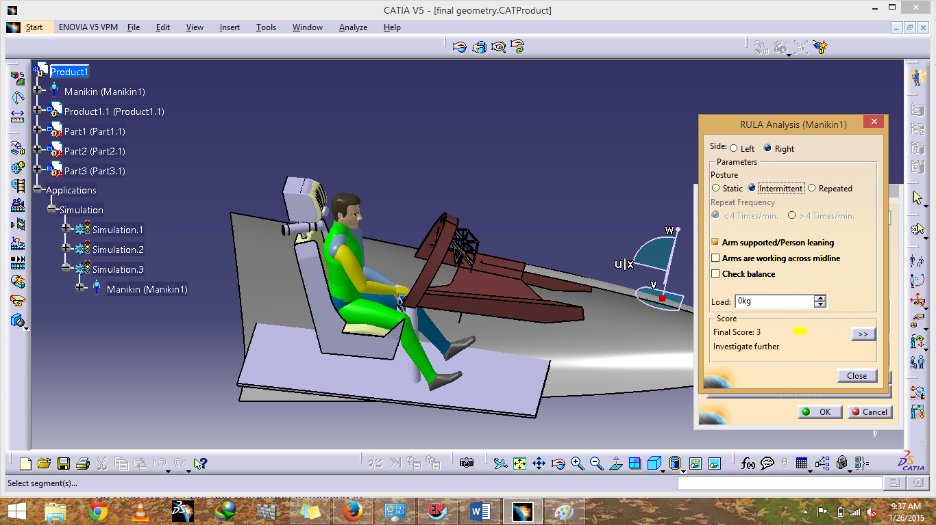
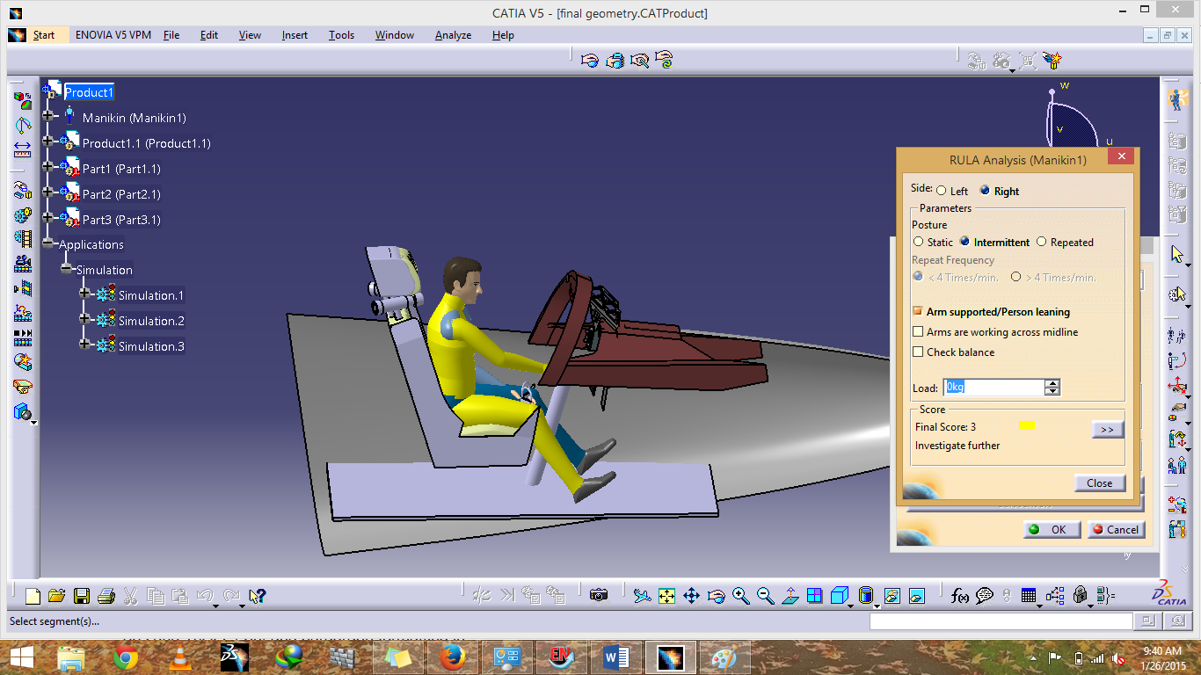
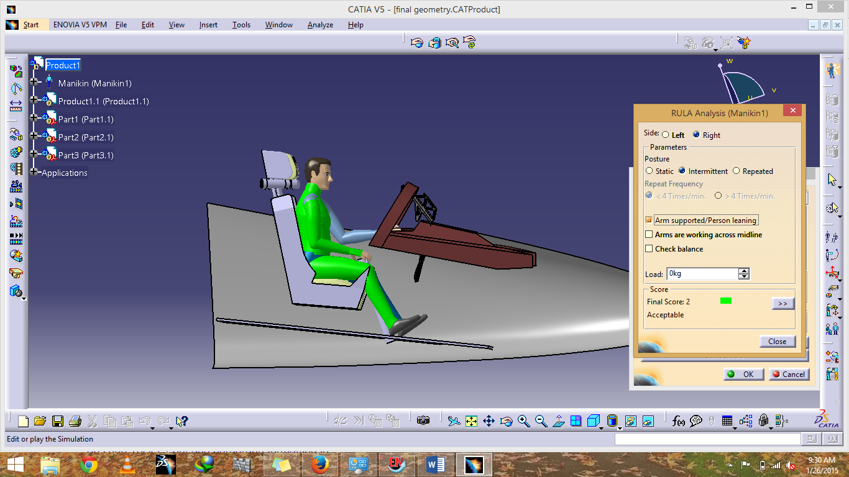
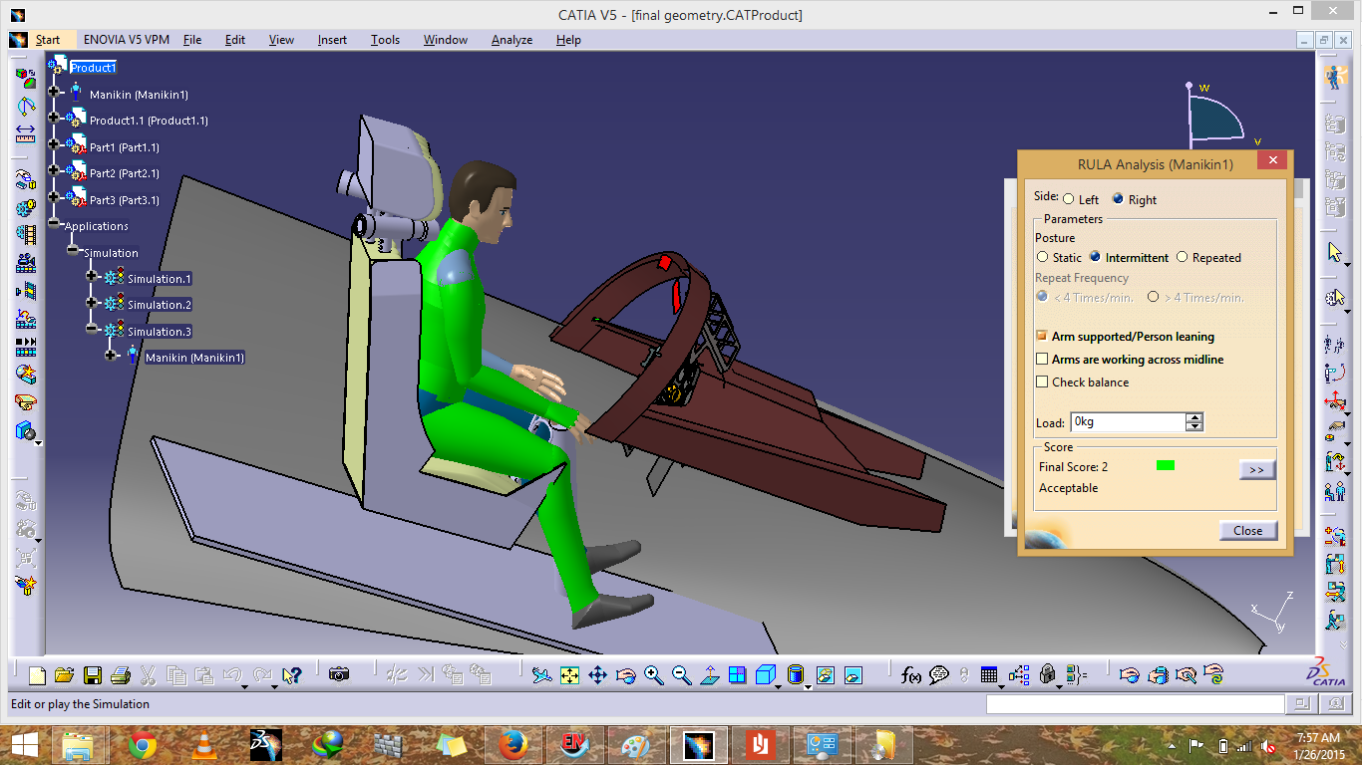
Full And Free Movement
Right side deflection
Forward Deflection
Back Deflection
Left Side Deflection
Neutral position
Position | RULA Score | Color
Neutral position | 2
Right deflection | 2
Forward deflection | 3
Left deflection | 3
Back deflection | 2
GTA
Center stick
Intermittent posture
Repeated posture
GTA
side stick
Intermittent posture
Repeated posture
Notes:
Got to mark the scores

Slide 18
Full And Free Movement
Position of the control stick | RULA score | Color
Neutral position | 3
Left deflection | 3
Forward deflection | 5
Right deflection | 3
Back deflection | 3
GTA
Center stick
Intermittent posture
Repeated posture
GTA
side stick
Intermittent posture
Repeated posture

Slide 19
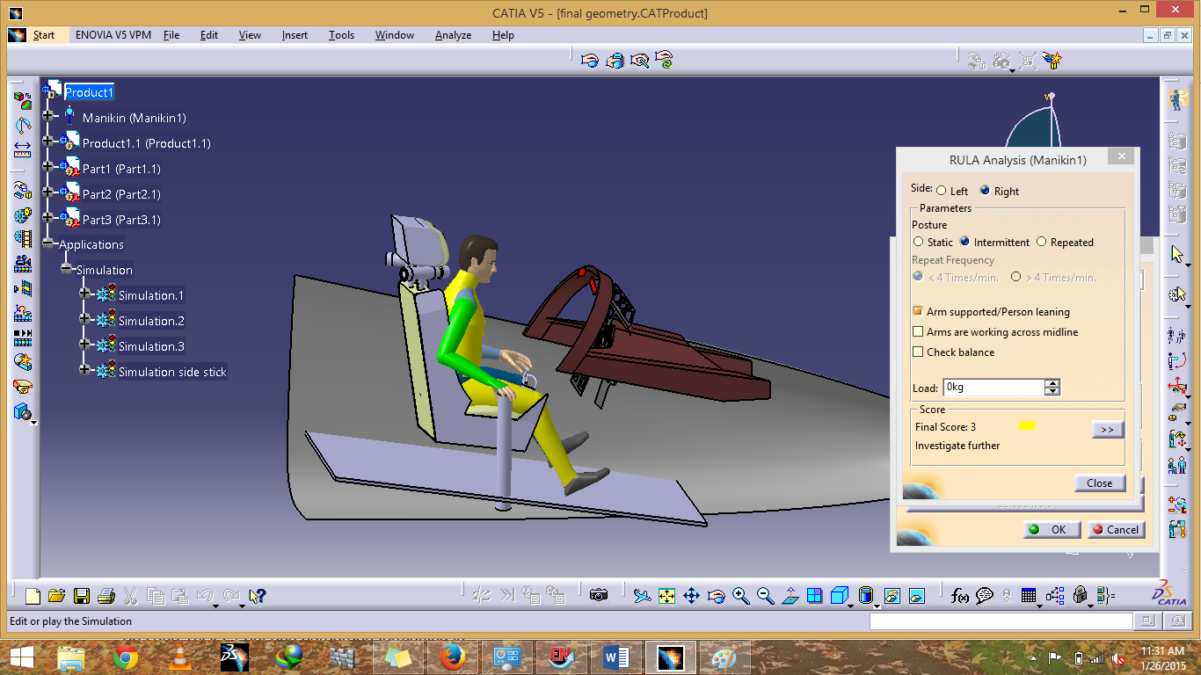
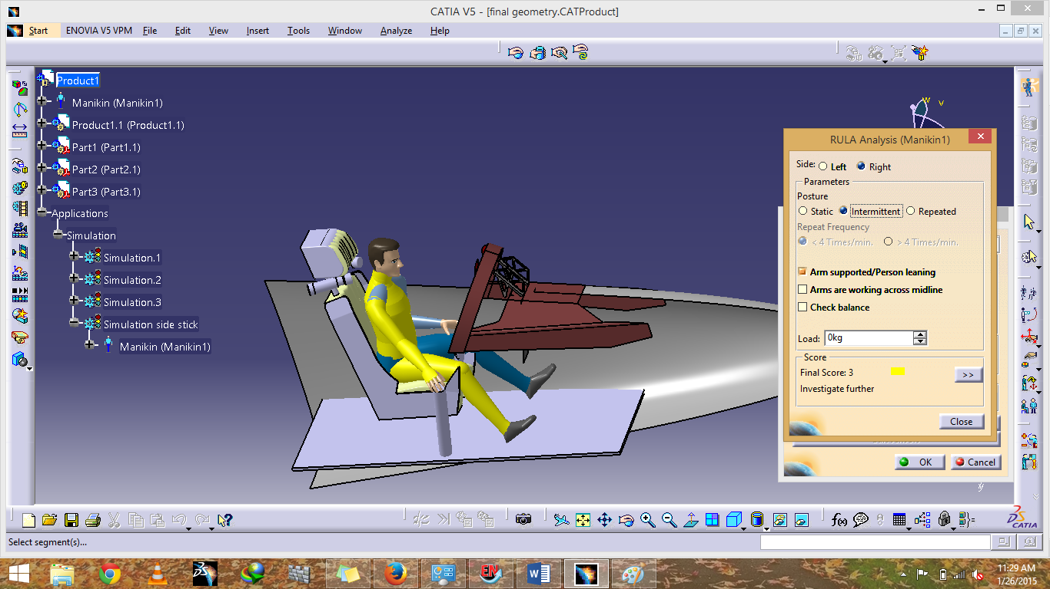
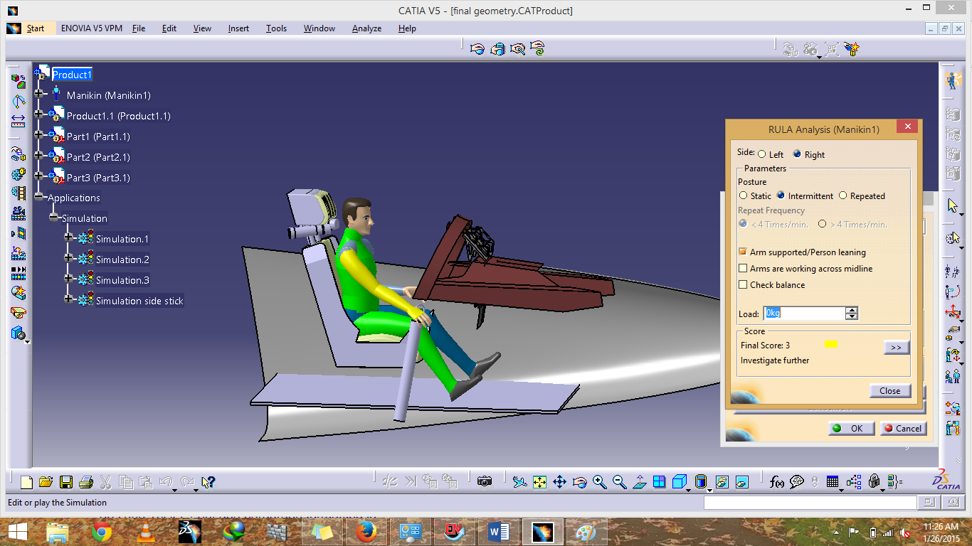
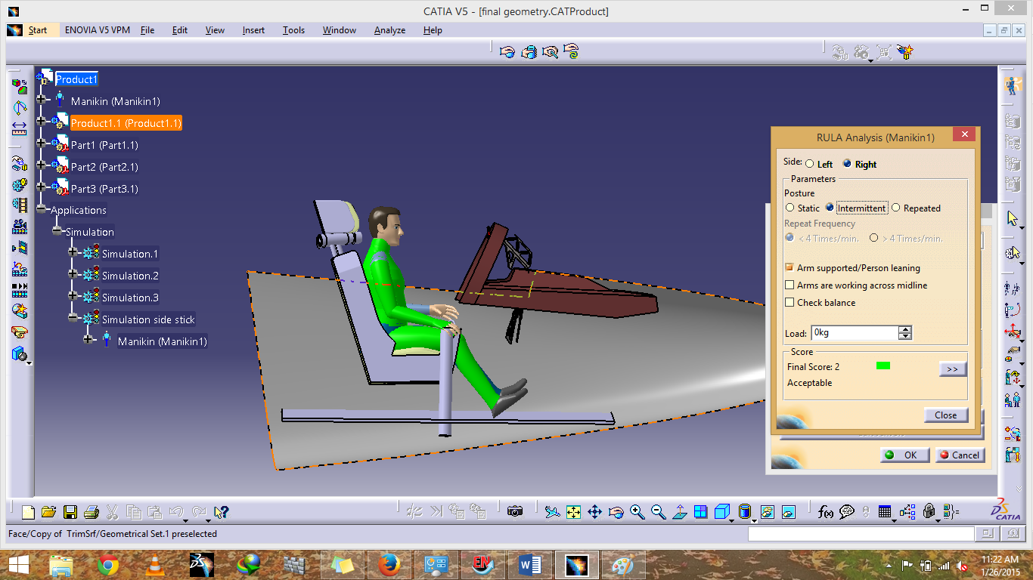
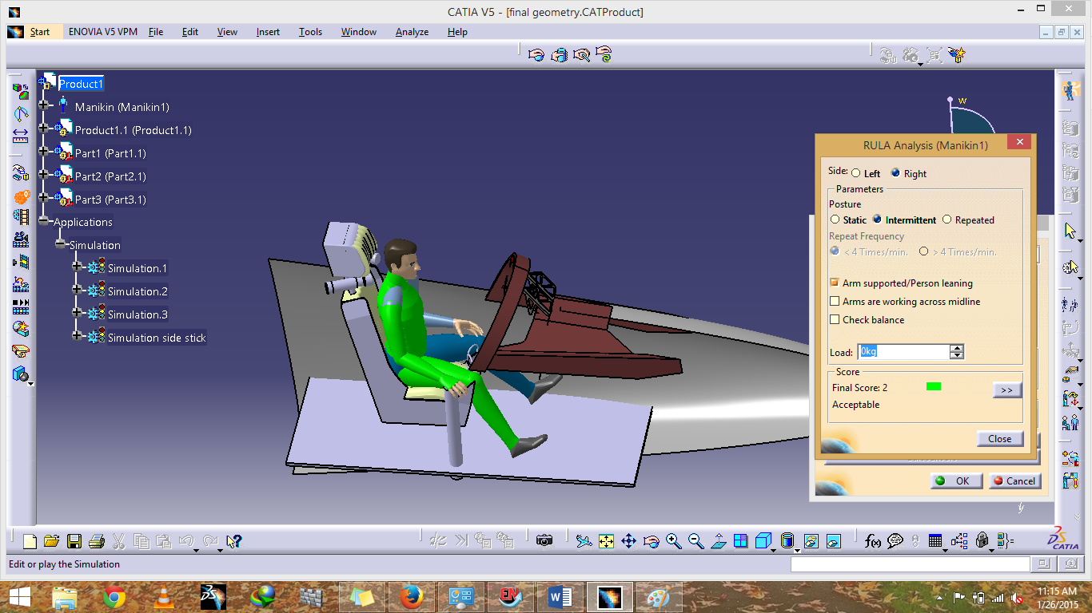
Full And Free Movement
Position of the control stick | RULA score | color
Neutral position | 2
Left deflection | 2
Forward deflection | 3
Right deflection | 3
Back deflection | 3
Left Side Deflection
Forward Deflection
Forward Deflection
Neutral Position
Right Side Deflection
GTA
Center stick
Intermittent posture
Repeated posture
GTA
side stick
Intermittent posture
Repeated posture

Slide 20
Full And Free Movement
Position of the control stick | RULA score | color
Neutral position | 3
Left deflection | 3
Forward deflection | 3
Right deflection | 5
Back deflection | 3
GTA
Center stick
Intermittent posture
Repeated posture
GTA
side stick
Intermittent posture
Repeated posture

Slide 21
Results And Conclusion

Slide 22
Comparison Of Full And Free Movement Of Control Stick For Intermittent Posture
 | Center stick
Position of control stick | RULA score | Color | RULA Score | Color
Neutral position | 2 |  | 2
Left deflection | 2 |  | 2
Forward deflection | 3 |  | 3
Right deflection | 3 |  | 3
Back deflection | 2 |  | 3
Side stick

Slide 23
Comparison Of Full And Free Movement Of Control Stick For Repeated Posture
 | Center stick
Position of control stick | RULA Score | Color | RULA score | Color
Neutral position | 3 |  | 3
Left deflection | 3 |  | 3
Forward deflection | 5 |  | 3
Right deflection | 3 |  | 5
Backward deflection | 3 |  | 3
Side stick

Slide 24
Comparison of results and Conclusion
Intermittent
center stick
3 green, 2 yellow
Side stick
2 green ,3 yellow
Repeated posture
Same RULA score with one orange and 4 yellow RULA scores.

Slide 25
References
Salvendy, G., Handbook of human factors and ergonomics. 2012. 16.
Sanders, M.S.M., Ernest J, Human factors in engineering and design.
Vignais, N.M., Markus Bleser, Gabriele Mura, Katharina Gorecky, Dominic Marin, Frédéric, Innovative system for real-time ergonomic feedback in industrial manufacturing. Applied ergonomics, 2103. 44(4): p. 566-574.
McAtamney, L.N.C., E, RULA: a survey method for the investigation of work-related upper limb disorders. Applied ergonomics, 1993. 24(2): p. 91-99.
Porter, J.C., Keith Freer, MT Bonney, Maurice C, Automotive Ergonomics. Chapter 3. Computer-Aided Ergonomics Design Of Automobiles. Publication of: Taylor And Francis Ltd, 1993.
McAtamney, L. and E. Nigel Corlett, RULA: a survey method for the investigation of work-related upper limb disorders. Applied Ergonomics, 1993. 24(2): p. 91-99.

Slide 26
References
Jung, E.S., D. Kee, and M.K. Chung, Upper body reach posture prediction for ergonomic evaluation models. International Journal of Industrial Ergonomics, 1995. 16(2): p. 95-107.
Jung, E.S. and D. Kee, A man-machine interface model with improved visibility and reach functions. Computers & industrial engineering, 1996. 30(3): p. 475-486.
Task, H.L., Night vision compatible illumination for vehicle crewmember workspace. 1986, Google Patents.
Cole, J.B., D.B. Grimes, and R.P. Rao. Learning full-body motions from monocular vision: Dynamic imitation in a humanoid robot. in Intelligent Robots and Systems, 2007. IROS 2007. IEEE/RSJ International Conference on. 2007. IEEE.

Slide 27
Thank You

Slide 28
QUESTIONS????

