Slide 2
AN APPLICATION OF SUBSTRUCTURING TECHNIQUE FOR A LARGE BODY DYNAMIC ANALYSIS
Dr. Nadeem Shafi khan
Engr. Huda zahid
CAE, National University Of Sciences And
Technology
hudaflash78@gmail.com
Nadeem@gatech.edu

Slide 3
SEQUENCE
Literature review
Technique review
Software programming
Model wing analysis
Results analysis and comparison
Fighter aircraft wing analysis
Results analysis and comparison
Conclusions
Questions

Slide 4
AIM
In the research carried out, the accuracy of the results was desired by the application of substructuring technique in comparison with FEM, and for this purpose a structural analysis on monocoque structure of the wing
of JF 17 aircraft was carried out, in ANSYS software.

Slide 5
PROJECT TIMELINE
Literature Review
PHASE 1
Understanding
of software

Slide 6
Understanding of technique
Modeling of sample wing
Comparison of results
Carrying out various analysis
PHASE 2
Results with FEM
Results with substructuring

Slide 7
Importing wing in ANSYS
Mode superposition transient dynamic analysis
Comparison of results
Phase 3
Results with FEM
Results with
substructuring

Slide 8
MOTIVATION
Analyses with large and complex parts are lengthy, require large computational power and are time consuming because of the involvement of
Large number of nodes
Many DOFs
Large matrices
Difficult to invert

Slide 9
SUBSTRUCTURING TECHNIQUE
Sub structuring is a technique that involves partitioning of the entire structure into several components.
Each component is a group of finite elements and represented as a matrix. This single-matrix component is called a superelement or a substructure.
A superelement simply represents a collection of elements that are reduced to act as one element.
Notes:
The super elements upon assembly, is considered as an individual element for computational purposes.

Slide 10
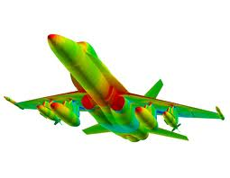
SCOPE
The employment of Sub structuring technique on a structural body would:
Allow for direct model updating.
For simplified analysis.
Reduce computational efforts and time consumption.
Partial redesign would only require partial reanalysis.
Notes:
problem associated with multiple analysis on different parts of the structure and simultaneous dealings with both linear and non linear parts in geometry. simplified and easy analysis

Slide 11
TECHNIQUE REVIEW
Large structures are divided into components.
Each component is analyzed separately.
The objective is to reduce the no. of elements and so the no of degree of freedom.
The matrix is reduced to create equivalent stiffness matrix
Small and easy to analyze
Contains all important information
Introduction to Super element, MDOF and interface nodes
Notes:
The approach is to derive the behavior of the entire assembly from its components.
The concepts introduced are
Master degree of freedom,,Interface nodes,,Substructure,,Main structure

Slide 12
BREAKDOWN OF THE STRUCTURE

Slide 13
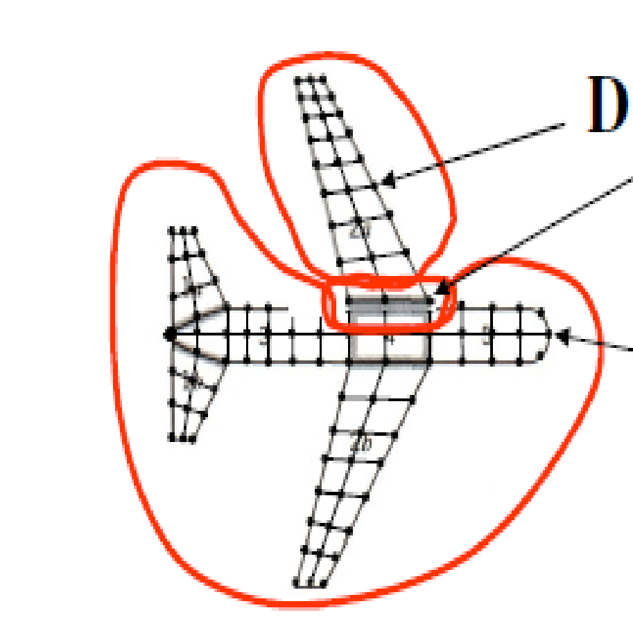
CONT..
SE
Notes:
mdof contains all possible dof of all the nodes of dt element

Slide 14
SUPERELEMENT
Notes:
. The MDOFs are the DOFs that the superelement uses to interface with, or connect to, the other bodies or joints.

Slide 16
APPROACHES FOR TECHNIQUE
Three types of sub-structuring approaches can be found in literature
Top down
Bottom up
Nested
This approach is suitable for substructuring models
that are small enough to fit on the computer
This approach is suitable for very large models which are divided into smaller super elements so that they can fit on the computer.
This technique usually deals with the models containing super-element with in the super-element.
Notes:
Slightly different approaches.. . For substructuring of smaller models or for isolated component analysis.

Slide 17
PROCEDURAL STEPS
Three discrete steps involved are
.
Super elements are generated during this step. It involves
the selection of MDOF and at the end of this step SE
matrix file is generated.
GENERATION PASS
The main structure is generated during this step and the
SE matrix file is read in. At the end of this step, solution for
main structure, which includes the solution for MDOF of
the SE, is obtained.
USE PASS
During this step complete solution for SE is obtained by expanding the MDOF solution available from the use pass.
EXPANSION PASS

Slide 18
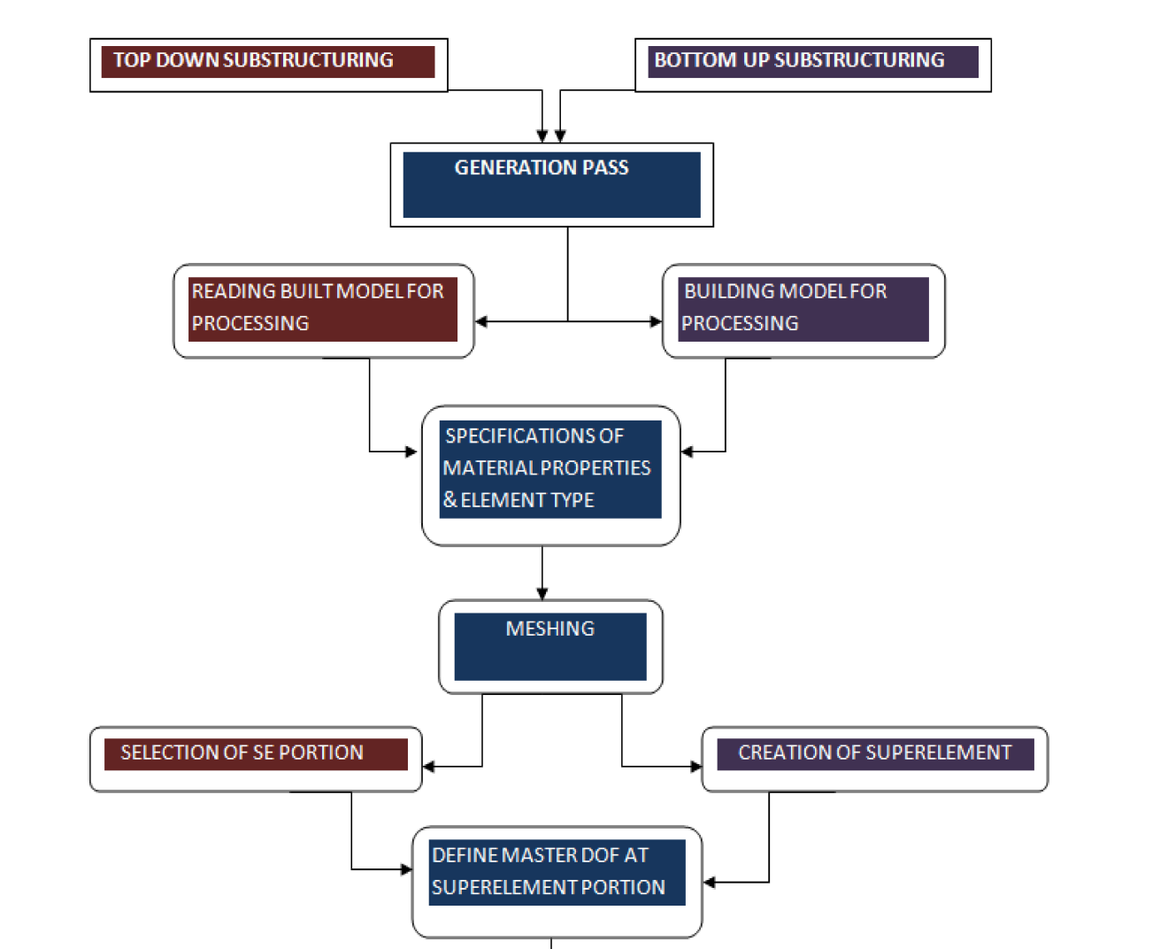
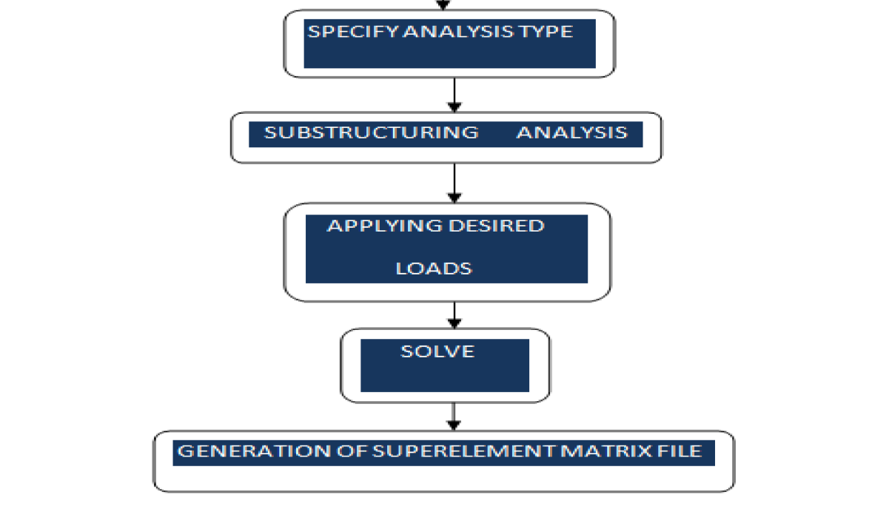

Slide 19
DIFFERENCE OF
TECHNIQUES

Slide 20
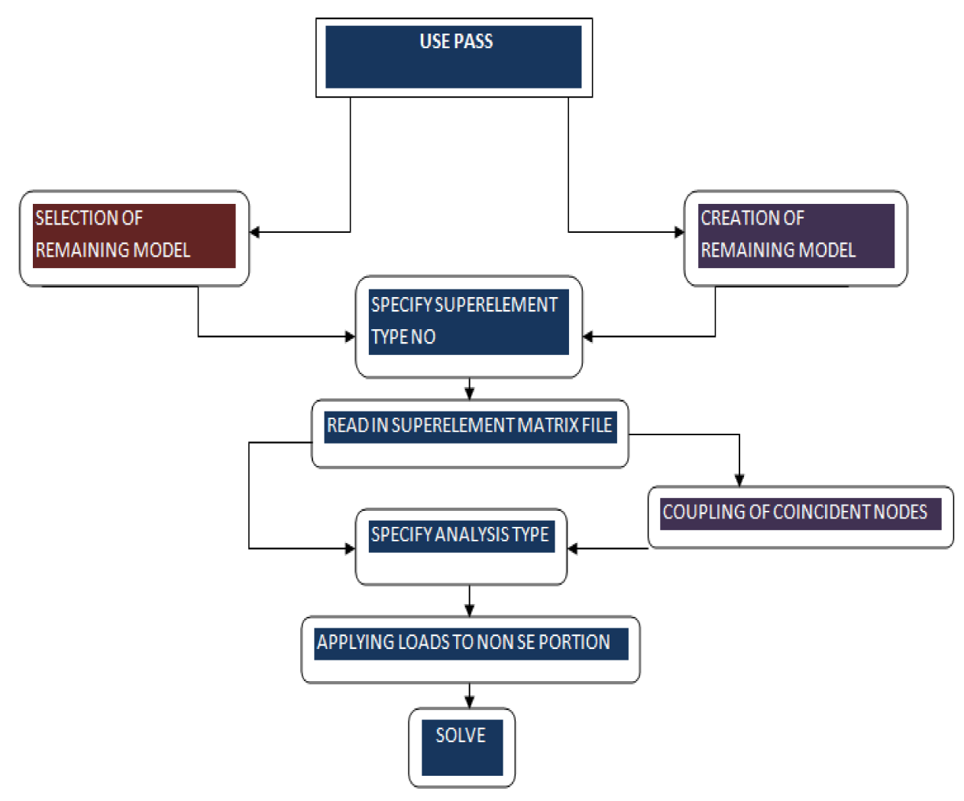

Slide 22
ANALYSIS APPROACH IN ANSYS
Two approaches to the software
Command method
GUI method
Easy and quick method
Complete understanding to the commands
Main menu available

Slide 23
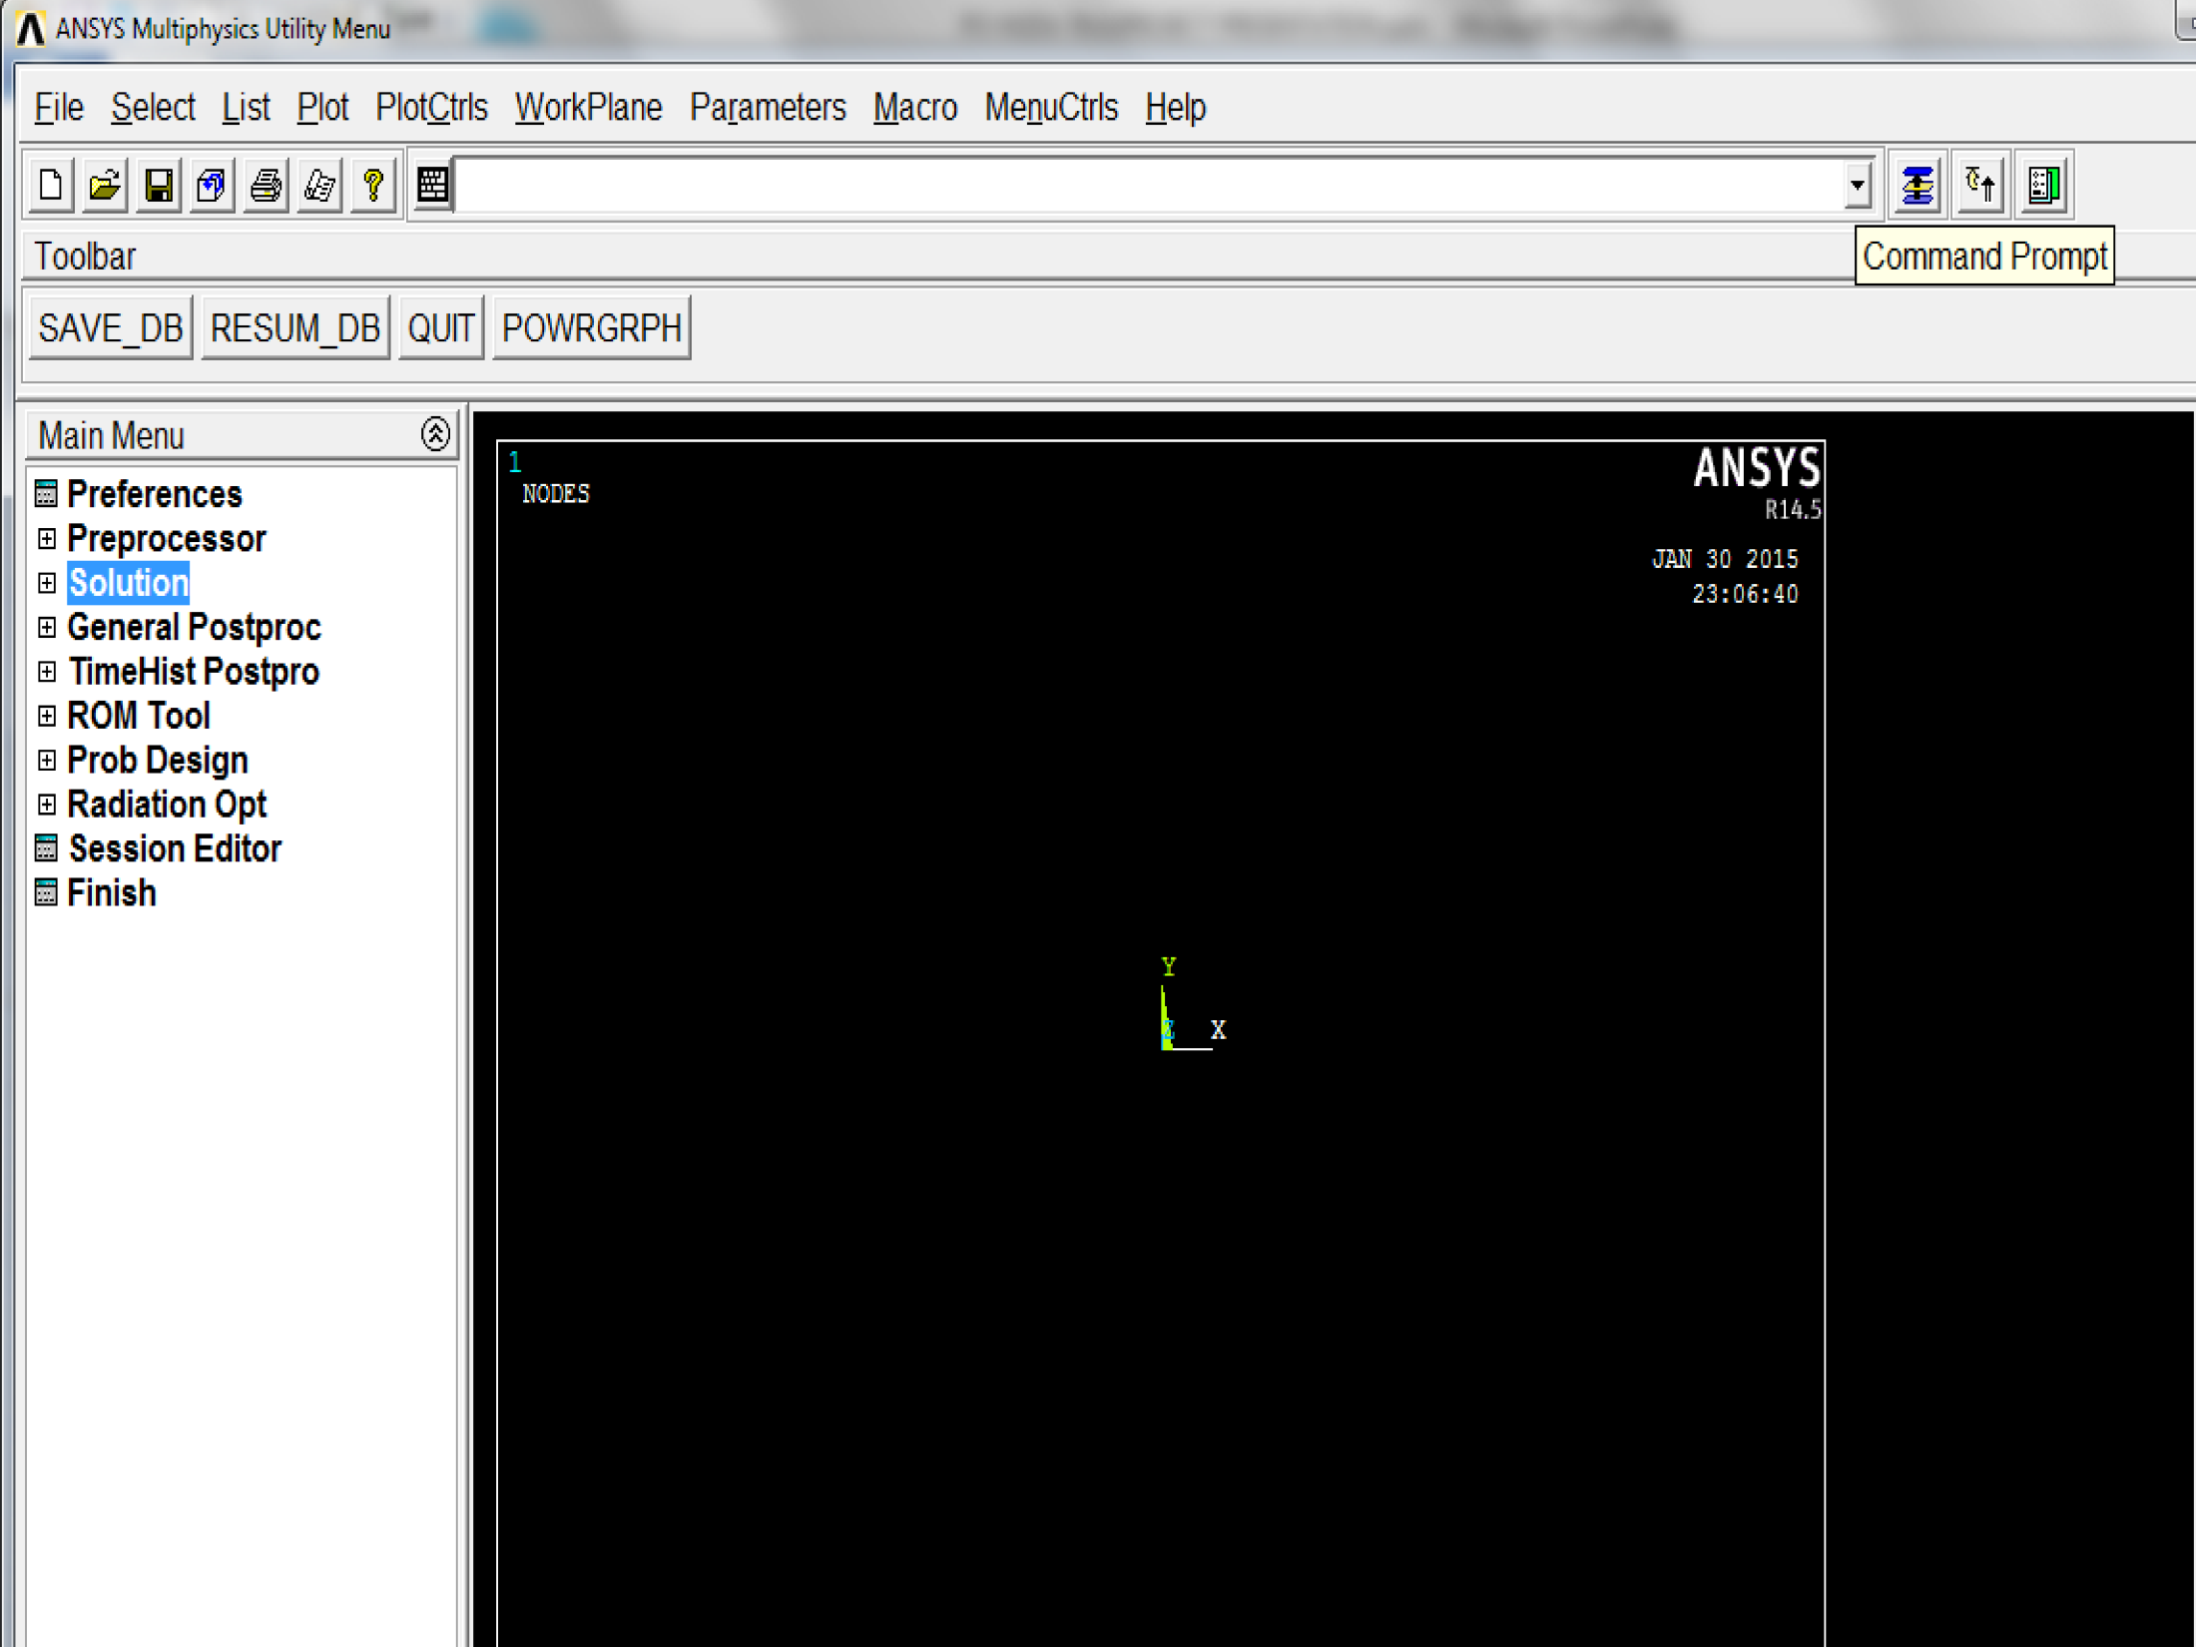

Slide 24
MODEL WING ANALYSIS

Slide 25
KEY POINTS

Slide 26
KEY POINTS

Slide 27
RESULTS COMPARISON
MODAL ANALYSIS
PARAMETER | WITHOUT SUBSTRUCTURING | WITH SUBSTRUCTURING
FREQUENCY OF 1st MODE | 3.6812 | 3.906
DEFLECTION IN Y DIRECTION | 25.9506mm | 27.681mm

Slide 28
MODE SUPERPOSITION
HARMONIC ANALYSIS

Slide 29
Modeling of the wing

Slide 33
WITH SUBSTRUCTURING
TECHNIQUE

Slide 34
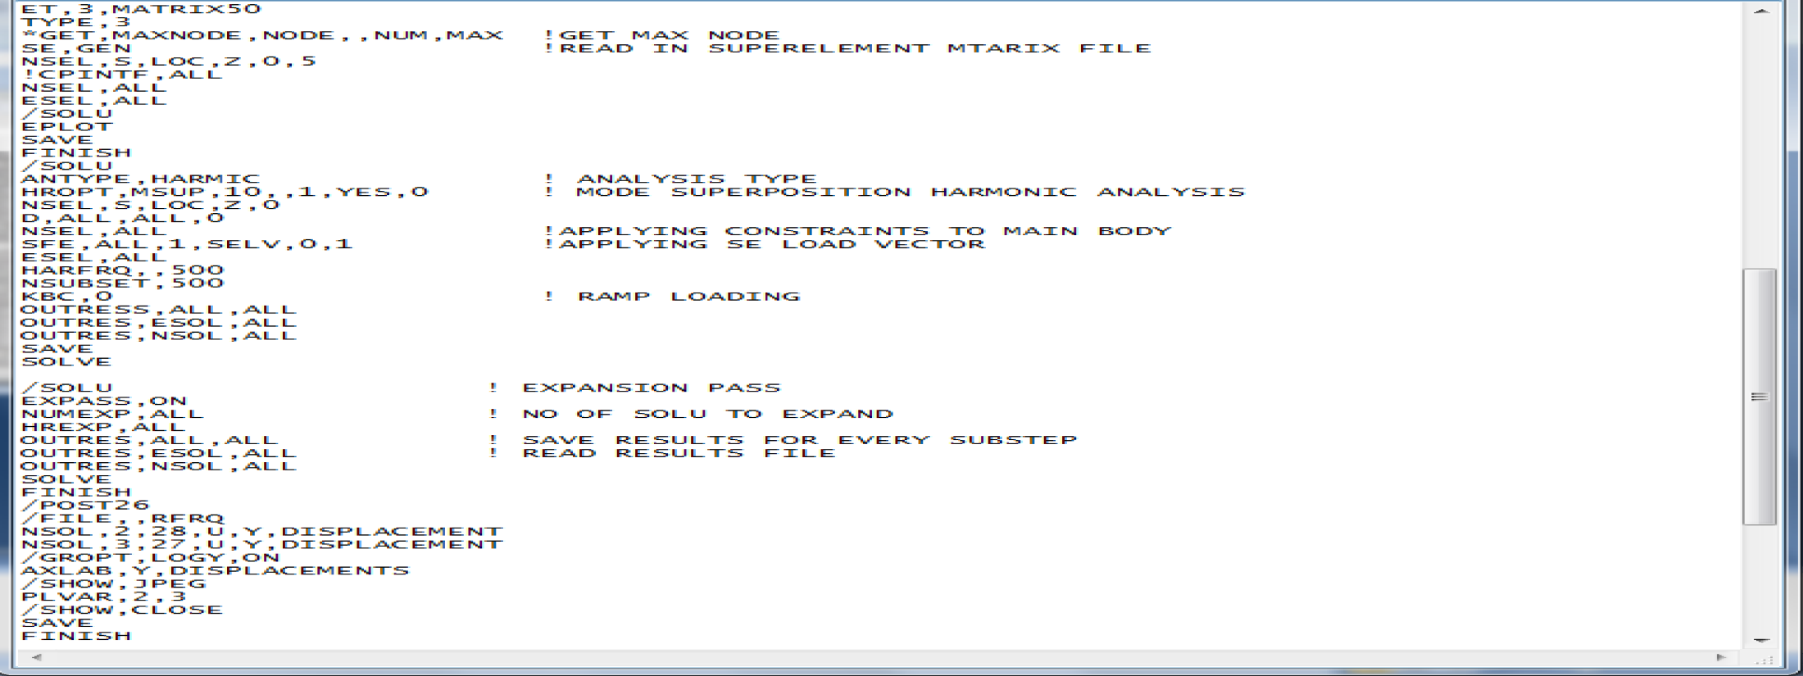

Slide 37
COMPARISON
PARAMETERS | FEM RESULTS | SUBSTRUCTURING RESULTS
FREQ | 500 Hz | 500 Hz
DEFLECTION | 2.8768mm | 2.84102mm
STRESSES | 29.1N/mm² | 29.1N/mm²

Slide 38
TRANSIENT DYNAIMIC ANALYSIS
Transient dynamic analysis is a technique used to determine the dynamic response of a structure as it respond to any time-dependent loads.
Two methods are available for a transient dynamic analysis in ANSYS program
Full transient method
Mode-superposition transient method
Notes:
(sometimes called time-history analysis) . determine the time-varying displacements, strains, stresses, and forces in a structure as it responds to any combination of static, transient, and harmonic loads.inertia or (M){u.. } + (C){ } + (K){u} = {F(t)}… The program uses the Newmark time integration method or an improved method called HHT to solve these equations at discrete time points. The time increment between successive time points is called the integration time step. The accuracy of the transient dynamic solution depends on the integration time step: the smaller the time step, the higher the accuracy. A time step that is too large introduces an error that affects the response of the higher modes (and hence the overall response). A time step that is too small wastes computer resources. e dynamic response of a structure can be thought of as a combination of modes. The full method uses the full system matrices to calculate the transient response (no matrix reduction). It is the more general method because it allows all types of nonlinearities to be included (plasticity, large deflections, large strain, and so on). The time scale of the loading is such that the damping effects are considered to be important.

Slide 39
MODE SUPERPOSITION METHOD
The mode-superposition method scales the mode shapes obtained from a modal analysis and sums them to calculate the dynamic response.
The procedure to use the method consists of five main steps
Build the model.
Obtain the modal solution.
Obtain the mode-superposition transient solution.
Expand the mode-superposition solution.
Review the results.
Notes:
Understand the dynamics of the problem. By doing a modal analysis, which calculates the natural frequencies and mode shapes, you can learn how the structure responds when those modes are excited. The natural frequencies are also useful for calculating the correct integration time step
so automatic time stepping is not allowed. It is faster and less expensive than the full method.
The time step is constant throughout the transient analysis.

Slide 40
Notes:
he other methods, unsymmetric and damped, do not apply to moDE SUPEREPOSITION.Jobname.RFRQ
To find many modes (about 40+) of large models. Recommended when the model consists of poorly shaped solid and shell elements.de-superposition.PCG LANCZOS DOES NOT SUPPORT SUPERELEMENT. SUPERNODE WHEN Use this method for 2-D plane or shell/beam structures (300 modes or more) and for 3-D solid structures.LIMITATION OF ansys.block lanzos The Block Lanczos method uses the sparse matrix solver. typically very robust

Slide 41
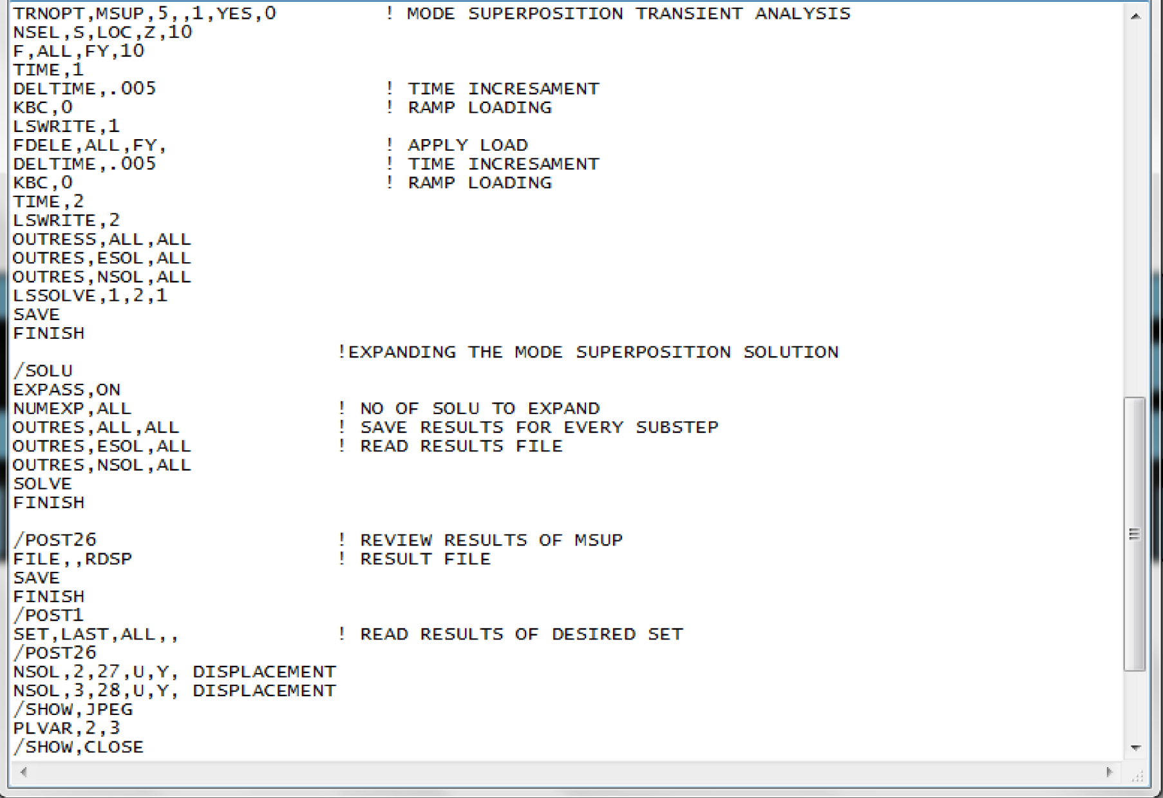
Notes:
FOR THE ANALYSIS both the approaches were made in use .for the command approach the commands were written on the note pads and then pasted in the command bar.

Slide 44
WITH SUBSTRUCTURING
TECHNIQUE

Slide 48
COMPARISON OF RESULTS
PARAMETERS | FEM RESULTS | SUBSTRUCTURING RESULTS
TIME STEP | .005 | .005
DEFLECTION | 165.301mm | 164.64mm

Slide 49
ACTUAL WING ANALYSIS

Slide 50
MDOF
MDOF
SE PORTION
MAIN BODY

Slide 51
MESH GRID INDEPENDENCE
7000 elements
9000 elements
11000 elements
13000 elements

Slide 52
MESH GRID INDEPENDENCE
STATIC LOADING CONDITION | 7000 ELEMENTS | 9000 ELEMENTS | 11000 ELEMENTS | 13000 ELEMENTS
DEFLECTION | .4623ft | .4619ft | .4617ft | .4617ft

Slide 56
WITH SUBSTRUCTURING
TECHNIQUE

Slide 57
MAIN BODY

Slide 61
COMPARISON OF RESULTS
PARAMETERS | WITH SUBSTTRUCTURING | WITH FEM METHOD
TIME STEP | .005 | .005
FREQUENCY | 9.4593Hz | 9.4593Hz
DEFLECTION | .132451ft | .132449ft

Slide 62
CONCLUSION
Efficiency and accuracy of the results were proved from the comparison.
Technique can be carried out for harmonic, transient, modal and static analysis.
Limitations to the software were encountered.
Substructuring could be more helpful in analyzing larger and complex structure dynamics.

Slide 63
REFERNCES
Research Paper
W Kuntjoroa*, A. A. (2012). Wing Structure Static Analysis using Superelement.
Seshu, P. (December 30,1996). Substructuring and CMS. Bombay 400 076, India: 1997 John Wiley & Sons, Inc.
R. Ohayona, C. S. (2014,). Clarification about Component Mode Synthesis Methods for Substructures with Physical Flexible. Paris, France.
Sections from the books
Section 64 from the book's, M. J. (1962). On the Origins of Iterative Substructuring.
Bouhaddi, N. a. (1992). Substructuring Using a Linearized Dynamic Condensation Method,". Vol. 45, pp. 679-683.
ADVANCED TOPICS from the book: The finite element method and application in engineering using ANSYS, Ibrahim, G* , pp. 636-650

Slide 64
PROJECT POSTER

Slide 66
THANK YOU

Slide 67
QUESTIONS ?

